Slide 1

Android-x86 Project
Oreo (8.x) Porting
https://drive.google.com/open?id=1K8mvtAB_bHp4FKVSPxy99-Tfn_nF7V4M6C7MHmIA8pY
黃志偉
cwhuang@android-x86.org
2017/12/16
http://www.android-x86.org

Slide 2

Agenda
Introduction: what, why, how?
History and milestones
8.x porting status
Porting procedure
8.0 HIDL HALs
Develop android-x86
android-x86.org

Slide 3
About Me
A free software and open source amateur and promoter from Taiwan
    CLDP / CLE
    GNU Gatekeeper
    Android-x86 Open Source Project
    OPENTHOS
https://zh.wikipedia.org/wiki/Cwhuang
android-x86.org

Slide 4
Introduction
What's Android-x86?
Why need Android-x86?
How can we do it?
Who use it?
android-x86.org
Notes:
今天來此，首先跟大家介紹我們的 Android-x86 計劃。

Slide 5
What's Android-x86 ?
An open source project aimed to provide an Android solution for x86 devices
Android BSP (Board support Package) for x86 platform
At first we use ASUS Eee PC and Virtualbox as the reference platform.
Some vendors donate tablets, like Tegatech Tegav2, 4tiitoo AG WeTab and AMD
android-x86.org

Slide 6
Why needs Android-x86?
Android is an open source operating-system originally designed for arm platform
It's open source, we can port it to other platforms, like mips, PowerPC and x86
AOSP officially supports x86 now
  AOSP doesn’t have specific hardware components
  Still a lot of work to do to make it run on a real device
android-x86.org

Slide 7
But what are the benefits?
Understanding Android porting process
The x86 platform is widely available
A test platform much faster than SDK emulator
  Android-x86 on vbox / vmware
  Suitable for tablet apps
android-x86.org

Slide 8
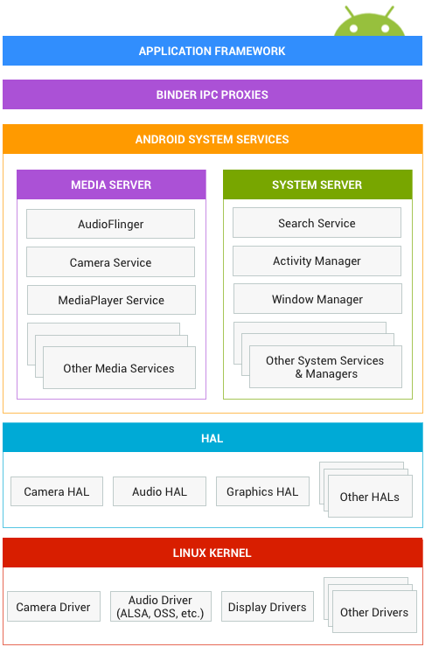
Android architecture
android-x86.org

Slide 9
How to do that?
Toolchains – already in AOSP
Kernel – vanilla almost works
https://wiki.linaro.org/LMG/Kernel/Upstreaming
  Use Google kernel/common tree as the base
  Patch kernel to support specific hardware we want
Libraries – bugfixes or improvements
  Runtime – bluetooth, vold, art, ...
HAL (hardware abstraction layer)
Framework
Apps
android-x86.org

Slide 10
Projects use Android-x86
OPENTHOS
1.0 – based on 5.1
2.0 – based on 8.0
CM-x86 / LineageOS-x86 / Blissroms-x86
Remix OS 2.0 / 3.0
2.0 – based on 5.1
3.0 – based on 6.0
Phoenix OS
1.5 – based on 5.1
2.5 – based on 7.1
Polaris OS
android-x86.org
Notes:
讓我們回顧一下這個計劃的歷使。計劃的起源，是由於 Google Android 在 x86 的平台無人維護，因此在 2009 四月間由我同事孫翋(Yi Sun)開始，收集相關 patch 放置在一集中處，並撰寫文件。
很快的我們發現必須建立自己的源碼樹(source tree)，才能夠做得更多。因此七月間我們成立了 android-x86.org，建立自己的 git server。
之後平均每個月我們都會釋出一個測試版。並在去年11月間釋出 1.6 穩定版。這是一個重要的里程埤。

Slide 11
History (2009)
Mar: Not maintained, need patches
Apr: Patch hosting for android x86 support by Yi Sun <beyounn at gmail.com>
May: Hard to maintain and sync with upstream
Jun: Need a common, complete code base
Jul: android-x86.org, release v0.9
Aug: Build 20090820
Sep: Build 20090916
Oct: Build 20091024
Nov: Android-x86 1.6 released
Dec: Eclair 2.0 porting
android-x86.org
Notes:
讓我們回顧一下這個計劃的歷使。計劃的起源，是由於 Google Android 在 x86 的平台無人維護，因此在 2009 四月間由我同事孫翋(Yi Sun)開始，收集相關 patch 放置在一集中處，並撰寫文件。
很快的我們發現必須建立自己的源碼樹(source tree)，才能夠做得更多。因此七月間我們成立了 android-x86.org，建立自己的 git server。
之後平均每個月我們都會釋出一個測試版。並在去年11月間釋出 1.6 穩定版。這是一個重要的里程埤。

Slide 12
History (2010)
Jan: Build 20100115 (Android 2.0)
Feb: Create eclair-x86 branch (Android 2.1)
Mar: Android-x86 1.6-r2 released
Apr: Eclair-x86 updated to 2.1-update1
Jul: Working on froyo-x86
Aug: A test iso for vm released
Sep: target eeepc, i915 HAL, 3G support
Oct: 3D hardware acceleration
Nov: Improved vold, target viewpad10
Dec: Installer read-write support, i965 support
android-x86.org
Notes:
今年起主要的工作在移植 Android 2.0 和 2.1，代號 eclair 的版本到 x86。目前 2.1 版的移植工作是在 eclair-x86 branch 上進行。不過三月間我們還釋出 1.6 的第二個穩定版，修正一些問題，並加入 3G 支援等功能強化。

Slide 13
History (2011)
Jan: Android-x86 2.2 released
Feb: Gingerbread-x86 branch (Android 2.3)
Mar: Honeycomb-x86 porting (private)
Jul: Android-x86 2.2-r2 released
Aug: Android-x86 2.3-RC1 released
Nov: Android-x86 3.2-RC2 released
Dec: ICS-x86 branch (Android 4.0)
android-x86.org

Slide 14
History (2012)
Jan: Build 20120101
Feb: Android-x86 4.0-RC1 released
Apr: Update ics-x86 to 4.0.4
Jul: Android-x86 4.0-RC2 released
Nov: Jb-x86 porting based on Android 4.2
Jul: Build 20121225 (Android 4.2)
android-x86.org

Slide 15
History (2013)
Feb: Build 20130228 (Android 4.2)
Jun: Android-x86 4.0-r1 released
Jul: Build 20130725 (Android 4.3)
Nov: Kitkat-x86 porting based on Android 4.4
android-x86.org

Slide 16
History (2014)
Feb: Android-x86 4.4-RC1 released
Apr: Add ntfs/exfat/ext4 support to vold
May: Android-x86 4.4-RC2 released
Aug: Android-x86 4.4-r1 released
Nov: Lollipop-x86 porting based on Android 5.0
Dec: Kernel 3.18 porting
android-x86.org

Slide 17
History (2015)
Jan: Android-x86 4.4-r2 released
Mar: Lollipop-x86 updated to Android 5.1
Apr: Kernel 4.0 porting
Oct: Android-x86 5.1-rc1 released
Oct: Marshmallow-x86 porting for Android 6.0
Oct: Move git server to SourceForge
Nov: Succeed to bring up Marshmallow-x86
android-x86.org

Slide 18
History (2016)
Jan: Android-x86 4.4-r4 released
Jan: Remix OS 2.0 Alpha based on lollipop-x86
Jan: Kernel 4.4 is ready to test
Feb: FossHub offers download page
Mar: Remix OS 2.0 Beta released
Apr: OSDN provides download page
Jun: Android-x86 6.0-rc1 released
Jul: Remix OS 3.0 based on Android-x86 6.0
Aug: Launch the Analytics program
Sep: Android-x86 6.0-r1 / cm-x86 13.0-rc1
Oct: Move git hosting to OSDN
android-x86.org

Slide 19
History (2017)
Jan: Android-x86 6.0-r2 / cm-x86-13.0-r1
Apr: Android-x86 6.0-r3 released
Jun: Android-x86 7.1-rc1 released
Sep: Oreo-x86 porting for Android 8.0
Oct: Android-x86 7.1-rc2 released
Nov: Cm-x86-14.1-rc1 released
Dec: Oreo-x86 upgraded to 8.1.0_r1
android-x86.org

Slide 20
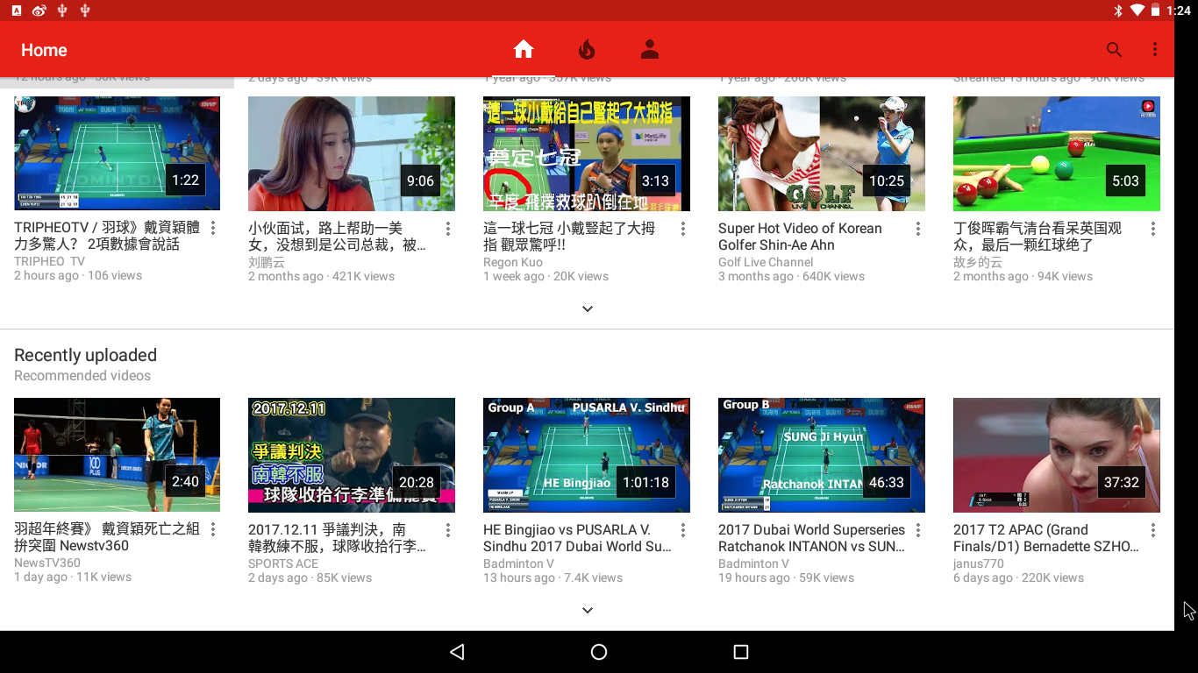
Android 8.0: most buggy release
Emulator can’t boothttps://issuetracker.google.com/issues/66066209
Mouse scrolling abruptly jump back
Full screen app is not full screen
android-x86.org

Slide 21
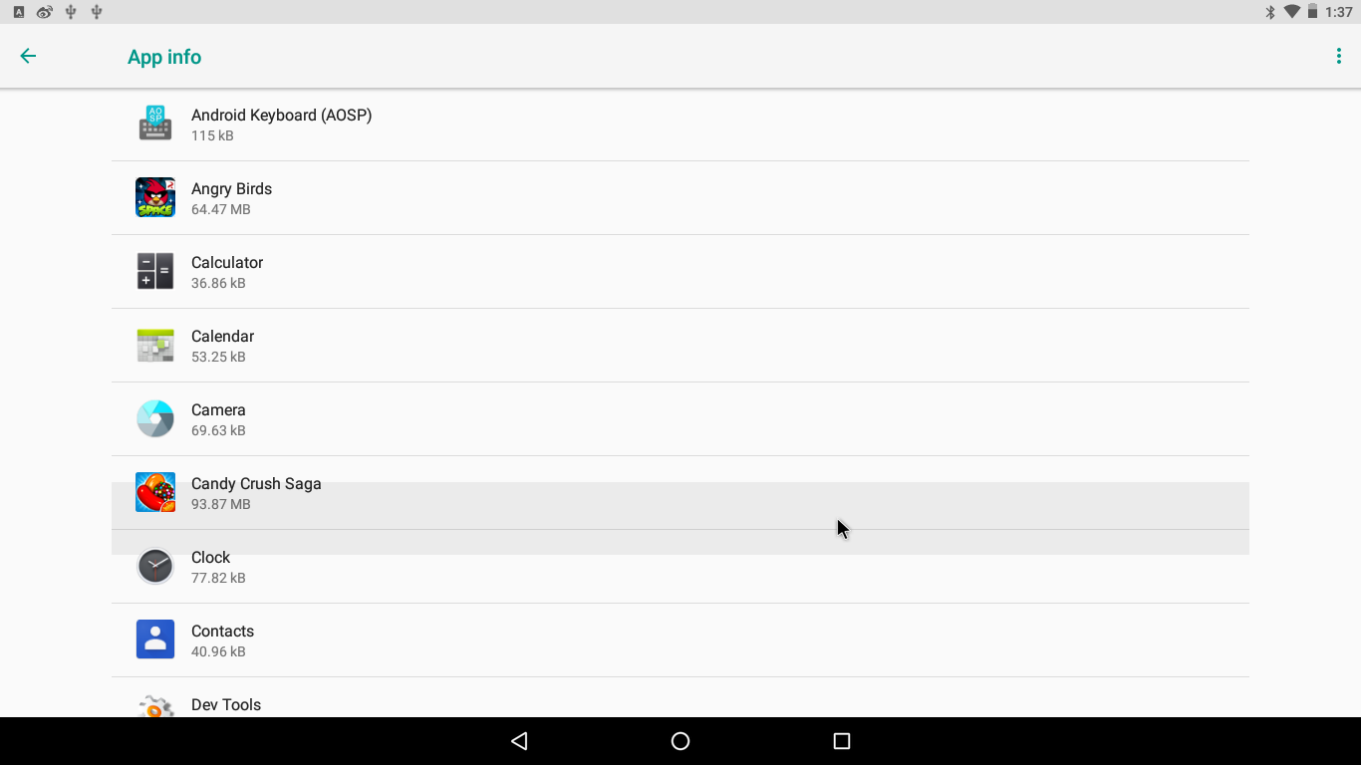

Android 8.0 bugs
Item selection by mouse mismatch
Gallery2 filter effect?
android-x86.org

Slide 22
Feature of oreo-x86
Android 8.0.0_r17 (Oreo) based
8.1.0_r1 is on going
Support both 32-bit and 64-bit systems in one generic image
LTS Kernel 4.9.x, KMS enabled
4.14 is on going
Live CD & disk installer, support ext4/ext3/ext2/ntfs/fat32
Provide hybrid iso image and EFI image
Hardware 3D acceleration (intel/amd/nvidia/vmware/qemu)
Hardware accelerated codec is not ready yet
Support Wifi, Ethernet, Bluetooth, Audio and Sensors
Auto-detect drivers
Touchscreen support
Compressed filesystem (squashfs)‏
Support virtual machine like Virtualbox, Qemu and Vmware
Debug mode and tool (vc switching, busybox, mksh, …)
android-x86.org

Slide 23
Porting status
 | Oreo-x86 | Nougat-x86 | Marshmallow-x86
Display | OK | OK | OK
3D HW Acceleration | OK | OK | OK
HW codec | X | OK | X
Wifi | OK | OK | OK
Touchscreen | OK | OK | OK
Audio | OK | OK | OK
Bluetooth | OK | OK | OK
Sensors | OK | OK | OK
Camera | X | OK | OK
Ethernet | OK | OK | OK
Backlight | OK | OK | OK
Suspend/Resume | OK | OK | OK
android-x86.org

Slide 24
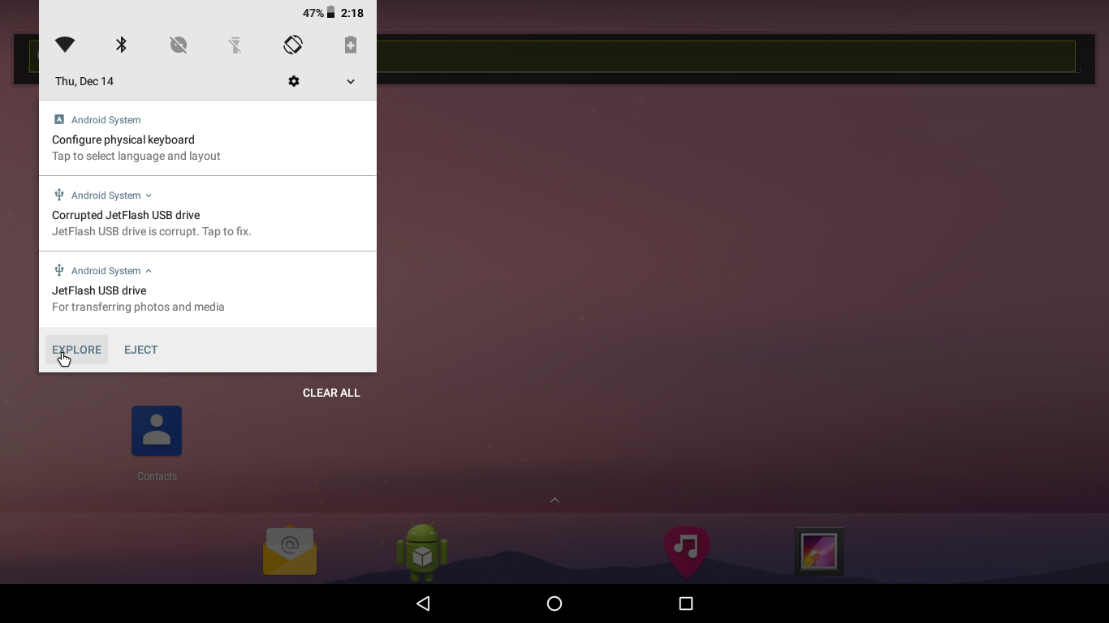
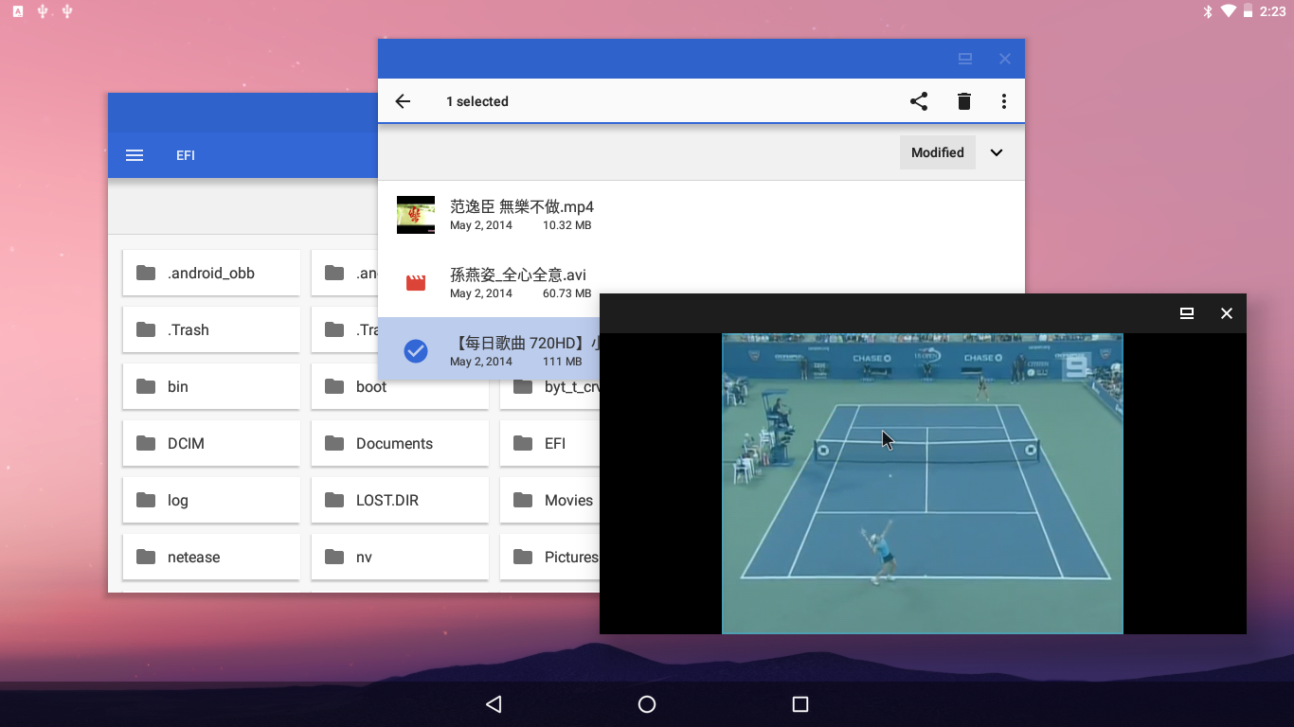
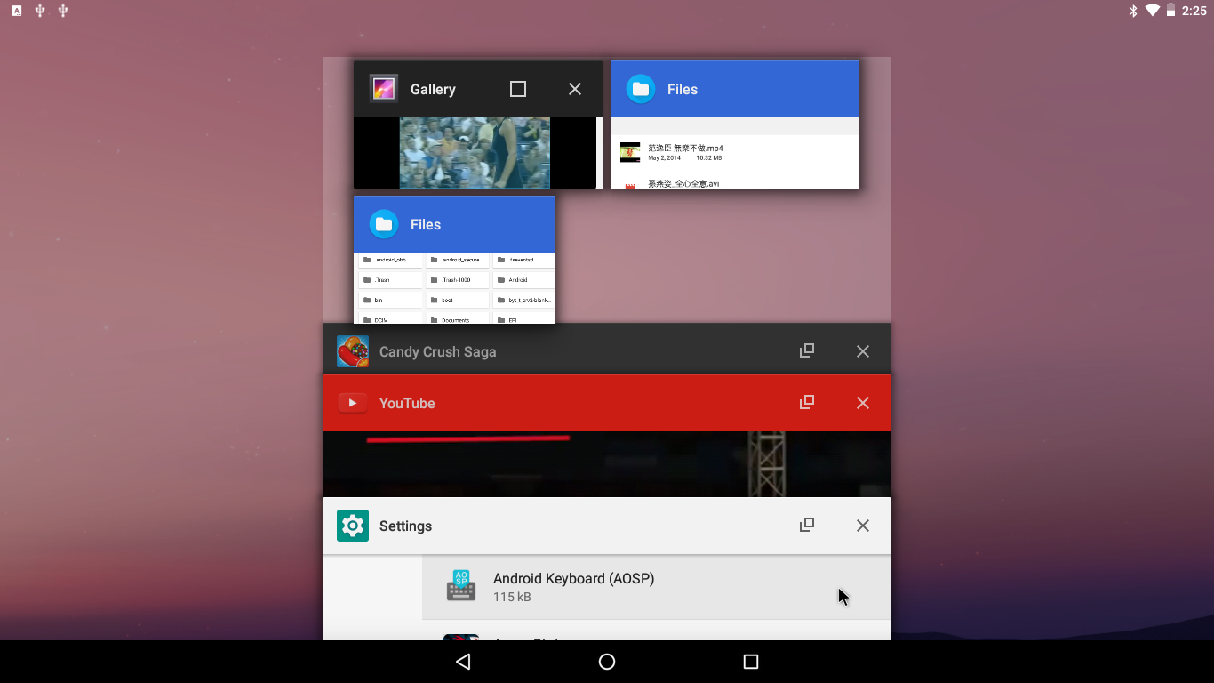
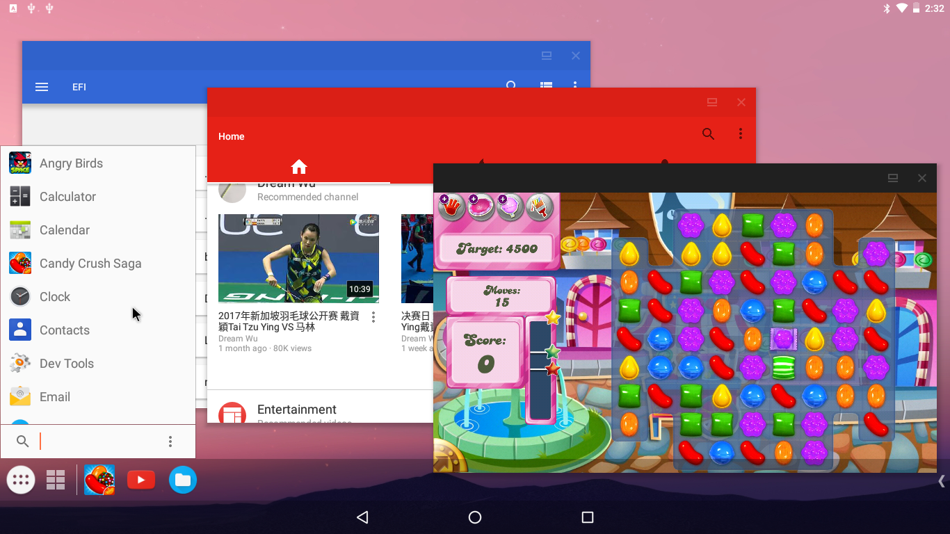
Screenshots
android-x86.org
Notes:
這是一些 Android-x86 的執行畫面。聽音樂、看照片、播影片、上網都沒問題。

Slide 25
Porting procedure (1/2)
Prepare the codebase by manifest.xml
  AOSP git projects
  Device configurations
    device/generic/{common,x86,x86_64}
  Modified AOSP git projects
    system/{bt,core,media,vold}
    frameworks/{av,base,native}
    packages/apps/Settings ...
  Added x86 specific git projects
    kernel
    bootable/newinstaller
    external/libdrm
    external/mesa ...
android-x86.org

Slide 26
Porting procedure (2/2)
Apply x86 patches (git rebase) to AOSP
Some patches need to be rewritten
Try to build and fix compiling errors
Try to boot and fix problems
  Display is the critical part
    Removing the workaround 10194508 breaks Mesa
      Solved by adding back the workaround to frameworks/native
  Log (logcat / dmesg) is the best friend
android-x86.org

Slide 27
Android 8.0: Project Treble
To separate the vendor implementation (device-specific, lower-level software written by silicon manufacturers) from the Android OS framework via a new vendor interface.
android-x86.org

Slide 28
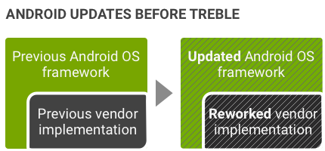
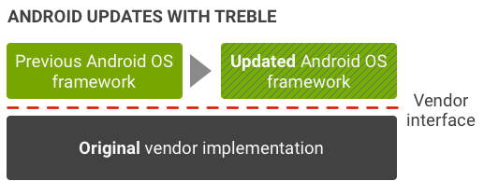
Upgrade with Treble
android-x86.org

Slide 29
HAL type
Binderized HAL -- expressed in HAL interface definition language (HIDL). Android framework and HALs communicate with each other using binder inter-process communication (IPC) calls.
Passthrough HALs -- A HIDL-wrapped conventional or legacy HAL.
Device manifest file: /vendor/manifest.xml
https://source.android.com/devices/architecture/vintf/objects
android-x86.org

Slide 30
HIDL HAL
Library: android.hardware.xxx@y.y
HAL: android.hardware.xxx@y.y-impl
Service: android.hardware.xxx@y.y-service
Binderized HAL: add ...-service to PRODUCT_PACKAGES
android-x86.org

Slide 31
Graphics stack
OpenGL ES libs: Mesa 17.3
~ 60 fps
Supported GPUs
  Intel integrated graphic chip
  AMD radeon/amdgpu
  Nvidia (nouveau)
  Vmware (vmwgfx)
  Qemu (virgl)
Not support
  Intel Atom Zxxx, E6xx (PowerVR)
Software rendering by SwiftShader
Android graphic system
drm_gralloc (HAL)
libGLES_mesa
libdrm
Kernel KMS driver
GPU hardware
android-x86.org

Slide 32
Graphics HAL
Passthrough mode: in manifest.xml
<hal format="hidl">
<name>android.hardware.graphics.allocator</name>
<transport arch="32+64">passthrough</transport>
<version>2.0</version>
<interface>
<name>IAllocator</name>
<instance>default</instance>
</interface>
</hal>
Contradicted to the requirement of AOSP
android-x86.org

Slide 33
Audio HAL
Binderized mode: in treble.mk
PRODUCT_PACKAGES += \
android.hardware.audio@2.0-impl \
android.hardware.audio@2.0-service \
manifest.xml
<hal format="hidl">
<name>android.hardware.audio</name>
<transport>hwbinder</transport>
<version>2.0</version>
<interface>
<name>IDevicesFactory</name>
<instance>default</instance>
</interface>
</hal>
android-x86.org

Slide 34
Wifi HAL
Binderized mode
PRODUCT_PACKAGES += \
android.hardware.wifi@1.0-service
<hal format="hidl">
<name>android.hardware.wifi.supplicant</name>
<transport>hwbinder</transport>
<version>1.0</version>
<interface>
<name>ISupplicant</name>
<instance>default</instance>
</interface>
</hal>
Need to disable p2p: wpa_supplicant_overlay.conf
p2p_disabled=1
android-x86.org

Slide 35
Bluetooth HAL
Binderized mode
PRODUCT_PACKAGES += \
android.hardware.bluetooth@1.0-impl \
android.hardware.bluetooth@1.0-service \
libbt-vendor
Need to fix android.hardware.bluetooth@1.0 in hardware/interfaces, read and write BT socket once for an HCI packet
android-x86.org

Slide 36
Sensors HAL
Passthrough mode
PRODUCT_PACKAGES += \
android.hardware.sensors@1.0-impl
manifest.xml
<hal format="hidl">
<name>android.hardware.sensors</name>
<transport arch="32+64">passthrough</transport>
<version>1.0</version>
<interface>
<name>ISensors</name>
<instance>default</instance>
</interface>
</hal>
android-x86.org

Slide 37
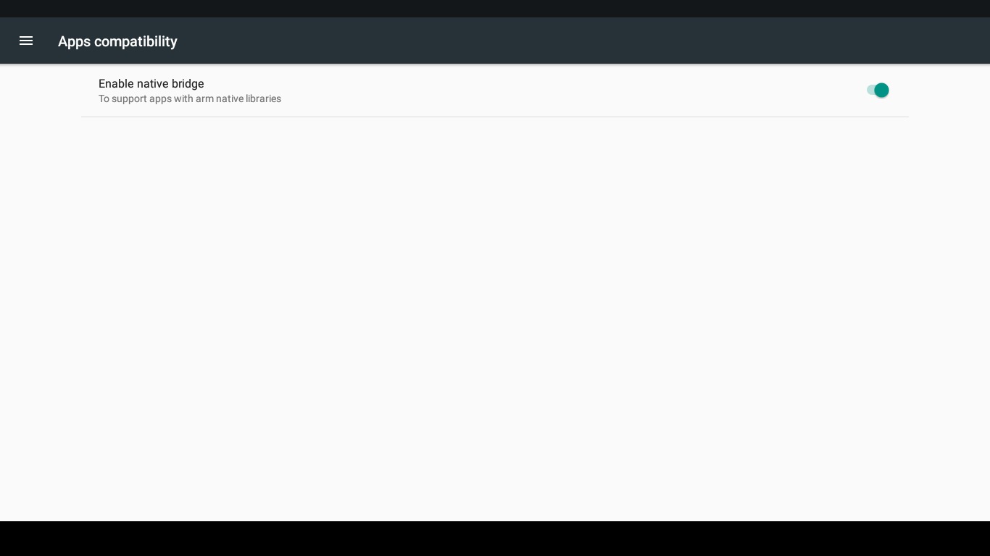
Apps compatibility
Run arm apps by Houdini (by Intel)
Supported by nativebridge since 5.1
libnb: need to update callback version to 3
android-x86.org

Slide 38
8.1 Porting status
Merged to android-8.1.0_r1
Build-able and bootable
Unstable, always ANR
android-x86.org

Slide 39
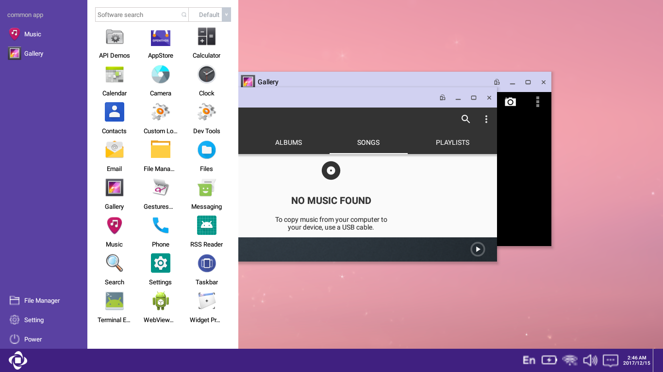
OPENTHOS is porting to 8.x
Developed in Emulator
Will merge with x86 soon
android-x86.org

Slide 40
Develop android-x86
Get the source tree
Create a target (optional)
Customize kernel (optional)
Build the image
Test on target device
android-x86.org

Slide 41
Get source
The git server
  git.androidx86.org
  android-x86.git.sf.net
  git.osdn.net
$ repo init -u git://git.osdn.net/gitroot/android-x86/manifest \
-b oreo-x86
$ repo sync --no-tags --no-clone-bundle
android-x86.org

Slide 42
Build an iso / efi image
$ source build/envsetup.sh
$ lunch android_x86-userdebug
$ make -jN iso_img
  out/target/product/$target/$target.iso
{kernel,initrd.img,installer.img,ramdisk.img,system.sfs}
android-x86.org

Slide 43
Test the iso image
Hybrid iso format
Create a bootable USB
  dd if=target.iso of=/dev/sdX
  Unetbootin
  Linux Live USB Creator ( LiLi )
Boot from the USB disk
  Live mode
  VESA mode
  Debug
  Installer
android-x86.org

Slide 44
Open source activities
www.android-x86.org
code.google.com/p/android-x86
osdn.net/projects/android-x86
twitter.com/android_x86
IRC at irc.freenode.net #android-x86
groups.google.com/group/android-x86
    android-x86@googlegroups.com
    Over 10,000 subscribers
    > 1000 emails/month
android-x86.org

Slide 45
Call for developers
Google group: Android-x86
http://groups.google.com/group/android-x86
IRC channel at irc.freenode.net
#android-x86
android-x86.org
Notes:
請記得，這是一個開放源碼的計劃，歡迎大家加入。

Slide 46
Thank you!
android-x86.org
Notes:
請記得，這是一個開放源碼的計劃，歡迎大家加入。

