Slide 1
Accelerating Datacenter Infrastructure with Reconfigurable Hardware
Bojie Li
4th year Ph.D. student
University of Science and Technology of China
Intelligent Cloud & Edge group, Microsoft Research Asia

Slide 2
Rise of Domain-Specific Architecture
Note: assumes power consumption of 160W/TPU2 chip (not confirmed)
Moore’s Law (2x per 1.5 years)
Still working for specialized hardware
LOG SCALE
CPU: End of frequency & Dennard scaling
Notes:
Moore’s law is ending for CPU due to end of frequency scaling and Dennard scaling.
However, Moore’s law is still working for specialized hardware.
Green plots show the energy efficiency of GPUs.
Red plots show FPGAs.
Blue plots show the TPU ASIC.

Slide 3


Reconfigurable Cloud Architecture
DRAM
DRAM
Hardware acceleration plane
CPU
CPU
Deep neural networks
QPI
SQL
Web search ranking
SDN offload
Gen3 x8
Gen3 2x8
NIC
DRAM
1
FPGA
2
Traditional software (CPU) server plane
QSFP
QSFP
QSFP
40Gb/s
40Gb/s
ToR
Notes:
We add an FPGA between the top-of-rack (ToR) switch and the NIC in each server.
The FPGAs form a hardware acceleration plane between the traditional software server plane and the network communication plane.

Slide 4
Reconfigurable Cloud Architecture
DRAM
DRAM
Hardware acceleration plane
CPU
CPU
Deep neural networks
QPI
SQL
Web search ranking
SDN offload
Gen3 x8
Gen3 2x8
NIC
DRAM
1
FPGA
2
Traditional software (CPU) server plane
QSFP
QSFP
QSFP
40Gb/s
40Gb/s
ToR
  Why FPGAs?
  Fast due to massive parallelism and flexible interconnect
  - Millions of logic elements Thousands of “cores” in parallel
  - Thousands of memory blocks TB/s memory bandwidth
Notes:
We add an FPGA between the top-of-rack (ToR) switch and the NIC in each server.
The FPGAs form a hardware acceleration plane between the traditional software server plane and the network communication plane.

Slide 5
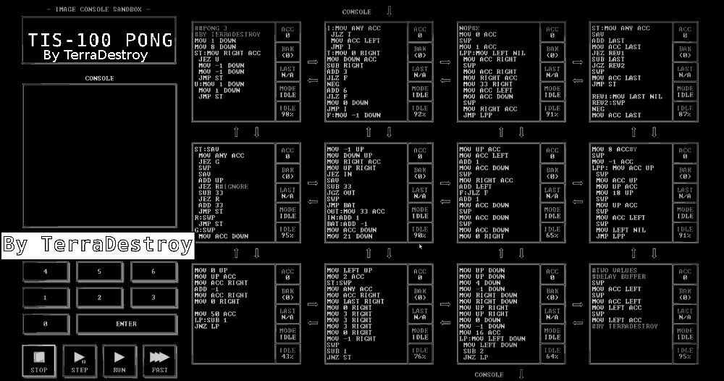
Why FPGA is fast: logic & mem parallelism
Notes:
TIS-100

Slide 6

Why FPGA is fast: flexible interconnect
Notes:
Shenzhen I/O

Slide 7
Reconfigurable Cloud Architecture
DRAM
DRAM
Hardware acceleration plane
CPU
CPU
Deep neural networks
QPI
SQL
Web search ranking
SDN offload
Gen3 x8
Gen3 2x8
NIC
DRAM
1
FPGA
2
Traditional software (CPU) server plane
QSFP
QSFP
QSFP
40Gb/s
40Gb/s
ToR
  Why FPGAs?
  Fast due to massive parallelism and flexible interconnect
  - Millions of logic elements Thousands of “cores” in parallel
  - Thousands of memory blocks TB/s memory bandwidth
  Low power consumption (~20W)
  General computing platform to accelerate various cloud services
  Mature technology with a reasonable price
Notes:
We add an FPGA between the top-of-rack (ToR) switch and the NIC in each server.
The FPGAs form a hardware acceleration plane between the traditional software server plane and the network communication plane.

Slide 8
KV-Direct: High-Performance In-Memory Key-Value Store with Programmable NIC
Published on SOSP’17
Bojie Li^{1,2} Zhenyuan Ruan^{1,3} Wencong Xiao^{1,4} Yuanwei Lu^{1,2} Yongqiang Xiong¹ Andrew Putnam¹ Enhong Chen²
Lintao Zhang¹
¹Microsoft Research ²USTC ³UCLA ⁴Beihang University
Notes:
Thanks Adita for the introduction.
Hello everyone, I’m Bojie Li, a fourth year PhD student in a joint PhD program of USTC and Microsoft Research.
In this session we have seen two wonderful works, Eris and NetCache to use in-network processing with dataplane programmable switches to accelerate systems.
Now I will show programmable NICs can also be very useful in accelerating datacenter workloads.
Our KV-Direct work is done during internship in Microsoft Research Asia with my colleagues. Zhenyuan Ruan and me are co-first authors who design and implement this system together.

Slide 9


Key-Value Store in Data Centers
Web Cache
Key
Value
User ID
Recent Tweets
SQL
Query result
Session
Browser cookies
Notes:
As everyone knows, traditional key-value stores like memcached or redis are used for caching in web services.

Slide 10
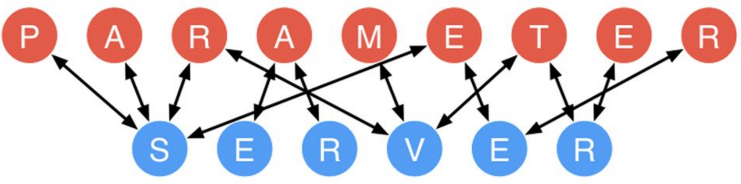
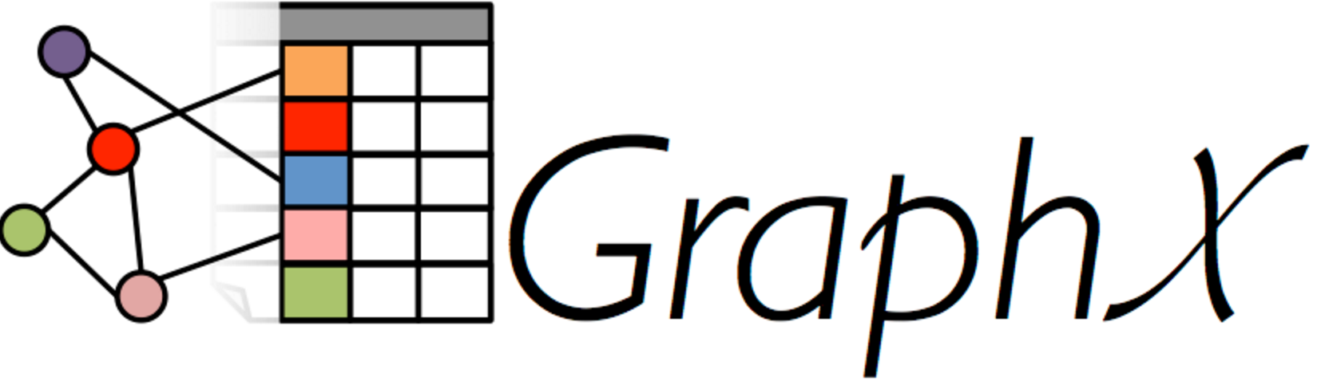
Key-Value Store in Data Centers
Web Cache
Shared Data Structure
Key
Value
Key
Value
User ID
Recent Tweets
Graph node
List of edges
SQL
Query result
Feature
Weight
Session
Browser cookies
Shard
Sequence number
More demanding workload
Notes:
In recent years, key-value store goes beyond object caching and becomes an infrastructure service to store shared data structure in a distributed system.
Examples include parameter servers in machine learning, graph computing engine and sequencers for distributed transactions, as the Eris paper in this session just said.
Shared data structure stores demands more performance compared to web cache.

Slide 11
Key-Value Store in Data Centers
Shared Data Structure
Design Goals
High throughput
Low tail latency
Write intensive
Vector operations
____
Atomic operations
Key
Value
Graph node
List of edges
Feature
Weight
Shard
Sequence number
More demanding workload
Notes:
These shared data structure stores have enormous throughput requirement, for example a graph computation application may need billions of key-value operations per iteration.
Second, it requires low tail latency because the latency of an application is typically determined by the slowest one.
Third, the workload is no longer read intensive, so both reads and writes need to be efficient.
Finally, we should have built in support for vector operations and atomic operations.

Slide 12
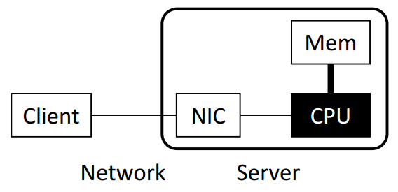
Key-Value Store Architectures
Software (Kernel TCP/IP)
Bottleneck: Network stack in OS
(~300 Kops per core)
Notes:
Key-value store is a holistic exercise of systems, including networking, computation and memory accesses.
For traditional key-value stores such as memcached and redis, the bottleneck is network stack in operating system. We all know that TCP/IP stack are slow.

Slide 13
Key-Value Store Architectures
Software (Kernel TCP/IP)
Bottleneck: Network stack in OS
(~300 Kops per core)
Software
(Kernel Bypass)
e.g. DPDK, mtcp, libvma, two-sided RDMA
Bottlenecks: CPU random memory access
and KV operation computation
(~5 Mops per core)
Notes:
Next, researchers use kernel-bypass networking to mitigate the network stack overhead.
One way is to build a lightweight network stack in user-mode.
Another way is to leverage two-sided RDMA to offload the networking stack into NIC hardware.
However, the throughput bottleneck is now CPU random access and key-value operation computation.

Slide 14
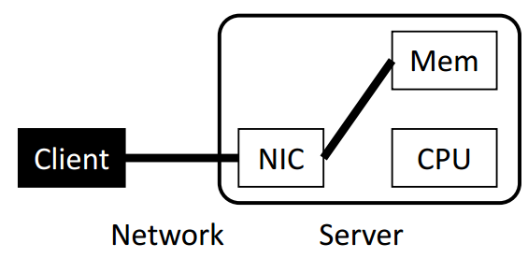
Key-Value Store Architectures
Software (Kernel TCP/IP)
Bottleneck: Network stack in OS
(~300 Kops per core)
Software
(Kernel Bypass)
e.g. DPDK, mtcp, libvma, two-sided RDMA
Bottlenecks: CPU random memory access
and KV operation computation
(~5 Mops per core)
One-sided RDMA
Communication overhead: multiple round-
trips per KV operation (fetch index, data)
Synchronization overhead: write operations
Notes:
Another key-value store architecture is to bypass the server CPU entirely using one-sided RDMA.
The KV processing is offloaded to clients, and they access the key-value store via remote memory access.
However, in this design, there is significant communication overhead due to multiple round-trips per KV operation.
Furthermore, when clients need to write on a same key-value pair, they need synchronization to ensure consistency.

Slide 15
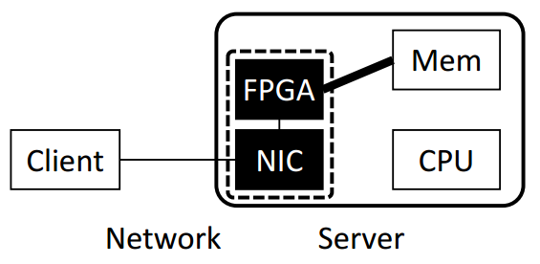
Key-Value Store Architectures
Software
(Kernel TCP/IP)
Software
(Kernel Bypass)
KV-Direct FPGA + NIC
Offload KV processing on CPU
to Programmable NIC
Extend RDMA semantics to key-value semantics
One-sided RDMA
Notes:
We propose KV-Direct to offload KV processing on CPU to programmable NIC.
The name of KV-Direct means that the NIC directly fetches data and applies updates in the host memory to serve KV requests, completely bypassing server CPU.

Slide 16
A Commodity Server with SmartNIC
DRAM
DRAM
CPU
CPU
QPI
Gen3 x8
Gen3 2x8
NIC
DRAM
1
FPGA
2
QSFP
QSFP
QSFP
40Gb/s
40Gb/s
ToR
Notes:
This slides show the architecture of our server with SmartNIC.
Our programmable NIC is composed of two parts, an FPGA and a standard network interface card.
The FPGA has some on-board DRAM, and can access the host DRAM via PCIe link.
For the network part, the FPGA stays between the NIC and the top of rack switch.

Slide 17
KV-Direct Architecture
Network Decoder
Request Scheduler
NIC
Network Encoder
Hash Table
Slab Allocator
Load Dispatch
On-board DRAM
PCIe
(host mem)
Notes:
Now we look at the architecture of KV-Direct.
key-value operations are received from the NIC and decoded in the network decoder,
Then the request scheduler issues independent key-value operations to the hash table,
Small key-value pairs are stored inline in the hash table, while larger key-value pairs are stored in dynamically allocated memory, which requires a slab memory allocator.
The memory accesses are dispatched to either on-board DRAM, or the PCIe bus to access host memory.
When the memory lookup result comes back, finally we encode the KV operation results and send to the client.

Slide 18
Performance Challenges
40 GbE
Reconfigurable NIC
NIC
ToR switch
On-board DRAM (4 GB)
FPGA
PCIe Gen3
x16 DMA
Host DRAM (256 GB)
CPU
Notes:
Here we look at the exact performance numbers of our system and see the performance challenges of our system.

Slide 19
Performance Challenges
40 GbE
Reconfigurable NIC
NIC
ToR switch
On-board DRAM (4 GB)
FPGA
Header overhead and limited parallelism:
Be frugal on
memory accesses
PCIe Gen3
x16 DMA
13 GB/s
120 Mops
Host DRAM (256 GB)
CPU
Notes:
First, our PCIe interface between FPGA and host memory has limited throughput.
There is something worse. PCIe transport layer packets has header overhead, and the PCIe IP core in our FPGA has limited parallelism, which limits our PCIe throughput to 120 million operations per second.
So we need to be frugal on memory accesses.

Slide 20
Performance Challenges
40 GbE
Reconfigurable NIC
NIC
ToR switch
On-board DRAM (4 GB)
FPGA
Atomic operations have dependency:
PCIe latency hiding
PCIe Gen3
x16 DMA
1us delay
120 Mops
Host DRAM (256 GB)
CPU
Notes:
Second, the PCIe bus has delay of nearly 1 microsecond, due to additional delay in the PCIe IP core in our FPGA.
When atomic operations operate on the same key, they depend on the result of each other and needs to executed one by one.
Therefore, we need to hide the PCIe latency, otherwise the throughput will degrade to 1 million operations per second.

Slide 21
Performance Challenges
40 GbE
Reconfigurable NIC
NIC
ToR switch
0.2us delay
100 Mops
On-board DRAM (4 GB)
FPGA
Load dispatch
PCIe Gen3
x16 DMA
1us delay
120 Mops
Host DRAM (256 GB)
CPU
Notes:
Third, we hope to leverage both the throughput of on-board DRAM and host DRAM, so we need an efficient load dispatch mechanism.

Slide 22
Performance Challenges
60 Mpps
40 GbE
Reconfigurable NIC
NIC
ToR switch
0.2us delay
100 Mops
Client-side batching
Vector-type operations
On-board DRAM (4 GB)
FPGA
PCIe Gen3
x16 DMA
1us delay
120 Mops
Host DRAM (256 GB)
CPU
Notes:
Finally, because network packet headers also have significant overhead, we leverage client-side batching and support vector-type operations to reduce network overhead.

Slide 23
Design Principles
Be frugal on memory accesses for both GET and PUT
Hide memory access latency
Leverage throughput of both on-board and host memory
Offload simple client computation to server
Notes:
I already know that many people may do not have a programmable NIC or FPGA, actually you do not need to be disappointed by this talk.
Actually, our design principles are not specific to the hardware design of our system. Pure CPU based designs can still benefit from the design principles.
Next we go through each of the optimizations.
First, we need to be frugal on the number of memory accesses.

Slide 24
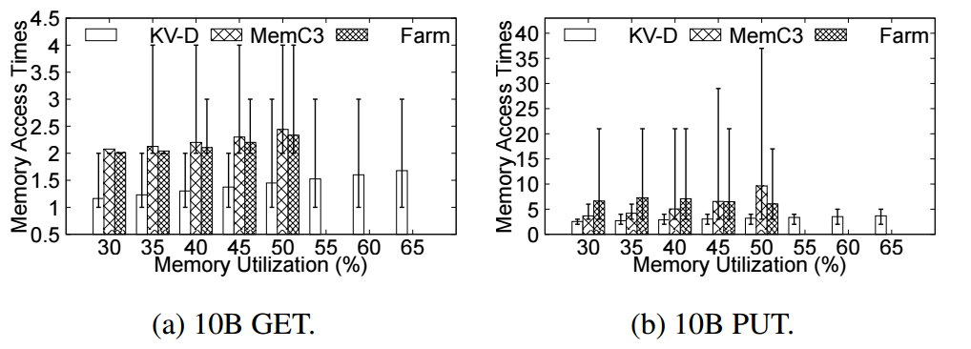
Be Frugal on Memory Accesses
Hash table: minimal access per GET & PUT
Cuckoo hashing: constant GET, sacrifice PUT.
Log-structured memory: fast PUT, sacrifice GET.
Our choice: Bucketized chaining: Close to 1 per GET, 2 per PUT
Notes:
Hash table is a central part to a key-value store.
Our goal is to achieve minimal memory accesses per both GET and PUT operation.
Cuckoo hashing achieves constant number of memory accesses per GET operation, but sacrifice PUT under high load factors.
Log-structured memory, on the other hand, requires only one memory write operation per PUT, but may require more memory read operations per GET.

Slide 25
Be frugal on memory accesses
Slab allocator for variable-sized KVs
512B
256B
128B
64B
32B
Notes:
Because KV-Direct is a general key-value store, it needs to store key-values of variable sizes. We need dynamic memory allocation for key-value pairs larger than some inline threshold.
As we can see from the figure, a slab allocator partitions the memory space into several slab entries with predetermined size.

Slide 26
Be frugal on memory accesses
Random memory access to merge free slabs
512B
256B
128B
64B
32B
New free slab
Adjacent slab to check
Notes:
However, the problem comes when a slab is freed.
When a slab is freed, the adjacent slab needs to be checked. If the adjacent slab is also free, we merge the two free slabs into a larger free slab. Otherwise, we mark the newly freed slab in the bitmap. This introduces two random memory accesses, one read and one write.

Slide 27
Be Frugal on Memory Accesses
Solution: lazy slab merging on CPU
Worst case: 0.07 amortized DMA operations per (de)allocation.
Host Daemon
32B stack
32B stack
Merger
Hashtable
Sync
512B stack
512B stack
Splitter
NIC side
Host side
Notes:
Our solution is to perform lazy slab merging on the CPU.
For each slab size, we cache slab entries on the NIC.
When a slab size is in short of slabs or has excessive slabs, we split or merge them on host CPU.
The NIC cache is synchronized with the host slab pool in batches.
This is similar to log-structured memory where we amortize the write operations by batching them and appending them to the end of operation list.
Due to batching, we achieve less than one tenth amortized DMA operations per allocation and deallocation.

Slide 28
Design Principles
Be frugal on memory accesses for both GET and PUT
Hide memory access latency
Leverage throughput of both on-board and host memory
Offload simple client computation to server
Notes:
The second design principle is to hide memory access latency.
This is the most important optimization in our system. If you can only remember one optimization technique, out-of-order execution is the take away.

Slide 29
Memory dependency
Client
NIC
Mem
K1 += a
K1 += b
PCIe RTT
~1 us
K1 unlocked
PCIe RTT
~1 us
Notes:
Memory dependency occur when multiple write operations have the same key. For example, we have two atomic add operation arriving simultaneously from clients.
The second atomic add depends on the result of first operation, so each operation takes a round-trip time between NIC and host memory, which is about one microsecond. This causes the throughput of write operations to be only 1 million operations per second.

Slide 30
Reservation Station
Cache most frequently accessed KVs
Client
NIC
Mem
K1 += a
K1 += b
K1 cached
Execute in cache
Notes:
To this end, we build a reservation station to cache most frequently accessed key-value pairs. After the first atomic operation completes, the second atomic operation can be immediately executed in the on-chip cache.
The NetCache paper in this session has shown that, a small number of cache entries is sufficient to cache the most popular key-value pairs.
This is a very important property

Slide 31
Pipeline stall
Client
NIC
Mem
K1 += a
K1 += b
K2 += c
Stalled due to K1
Notes:
A second case caused by memory dependency is pipeline stall.
For example, after two dependent atomic operations, there is a third atomic operation on a different key.
If we execute the operations one by one, the third operation would be blocked by the second operation.
Actually we know that the operation on K2 can be executed in parallel with K1.

Slide 32
Out-of-order execution
Client
NIC
Mem
K1 += a
K1 += b
K2 += c
OOO execution
Reordered response
Notes:
To this end, we design an out-of-order execution engine to issue independent key-value operations to the processing pipeline. When the responses come back, in order to ensure consistency, we reorder the response before sending back to the client.

Slide 33
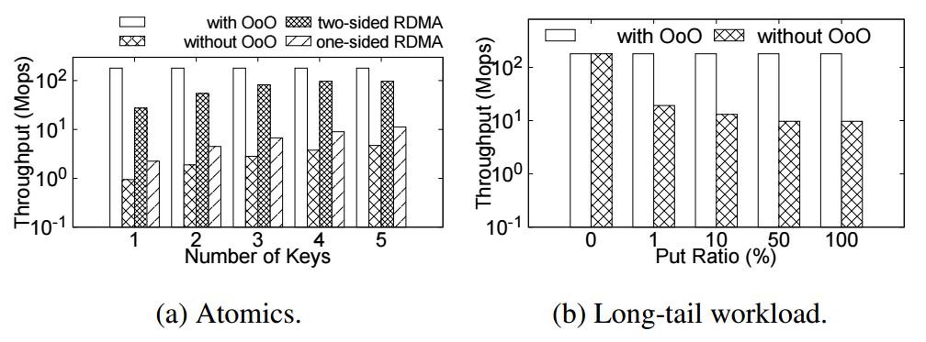
Out-of-order Execution
Throughput: 191x single-key atomics, 20x long-tail workload
We hope future RDMA NICs could adopt out-of-order execution for atomic operations!
Notes:
The out-of-order execution engine achieves nearly 200 times speedup for single-key atomics, which is useful for sequencers, as the Eris paper just said.
For long-tail workload, because there are several extremely popular keys, they are cached by the out-of-order execution engine, so the throughput is only bound by the clock frequency of our FPGA.
Out-of-order execution is a well-known optimization technique in computer architecture literature. We hope future RDMA NICs could adopt this technology for atomic operations.

Slide 34
Design Principles
Be frugal on memory accesses for both GET and PUT
Hide memory access latency
Leverage throughput of both on-board and host memory
Offload simple client computation to server
Notes:
Now we come to the third principle, leverage throughput of both on-board and host memory.

Slide 35
How to Use On-board DRAM?
40 GbE
Reconfigurable NIC
NIC
ToR switch
100 Mops
On-board DRAM (4 GB)
FPGA
PCIe Gen3
x16 DMA
120 Mops
Host DRAM (256 GB)
CPU
Notes:
The host memory is large, and the on-board DRAM is small. Both of them have similar throughput. Next we will see why this performance and capacity mismatch is a big challenge.

Slide 36
How to Use On-board DRAM?
Cache?
Load balance?
Up to 100 Mops
Up to 122 Mops
Dispatcher
On-board DRAM
(100 Mops)
25 Mops/GB
0.5 Mops/GB
On-board DRAM
(4 GB,
100 Mops)
Host Memory
(256 GB, 120 Mops)
Host Memory
(120 Mops)
Notes:
First we may try to use the on-board DRAM as a cache of host memory. However, the on-board DRAM may be even slower than the host memory, so making it a cache does no good.
(click) Second we may try to load balance the requests to the on-board DRAM and host memory. However, the on-board DRAM is much smaller than the host memory. Because the throughput load per gigabyte of storage is roughly the same, the throughput of on-board DRAM cannot be fully utilized, and the overall throughput is only slightly larger than the host memory.

Slide 37
Load Dispatch = Cache + Load Balance
184 Mops
Dispatcher: hash(addr)
Cache-able
(50%)
Not cache-able
(50%)
92 Mops
92 Mops
On-board DRAM
(4 GB, 100 Mops)
Host Memory
(256 GB, 120 Mops)
Cache
miss
(30%)
Cache hit
(70%)
28 Mops
120 Mops
64 Mops
Make full use of both on-board and host DRAM by adjusting the cache-able portion
Notes:
Our approach is a hybrid approach combining both cache and load balance.
The entire memory space is split to one cache-able portion and one non-cacheable portion according to hash of the memory address.
If the address is cache-able, we first look up the on board DRAM. If cache hit, the result is used.
If cache miss, we need to lookup the host memory.
If the address is not cache-able, we directly look up the host memory.
As we can see from the throughput numbers, both throughput of on-board DRAM and the host memory are nearly fully utilize.
By adjusting the portion of cache-able memory, we can balance the throughput of on-board DRAM and host memory.

Slide 38
Design Principles
Be frugal on memory accesses for both GET and PUT
Hide memory access latency
Leverage throughput of both on-board and host memory
Offload simple client computation to server
Notes:
The last optimization I will talk about is to offload simple client computation to server.

Slide 39
Vector-Type Operations
Example: key[0] += a, key[1] += b
Approach 1: Each element as a key
Approach 2: Compute at client
Client
Server
atomic_add(key_0, a)
atomic_add(key_1, b)
Client
Server
get(key)
Compute new vector
put(key, new_vector)
Notes:
As we have seen from the parameter server and graph engine scenario, vector-type operations are a common pattern in key-value stores.
Here we see an example two-element vector, and we need to perform an atomic add to each component of the vector.
With a traditional key-value store, we have two approaches to implement vector-type operations.
(click) First is to treat each element as a key.
In this way we need to issue multiple key-value operations.
(click) Second is to treat the entire vector as a big value.
In this way we need to transfer the entire vector over the network twice, which doubles the latency.
Furthermore, both approaches need to lock the entire vector to ensure consistency.

Slide 40
Vector-Type Operations
Example: key[0] += a, key[1] += b
Approach 1: Each element as a key
Approach 2: Compute at client
Our approach:
Vector operations
Client
Server
Client
Server
atomic_add(key_0, a)
atomic_add(key_1, b)
vector_atomic_add
(key, [a,b])
Client
Server
Actually the “atomic add” function can be user-defined.
get(key)
Compute new vector
put(key, new_vector)
Notes:
Our approach is to support vector-type operations directly on the server side, so the clients do not need to lock the vector and can save a lot of network bandwidth.
Actually the atomic add function can be any user-defined function. Please consult the paper for details.

Slide 41
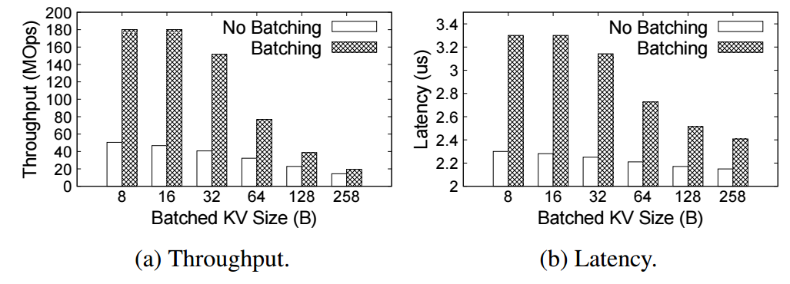
Client-side Network Batching
Amortize packet header overhead
3.6x throughput
(50 Mops -> 180 Mops)
+1 us latency
(2.2 us -> 3.3 us)
Notes:
To reduce network overhead, we further leverage client-side network batching to pack multiple key-value operations into one single network packet.
Before network batching, one network packet only carries one key-value operation, so the throughput is only 50 million operations per second.
With network batching, the network throughput is no longer bottleneck for tiny key-value operations.
On the latency part, client-side network batching only adds 1 microsecond delay.

Slide 42
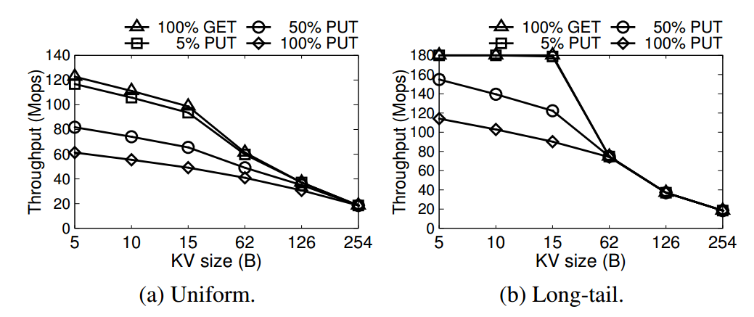
KV-Direct System Performance
Throughput
Notes:
With all these optimizations we have mentioned, KV-Direct pushes the performance to the limit of underlying hardware.
Under uniform workload, for tiny key-value sizes, the GET throughput is over 120 million operations per second. The PUT throughput is approximately half of the GET throughput. This is because one GET operation needs one memory access, and one PUT operation needs two memory accesses, one for read and the other for write.
For larger key-value sizes, the throughput is bounded by the network throughput.

Slide 43
KV-Direct System Performance
Throughput
Notes:
Under long-tail workload, the throughput is higher than uniform workload.
This is because the out-of-order execution engine caches several most popular keys in the on-chip memory, so it does not need to access on-board DRAM or host memory.
For GET operation on tiny KV sizes, the throughput achieves 180 million operations per second. This is the clock frequency of our FPGA.

Slide 44
KV-Direct System Performance
Notes:
KV-Direct is not only high throughput but also low latency.
Latency of KV-Direct is around 5 to 10 microseconds.
Without batching, the latency reduces about 1 microsecond.

Slide 45
Little Impact on CPU Performance
CPU performance | Random memory access | Sequential memory access
KV-Direct NIC idle | 14.4 GB/s | 60.3 GB/s
KV-Direct NIC busy | 14.4 GB/s | 55.8 GB/s
40 GbE
Reconfigurable NIC
NIC
ToR switch
On-board DRAM (4 GB)
FPGA
PCIe Gen3
x16 DMA
13 GB/s
120 Mops
Run other tasks
on CPU
Host DRAM (64 GB KVS,
192 GB other)
CPU
100 GB/s
600 Mops
Notes:
Because PCIe throughput is much lower than available bandwidth of all channels of host DRAM, we reserve only a part of host DRAM for key-value store, and the remaining part can be used for other workloads running on CPU.
(click) As we see from the CPU performance benchmark numbers, when KV-Direct NIC is under peak load, it is little impact on CPU performance and memory access performance. So the server can still run workloads that are not network intensive.

Slide 46
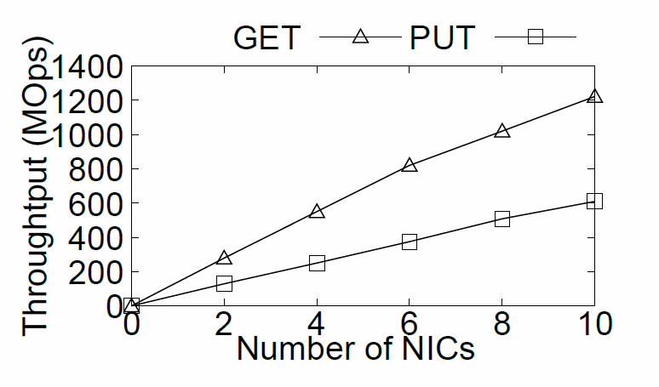
Scalability with Multiple NICs
Notes:
Because a single KV-Direct NIC has not saturated the bandwidth of host DRAM, we can leverage multiple programmable NICs to scale up the KV-Direct system. As we can see in the figure, the throughput increases almost linearly with number of NICs.

Slide 47
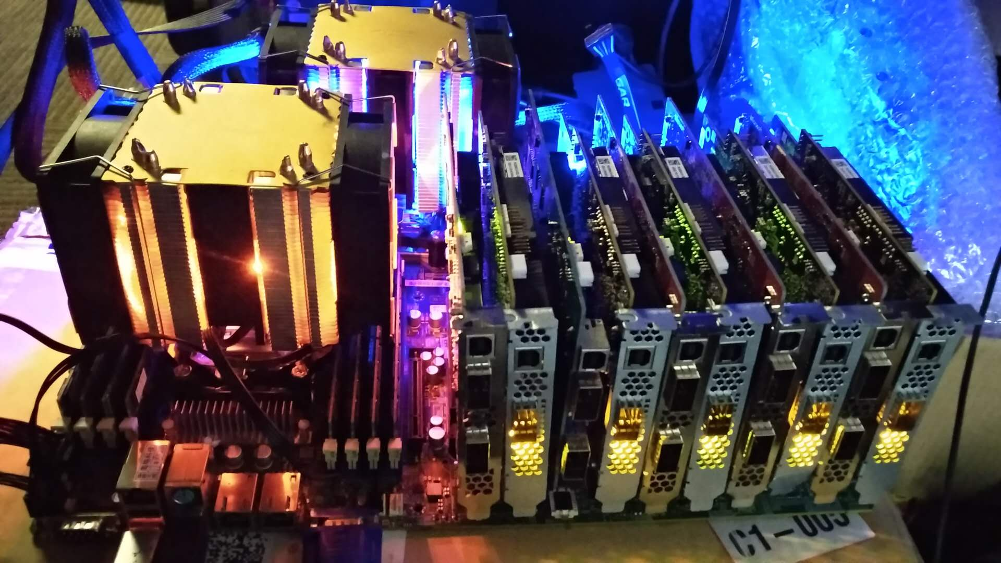
Scalability with Multiple NICs
1.22 billion KV op/s
357 watts power
Notes:
This photo is our test server with 10 programmable NICs, two Xeon E5 processors and 128 Gigabytes of memory.
Each programmable NIC is connected to the motherboard via 8 lanes of PCIe Gen3, so the 10 NICs saturate the 80 PCIe lanes from two Xeon E5 processors.
(click) With 10 programmable NICs, KV-Direct achieves 1.2 billion key-value operations per second with less than 400 watts of power consumption, setting a new milestone for general purpose key-value stores.

Slide 48
KVS Performance Comparison
 | Tput (Mops) (GET / PUT) | Power (Kops/W) | Comment | Latency (us) (GET / PUT)
Memcached | 1.5 / 1.5 | 5 / 5 | TCP/IP | 50 / 50
MemC3 | 4.3 / 4.3 | 14 / 14 | TCP/IP | 50 / 50
RAMCloud | 6 / 1 | 20 / 3.3 | Kernel bypass | 5 / 14
MICA (12 NICs) | 137 / 135 | 342 / 337 | Kernel bypass | 81 / 81
FARM | 6 / 3 | 30 (261) / 15 | One-side RDMA | 4.5 / 10
DrTM-KV | 115 / 14 | 500 (3972) / 60 | One-side RDMA | 3.4 / 6.3
HERD | 35 / 25 | 490 / 300 | Two-side RDMA | 4 / 4
FPGA-Xilinx | 14 / 14 | 106 / 106 | FPGA | 3.5 / 4.5
Mega-KV | 166 / 80 | 330 / 160 | GPU | 280 / 280
KV-Direct (1 NIC) | 180 / 114 | 1487 (5454) / 942 (3454) | Programmable NIC | 4.3 / 5.4
KV-Direct (10 NICs) | 1220 / 610 | 3417 (4518) / 1708 (2259) | Programmable NIC | 4.3 / 5.4
* Number in parenthesis indicates power efficiency based on power consumption of NIC only, for server-bypass systems.
Notes:
KV-Direct achieves high throughput and power efficiency compared to existing work.
In the table we show several existing systems, including traditional TCP IP, kernel-bypass networking, RDMA, FPGA and GPU.

Slide 49
KVS Performance Comparison
 | Tput (Mops) (GET / PUT) | Power (Kops/W) | Comment | Latency (us) (GET / PUT)
Memcached | 1.5 / 1.5 | 5 / 5 | TCP/IP | 50 / 50
MemC3 | 4.3 / 4.3 | 14 / 14 | TCP/IP | 50 / 50
RAMCloud | 6 / 1 | 20 / 3.3 | Kernel bypass | 5 / 14
MICA (12 NICs) | 137 / 135 | 342 / 337 | Kernel bypass | 81 / 81
FARM | 6 / 3 | 30 (261) / 15 | One-side RDMA | 4.5 / 10
DrTM-KV | 115 / 14 | 500 (3972) / 60 | One-side RDMA | 3.4 / 6.3
HERD | 35 / 25 | 490 / 300 | Two-side RDMA | 4 / 4
FPGA-Xilinx | 14 / 14 | 106 / 106 | FPGA | 3.5 / 4.5
Mega-KV | 166 / 80 | 330 / 160 | GPU | 280 / 280
KV-Direct (1 NIC) | 180 / 114 | 1487 (5454) / 942 (3454) | Programmable NIC | 4.3 / 5.4
KV-Direct (10 NICs) | 1220 / 610 | 3417 (4518) / 1708 (2259) | Programmable NIC | 4.3 / 5.4
* Number in parenthesis indicates power efficiency based on power consumption of NIC only, for server-bypass systems.
Notes:
The throughput of KV-Direct is equivalent to 20 to 30 CPU cores.
The MICA system uses 12 NICs, but we achieve the throughput with only a single NIC.
Although the GET throughput of DrTM is high, the PUT throughput is low, this is because it uses one-sided RDMA and the clients need synchronization to keep consistency on write operations.
The Mega-KV system uses GPU, although the throughput of GPU memory is high, its capacity is much smaller than the host memory.

Slide 50
KVS Performance Comparison
 | Tput (Mops) (GET / PUT) | Power (Kops/W) | Comment | Latency (us) (GET / PUT)
Memcached | 1.5 / 1.5 | 5 / 5 | TCP/IP | 50 / 50
MemC3 | 4.3 / 4.3 | 14 / 14 | TCP/IP | 50 / 50
RAMCloud | 6 / 1 | 20 / 3.3 | Kernel bypass | 5 / 14
MICA (12 NICs) | 137 / 135 | 342 / 337 | Kernel bypass | 81 / 81
FARM | 6 / 3 | 30 (261) / 15 | One-side RDMA | 4.5 / 10
DrTM-KV | 115 / 14 | 500 (3972) / 60 | One-side RDMA | 3.4 / 6.3
HERD | 35 / 25 | 490 / 300 | Two-side RDMA | 4 / 4
FPGA-Xilinx | 14 / 14 | 106 / 106 | FPGA | 3.5 / 4.5
Mega-KV | 166 / 80 | 330 / 160 | GPU | 280 / 280
KV-Direct (1 NIC) | 180 / 114 | 1487 (5454) / 942 (3454) | Programmable NIC | 4.3 / 5.4
KV-Direct (10 NICs) | 1220 / 610 | 3417 (4518) / 1708 (2259) | Programmable NIC | 4.3 / 5.4
* Number in parenthesis indicates power efficiency based on power consumption of NIC only, for server-bypass systems.
Notes:
On the power efficiency part, KV-Direct is 10x power efficient than existing work with pure CPU, one-sided RDMA, two-sided RDMA or GPU. Number in parenthesis indicates power efficiency based on power consumption of NIC only, for server-bypass systems. This methodology is justified because other workload can still run on CPU with little performance impact.
(click) Finally, the latency of KV-Direct is on-par with the best of other systems.

Slide 51
Extend RDMA to Key-Value operation with Programmable NIC
DRAM
DRAM
CPU
CPU
QPI
Gen3 x8
Gen3 2x8
NIC
DRAM
1
FPGA
2
QSFP
QSFP
QSFP
40Gb/s
40Gb/s
ToR
Notes:
In conclusion, KV-Direct leverages programmable NICs to accelerate an important workload in data centers, in-memory key value stores. KV-Direct is able to obtain superior performance by carefully co-designing hardware and software in order to remove bottlenecks in the system and achieve performance that is close to the physical limits of the underlying hardware.
After years of broken promises, FPGA-based reconfigurable NIC finally becomes widely available in main stream data centers. Many significant workloads will be scrutinized to see whether they can benefit from reconfigurable hardware, and we expect much more fruitful work in this general direction.

Slide 52
How did we develop
KV-Direct on FPGA?

Slide 53
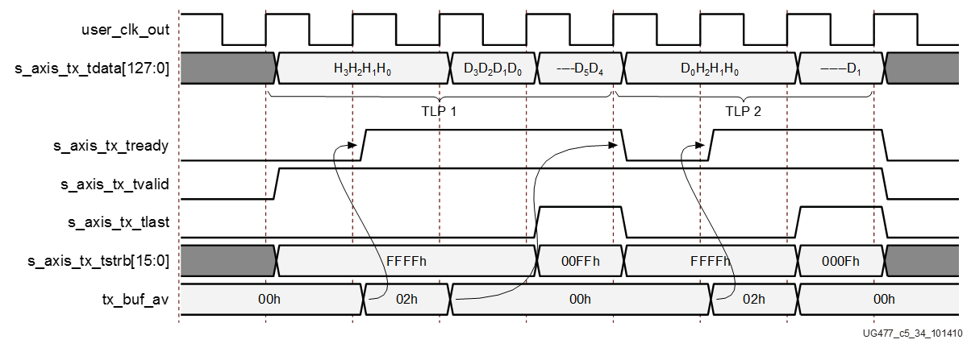

FPGA challenge: Programmability
Hardware description language (HDL): push many software developers away
PCIe Core
DMA Engine
always @ (posedge SYSCLK or negedge RST_B)
begin
if(!RST_B)
DMA_TX_DATA <= `UD 8'hff;
else
DMA_TX_DATA <= `UD DMA_TX_DATA_N;
end
//send: "hello world !"
always @ (posedge SYSCLK)
begin
if (rst) begin
dma_data <= 88’h0;
dma_valid <= 1’b0;
else
if (dma_start) begin
dma_data <= 88’h68656C6C6F20776F726C64;
dma_valid <= 1’b1;
end
else begin
dma_data <= 88’h0;
dma_valid <= 1’b0;
end
end
end
Ahhhhhhhhhhhh!
Notes:
The main challenge to use FPGA is programmability.
Conventionally, FPGA is programmed with low-level hardware description languages, such as Verilog and VHDL.
This example shows a HelloWorld program in Verilog.
To print a HelloWorld string on the screen, we first need to translate the string into ASCII codes.
In order to send the codes to the host memory, we need to write a DMA engine.
The DMA engine needs to call a PCI express IP core, which requires reading three hundred pages of manual to understand the interface.
The difficulty of hardware description languages have pushed many software developers away for years.

Slide 54
Project ClickNP [SIGCOMM’16]
Making FPGA accessible to software developers
Flexibility: fully programmable using high-level language
Modularized: Click abstractions familiar to software developers; easy code reuse
High performance: high throughput; microsecond-scale latency
Joint CPU/FPGA packet processing: FPGA is no panacea; fine-grained processing separation
Notes:
In this work, we present ClickNP, a platform to make FPGA accessible to software developers.
We have several design goals.
First, the platform should be fully programmable using high-level languages.
Second, the platform should have a modular architecture familiar to software developers. In particular, we choose abstractions similar to the Click modular router for easy code reuse.
Third, the platform should provide high performance, both in terms of throughput and latency.
Finally, the platform should support joint CPU and FPGA packet processing. That’s because FPGA is not suitable for every kind of workload. We should support fine-grained processing separation between CPU and FPGA. This requires high performance and low latency communication between CPU and FPGA.

Slide 55
Programming model
as if programming on a multi-core processor
cores (elements) running in parallel
A
B
C
mem
mem
mem
communicate via channels, not shared memory
Notes:
ClickNP provides a modular programming model. Programming in ClickNP is much like programming on a multi-core processor.
There is one important difference, though.
In conventional multi-core processing, threads communicate via shared memory.
However, In ClickNP, the cores communicate via channels instead of shared memory.
Channel-based communication is more efficient in FPGA compared to shared global memory, because the shared global memory would be the bottleneck.

Slide 56
Element: single-threaded core
states
(reg/mem)
Process handler
input channels
output channels
(main thread)
(I/O)
(I/O)
Signal handler
(ISR)
signal/control from host
(interrupt)
Notes:
In ClickNP, the basic processing module is called an element, which resembles a single-threaded core.
Each element has the following components.
First, a set of local states that are only accessible inside the element.
Second, input and output channels to communicate with other elements.
Third, process handler, which is the main thread to read input channels, do processing and write to output channels in an infinite loop.
Finally, signal handler, which receives and processes commands from the manager thread in host program running on CPU. Signals resemble interrupts in CPU.

Slide 57
Architecture
ClickNP host process
ClickNP elements
Mgr thrd
Worker thrd
ClickNP library
ClickNP host mgr
ClickNP script
PCIe I/O channel
vendor libs
Host
Catapult PCIe Driver
ClickNP compiler
FPGA
Intermediate C files
Catapult shell
ClickNP
C compiler
vendor HLS
Verilog
vendor specific runtime
Cross-platform toolchain
Intel / Xilinx OpenCL / HLS
Visual Studio / GCC
Notes:
Here we look at the architecture of the ClickNP toolchain.
A ClickNP program is divided into three parts, a set of ClickNP elements, a ClickNP script to define the connections among elements, and a ClickNP host manager program.

Slide 58
Architecture
ClickNP host process
ClickNP elements
Mgr thrd
Worker thrd
ClickNP library
ClickNP host mgr
ClickNP script
PCIe I/O channel
vendor libs
Host
Catapult PCIe Driver
ClickNP compiler
FPGA
Intermediate C files
Catapult shell
ClickNP
C compiler
vendor HLS
Verilog
vendor specific runtime
Cross-platform toolchain
Intel / Xilinx OpenCL / HLS
Visual Studio / GCC
Notes:
The ClickNP compiler first compiles the ClickNP program to intermediate C code.

Slide 59
Architecture
ClickNP host process
ClickNP elements
Mgr thrd
Worker thrd
ClickNP library
ClickNP host mgr
ClickNP script
PCIe I/O channel
vendor libs
Host
Catapult PCIe Driver
ClickNP compiler
FPGA
Intermediate C files
Catapult shell
ClickNP
C compiler
vendor HLS
Verilog
vendor specific runtime
Cross-platform toolchain
Intel / Xilinx OpenCL / HLS
Visual Studio / GCC
Notes:
Then we call a vendor HLS tool, for example Altera OpenCL or Vivado HLS, to compile the intermediate C code into Verilog code.

Slide 60
Architecture
ClickNP host process
ClickNP elements
Mgr thrd
Worker thrd
ClickNP library
ClickNP host mgr
ClickNP script
PCIe I/O channel
vendor libs
Host
Catapult PCIe Driver
ClickNP compiler
FPGA
Intermediate C files
Catapult shell
ClickNP
C compiler
vendor HLS
Verilog
vendor specific runtime
Cross-platform toolchain
Intel / Xilinx OpenCL / HLS
Visual Studio / GCC
Notes:
Finally we call the hardware synthesis toolchain to generate the FPGA bitstream.

Slide 61
Architecture
ClickNP host process
ClickNP elements
Mgr thrd
Worker thrd
ClickNP library
ClickNP host mgr
ClickNP script
PCIe I/O channel
vendor libs
Host
Catapult PCIe Driver
ClickNP compiler
FPGA
Intermediate C files
Catapult shell
ClickNP
C compiler
vendor HLS
Verilog
vendor specific runtime
Cross-platform toolchain
Intel / Xilinx OpenCL / HLS
Visual Studio / GCC
Notes:
And call a standard C compiler to compile the ClickNP host program.

Slide 62
Architecture
ClickNP host process
ClickNP elements
Mgr thrd
Worker thrd
ClickNP library
ClickNP host mgr
ClickNP script
PCIe I/O channel
vendor libs
Host
Catapult PCIe Driver
ClickNP compiler
FPGA
Intermediate C files
Catapult shell
ClickNP
C compiler
vendor HLS
Verilog
vendor specific runtime
Cross-platform toolchain
Intel / Xilinx OpenCL / HLS
Visual Studio / GCC
Notes:
In runtime environment, the Catapult shell is the operating system on the FPGA, which was developed by the Microsoft Catapult team.
The Catapult shell provides resource abstractions to the ClickNP application logic.
On host side, the ClickNP library provides PCIe I/O channel abstraction to the CPU elements, and enables the host program to communicate with FPGA elements via signals.

Slide 63
Dimensions Where FPGAs Can Add Value in Cloud
Reduced cost (fewer cores or servers)
  Machine learning
  Compression / coding / crypto
  Stream processing
  Scatter-gather (latency hiding)
Latency sensitive operations
  Communication protocols
  Coordination / synchronization
  Real-time applications
  Measure / probe events
Programmability (versus ASICs)
  Reprogrammable, flexible
Some isolation from host
  Key escrow/HSM, virtualization, inspection
Cost savings
Host
isolation
Reduced latency
Programmability
Notes:
Finally, we would like to discuss several dimensions where FPGAs can add value.

Slide 64
Thank you!
Questions!
Go beyond the memory wall & reach a fully programmable world
Notes:
Thank you for listening!

Slide 65
Backup

Slide 66
What application?
Back-of-envelope calculations show potential performance gains when KV-Direct is applied in end-to-end applications. In PageRank, because each edge traversal can be implemented with one KV operation, KV-Direct supports 1.2 billion TEPS on a server with 10 programmable NICs. In comparison, GRAM (Ming Wu on SoCC’15) supports 250M TEPS per server, bounded by interleaved computation and random memory access.

Slide 67
Are the optimizations general?
The discussion section of the paper discusses NIC hardware with different capacity. First, the goal of KV-Direct is to leverage existing hardware in data centers instead of designing a specialized hardware to achieve maximal KVS performance. Even if future NICs have faster or larger on-board memory, under long-tail workload, our load dispatch design still shows performance gain. The hash table and slab allocator design is generally applicable to cases where we need to be frugal on memory accesses. The out-of-order execution engine can be applied to all kinds of applications in need of latency hiding.

Slide 68
Throughput is similar to state-of-art
With a single KV-Direct NIC, the throughput is equivalent to 20 to 30 CPU cores. These CPU cores can run other CPU intensive or memory intensive workload, because the host memory bandwidth is much larger than the PCIe bandwidth of a single KV-Direct NIC. So we basically save tens of CPU cores per programmable NIC. With ten programmable NICs, the throughput can grow almost linearly.

Slide 69
Consistency among multiple NICs
Each NIC behaves as if it is an independent KV-Direct server. Each NIC serves a disjoint partition of key space and reserves a disjoint region of host memory. The clients distribute load to each NIC according to the hash of keys, similar to the design of other distributed key-value stores. Surely, the multiple NICs suffer load imbalance problem in long-tail workload, but the load imbalance is not significant with a small number of partitions. The NetCache system in this session can also mitigate the load imbalance problem.

Slide 70
What is the non-batch throughput?
We use client-side batching because our programmable NIC has limited network bandwidth. The network bandwidth is only 5 GB/s, while the DRAM and PCIe bandwidth are both above 10 GB/s. So we batch multiple KV operations in a single network packet to amortize the packet header overhead. If we have a higher bandwidth network, we will no longer need network batching.

