Slide 1
Functional Safety of Automotive Operating Systems: An Overview
Junjie Mao
Tsinghua University
December 12, 2017

Slide 2
Outline
Why functional safety?
What is functional safety?
How is functional safety achieved for OS?
Categorizing and controlling failures
V-model development process
Automotive Safety Integrity Level (ASIL)
Further topics
Conclusion

Slide 3
Outline
Why functional safety?
What is functional safety?
How is functional safety achieved for OS?
Categorizing and controlling failures
V-model development process
Automotive Safety Integrity Level (ASIL)
Further topics
Conclusion

Slide 4
Why functional safety?
Rather than thinking of the vehicle as a mechanical machine, with some electrical components, it would be more accurate to think of the vehicle as a distributed computer system programmed for personal transport.
Roger Rivett, “The Challenge of Technological Change in the Automotive Industry”, in C.Dale and T. Anderson (eds.), Achieving Systems Safety: Proceedings of the Twentieth Safety-Critical Systems Symposium, Bristol, UK, 7-9th February 2012, London: Springer-Verlag London Limited, 2012, p. 35.

Slide 5
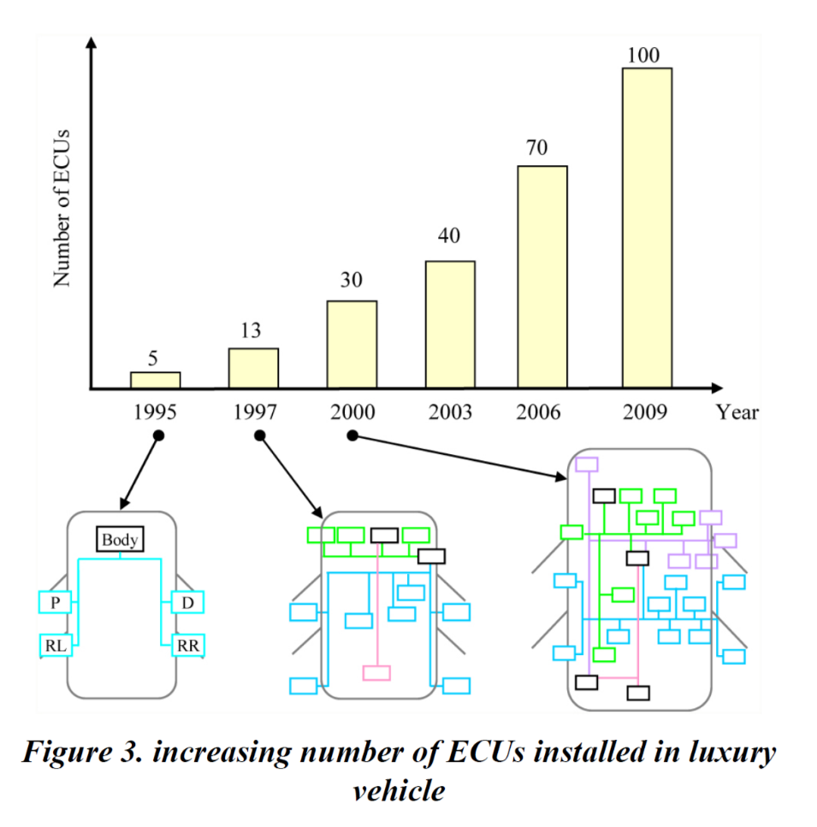
Why functional safety?
Yukihide Niimi, Takayuki Ono, Soichiro Arai Hideki sugimoto, and Riccardo Mariani, "Virtualization Technology and Using Virtual CPU in the Context of ISO26262: The E-Gas Case Study"

Slide 6
Functional Safety: the Standards
IEC 61508:2010: Functional Safety of Electrical/Electronic/Programmable Electronic Safety-related Systems
ISO 26262:2011: Road vehicles
EN 50129: Railway
IEC/EN 62061 & ISO 13849:2015: machinery
IEC 60601: medical electrical equipment

Slide 7
Functional Safety: the Standards
IEC 61508:2010: Functional Safety of Electrical/Electronic/Programmable Electronic Safety-related Systems
ISO 26262:2011: Road vehicles
EN 50129: Railway
IEC/EN 62061 & ISO 13849:2015: machinery
IEC 60601: medical electrical equipment

Slide 8
Item Dissolution
Item
System
Component
Source: ISO 26262-10:2012, p.4-5
Notes:
Source
- ISO 26262-10:2012, Clause 4.2

Slide 9
Outline
Why functional safety?
What is functional safety?
How is functional safety achieved for OS?
Categorizing and controlling failures
V-model development process
Automotive Safety Integrity Level (ASIL)
Further topics
Conclusion

Slide 10
Functional Safety: the Definition
absence of unreasonable risk due to hazards caused by malfunctioning behavior of E/E systems (ISO 26262-1:2011, 1.51)

Slide 11
Functional Safety: the Definition
absence of unreasonable risk due to hazards caused by malfunctioning behavior of E/E systems (ISO 26262-1:2011, 1.51)
Extent of harm to person health that is unacceptable in a certain context

Slide 12
Functional Safety: the Definition
absence of unreasonable risk due to hazards caused by malfunctioning behavior of E/E systems (ISO 26262-1:2011, 1.51)
electrical and/or electronic systems
software + hardware

Slide 13
Functional Safety: the Definition
absence of unreasonable risk due to hazards caused by malfunctioning behavior of E/E systems (ISO 26262-1:2011, 1.51)
in scope
not (directly) in scope
System failure
Unintended behavior
Functionality
Electric shock, fire, etc.
Security properties

Slide 14
Outline
Why functional safety?
What is functional safety?
How is functional safety achieved for OS?
Categorizing and controlling failures
V-model development process
Automotive Safety Integrity Level (ASIL)
Further topics
Conclusion

Slide 15
Faults, Errors, Failures and Hazards
Also called a hazard if it contributes to any accident scenario
Fault
Error
Failure
Engine control unit stops operation by intermittence
Ignition interrupted by intermittence
Vehicle bucks
Accident
Item - Vehicle
Fault
Error
Failure
Programming error at loop termination condition
Unwanted endless loop (leads to watchdog-reset)
Engine control unit stops operation by intermittence
Component - Engine Control Unit
Notes:
Source:
- ISO 26262-10:2012, Clause 4.3

Slide 16
Categorization of Failures
SW
Systematic
Safety Analysis
HW
Single-point
Random
HW
Safety mechanisms
Failures
Multiple-point
Common cause
Dependent
Analysis on dependent failures
Cascading
Notes:
Source:
- ISO 26262-10:2012, Clause 4.3

Slide 17
Safety Analysis
Given some known fault models, safety analyses
examine the consequences of failures,
find new hazards not previously identified, and
Derive measures to prevent or mitigate violations.
Applied at either system, hardware or software level.
Methods
Deductive: FTA, reliability block diagrams, Ishikawa diagram
Inductive: FMEA, ETA, Markov modelling
Notes:
Source:
- ISO 26262-9:2011, Clause 8

Slide 18
Safety Mechanisms
Technical solutions to detect faults or control failures in a limited time interval.
Either
switch to or maintain the item in a safe state, or
alert the driver
Examples
Hardware redundancy
Parity bits and EDE codes for memory
Software self-tests and watchdogs
Notes:
Source:
- ISO 26262-4:2011, Clause 6

Slide 19
Analysis of Dependent Failures
For each potential dependent failures identified by the safety analyses,
determine if it is plausible, and
specify measures for avoiding or controlling plausible dependent failures.
Applied either at system, hardware or software level.
Methods for identifying dependent failures
Cut sets or repeated identical events of an FTA
Repeated similar failure modes in an FMEA
Notes:
Source:
- ISO 26262-9:2011, Clause 7

Slide 20
Outline
Why functional safety?
What is functional safety?
How is functional safety achieved for OS?
Categorizing and controlling failures
V-model development process
Automotive Safety Integrity Level (ASIL)
Further topics
Conclusion

Slide 21
Notes:
Source:
- ISO 26262-10:2012, Clause 7

Slide 22
Item Level
Notes:
Source:
- ISO 26262-10:2012, Clause 7

Slide 23
System Level
Notes:
Source:
- ISO 26262-10:2012, Clause 7

Slide 24
HW/SW Level
Notes:
Source:
- ISO 26262-10:2012, Clause 7

Slide 25
Requirement Phases
Notes:
Source:
- ISO 26262-10:2012, Clause 7

Slide 26
Design Phases
Notes:
Source:
- ISO 26262-10:2012, Clause 7

Slide 27
Test Phases
Notes:
Source:
- ISO 26262-10:2012, Clause 7

Slide 28
Requirement Phase Verification
Verify that the requirements comply with those they are derived from.
(External) Consistency
Correctness
Completeness
Applied either at system, hardware or software level.
Methods
Inspection or walkthrough
Semi-formal or formal verification
Notes:
Source:
- ISO 26262-8:2011, Clause 6

Slide 29
Design Phase Verification
Verify that the design is compliant with the requirements.
(External) Consistency
Correctness
Completeness
Applied either at system, hardware or software level.
Methods
Inspection or walkthrough
Simulation or prototyping
Notes:
Source:
- ISO 26262-8:2011, Clause 9

Slide 30
Test Phase Verification
Verify the products comply with their requirements by execution within a test environment.
Software unit/integration test methods
Requirement-based, interface, fault-injection, resource usage, etc.
Test cases derived from requirements
Structural coverage should be determined
System integrate test methods
Also include stress, long-term and user tests.
Notes:
Source:
- ISO 26262-6:2011, Clause 9
- ISO 26262-6:2011, Clause 10
- ISO 26262-4:2011, Clause 8

Slide 31
Outline
Why functional safety?
What is functional safety?
How is functional safety achieved for OS?
Categorizing and controlling failures
V-model development process
Automotive Safety Integrity Level (ASIL)
Further topics
Conclusion

Slide 32
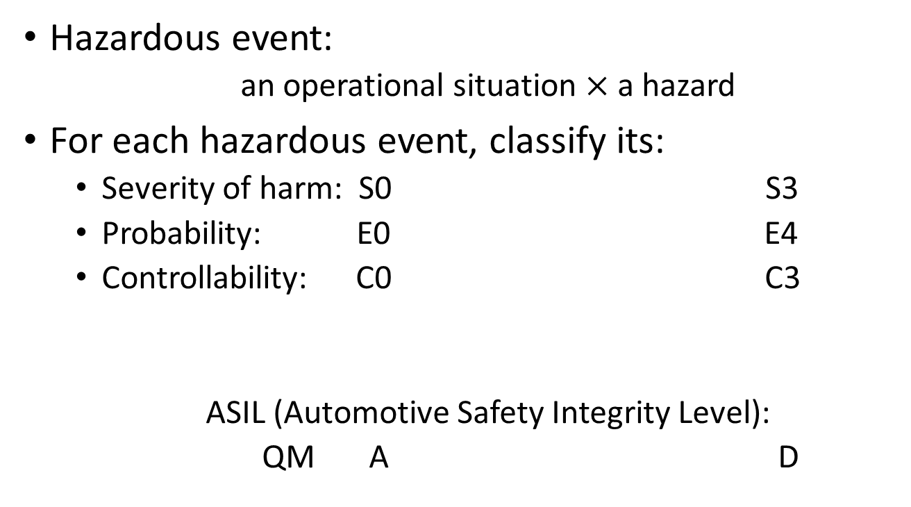
Automotive Safety Integrity Level
Hazardous event:
an operational situation $×$ a hazard
For each hazardous event, classify its:
Severity of harm: S0 S3
Probability: E0 E4
Controllability: C0 C3
ASIL (Automotive Safety Integrity Level):
QM A D
Notes:
Source:
- ISO 26262-3:2011, Clause 7.4.3

Slide 33
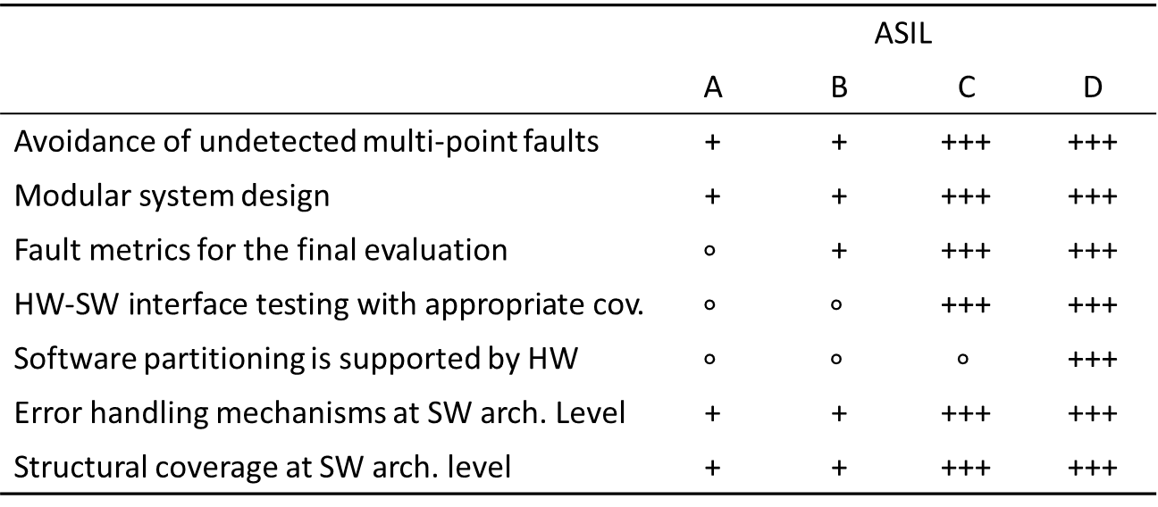
Requirements at Different ASIL
 | ASIL
 | A | B | C | D
Avoidance of undetected multi-point faults | + | + | +++ | +++
Modular system design | + | + | +++ | +++
Fault metrics for the final evaluation | $$∘$$ | + | +++ | +++
HW-SW interface testing with appropriate cov. | $$∘$$ | $$∘$$ | +++ | +++
Software partitioning is supported by HW | $$∘$$ | $$∘$$ | $$∘$$ | +++
Error handling mechanisms at SW arch. Level | + | + | +++ | +++
Structural coverage at SW arch. level | + | + | +++ | +++
$$∘$$ | Neutral | + | Recommended
 |  | +++ | Required
Notes:
Source:
ISO 26262-4:2011, Clause 6.4.4
ISO 26262-4:2011, Clause 7.4.3.7
ISO 26262-4:2011, Clause 7.4.4.2
ISO 26262-4:2011, Clause 8.4.2.1.2
ISO 26262-6:2011, Clause 7.4.11
ISO 26262-6:2011, Clause 7.4.15
ISO 26262-6:2011, Clause 10.4.6

Slide 34
Recommended Methods at Different ASIL
Notations for Software Architectural Design
Notations for design | ASIL
 | A | B | C | D
Informal notations | ++ | ++ | + | +
Semi-formal notations | + | ++ | ++ | ++
Formal notations | $$\text{+}$$ | + | + | +
$$∘$$ | Neutral | + | Recommended
++ | Highly Recommended
Notes:
Source:
- ISO 26262-6:2011, Clause 7.4.1

Slide 35
Recommended Methods at Different ASIL
Methods for the verification of software architectural design
Methods for the verification of design | ASIL
 | A | B | C | D
Walkthrough | ++ | + | $$∘$$ | $$∘$$
Inspection | + | ++ | ++ | ++
Prototype generation | $$∘$$ | $$∘$$ | + | ++
……
$$∘$$ | Neutral | + | Recommended
++ | Highly Recommended
Notes:
Source:
- ISO 26262-6:2011, Clause 7.4.18

Slide 36
Outline
Why functional safety?
What is functional safety?
How is functional safety achieved for OS?
Categorizing and controlling failures
V-model development process
Automotive Safety Integrity Level (ASIL)
Further topics
Conclusion

Slide 37
Further topics in ISO 26262
Standards on the management process
Hardware safety requirements and design
Standards on the post-release production phase
Configuration management
Change management
Qualification of HW/SW components and tools

Slide 38
Outline
Why functional safety?
What is functional safety?
How is functional safety achieved for OS?
Categorizing and controlling failures
V-model development process
Automotive Safety Integrity Level (ASIL)
Further topics
Conclusion

Slide 39
Conclusion
Functional safety requires the control of failures and unintended behavior.
Requirement, design and test phase verification to avoid unintended behavior
Safety analysis to control systematic failures
Safety mechanisms to control systematic and random failures
Analysis of dependent failures to control dependent failures
Use ASIL to balance safety with cost.

Slide 40
Thanks!

