Slide 1
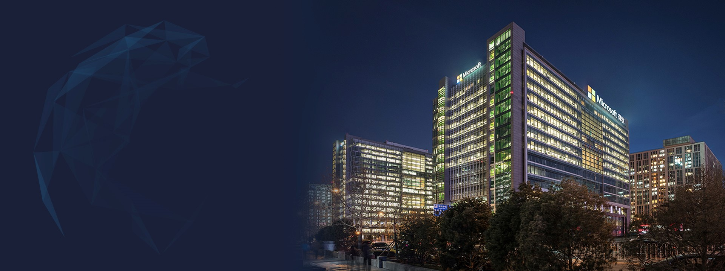
深度学习计算优化中的挑战与机会 The Challenges and Opportunities in Optimization of Deep Learning Computation
Microsoft Research
伍鸣
资深研究员
微软亚洲研究院系统组
Notes:
大家好，我是微软亚洲研究院系统组的伍鸣。我今天想跟大家交流分享的topic是在优化深度学习计算中的一些挑战和机会。在这个报告中，我也会概括的介绍我们组在这个方向正在进行的一些研究工作。

Slide 2
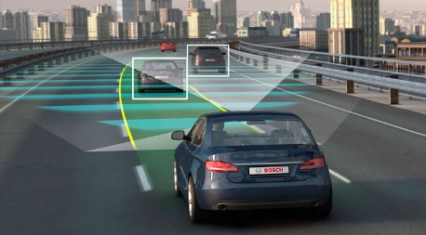
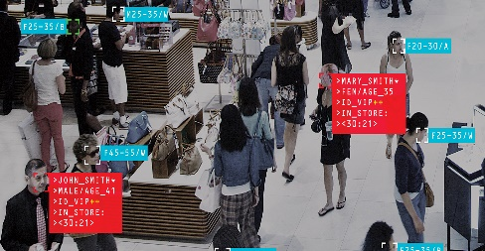
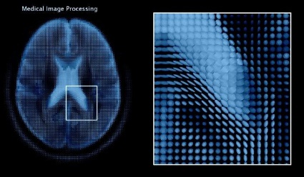
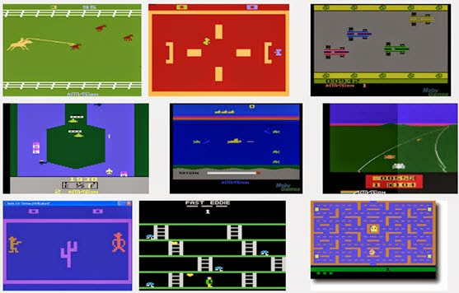
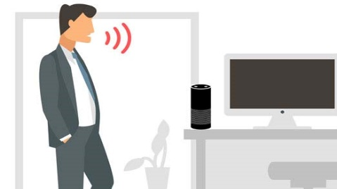
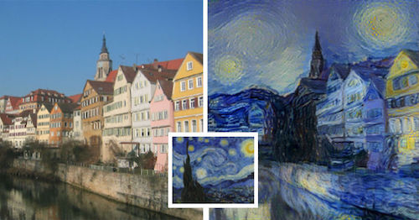
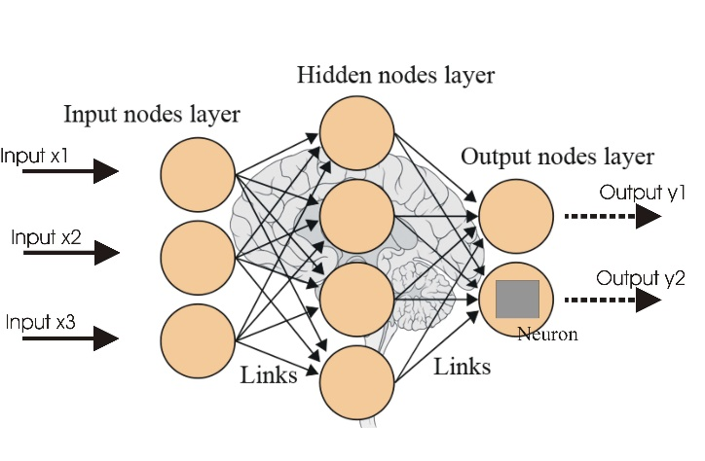
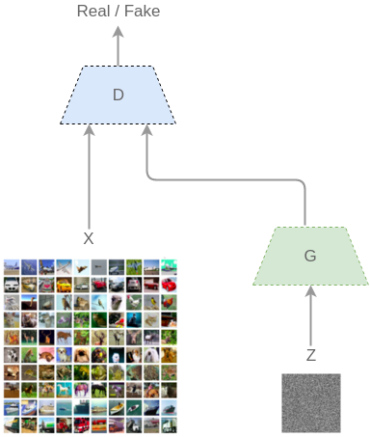
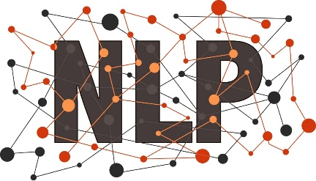
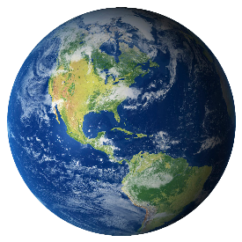
Self-driving
Surveillance detection
Translation
Medical diagnostics
Game
Deep Learning
Personal assistant
Art
Image recognition
Speech recognition
Natural language
Generative model
Reinforcement learning
Notes:
我们首先来大概了解一下深度学习。深度学习是机器学习的一个分支。它跟传统机器学习的一个主要区别在于它所使用的模型是人工神经网络。人工神经网络是借鉴了人脑结构的一些特点，比如神经元和突触，设计而成的。到目前为止，深度学习已经在许多技术领域被证明是非常有效，比如图像和语音识别，自然语言处理，强化学习等等。有些已经达到甚至超越人类的水平。这进而使得它在近些年，已经部分成功的或者是很有希望成功的被应用在许多我们生活的实际场景中，比如自动驾驶，安防，翻译，医疗等等。

Slide 3
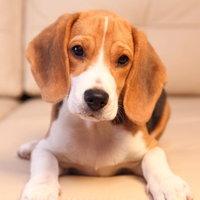
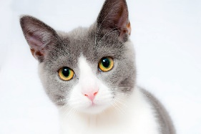
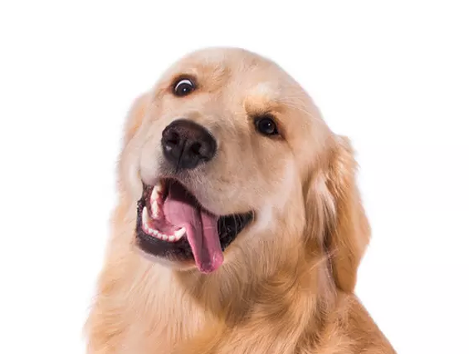
Deep Learning Approach
Cat
dog
Dog
cat
honey badger
Raccoon
$$w_{1}$$
$$w_{2}$$
$$w_{3}$$
$$w_{4}$$
$$w_{5}$$
loss
Errors
$$\frac{derror}{dw_{1}}$$
$$\frac{derror}{dw_{2}}$$
$$\frac{derror}{dw_{3}}$$
$$\frac{derror}{dw_{4}}$$
$$\frac{derror}{dw_{5}}$$
Dog
Notes:
那接下来我们用一个图像分类的例子来解释一下深度学习大概是如何工作的。首先我们有大量的标注过的图片数据。我们把这些图片作为深度神经网络的输入，通过神经网络，进行一个前向的计算，输出一个预测的分类。神经网络的每一层由神经元和连接神经元的边构成。边上有权重，也就是神经网络的模型参数。把模型参数看成变量，这个神经网络其实就是将输入转换成预测分类的函数。预测的分类和实际的分类比较一下会得到一个loss也可以叫error。因为我们想最小化这个error，我们可以使用梯度下降的方法，利用微分的链式规则把梯度反向传播到各个权重上，然后对权重进行更新，就完成一次训练的迭代过程。迭代反复进行直到模型收敛。训练好的模型就可以用前向计算对给定的输入进行推理。

Slide 4
Many core concepts of deep learning were in place by the 80s or 90s!
Notes:
事实上深度学习中的很多核心的概念比如神经网络，反向传播等等并不是新的。很多是几十年前就已经被提出来的。那到底是什么使得深度学习在最近变得这么成功呢？

Slide 5
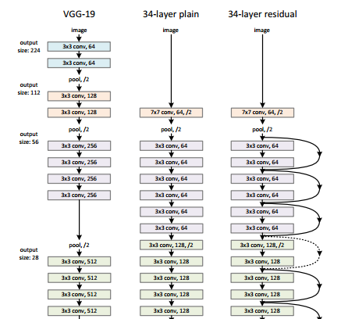
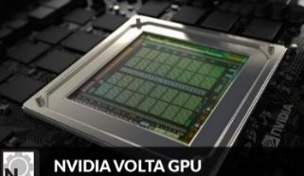
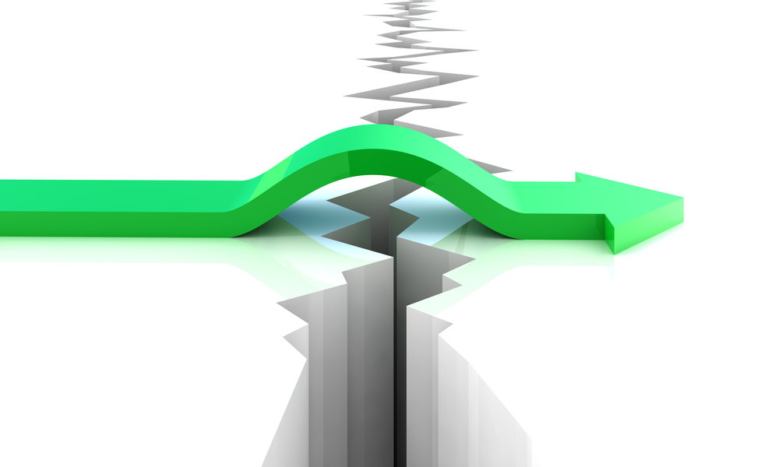
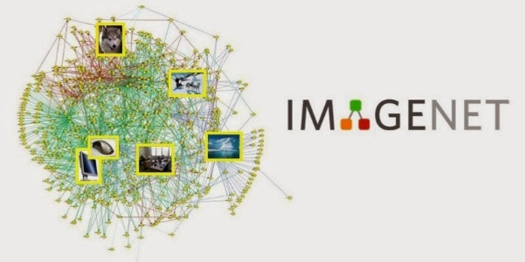
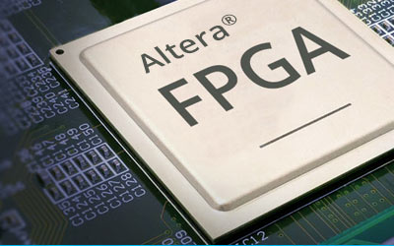
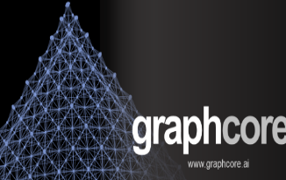
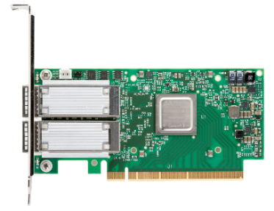
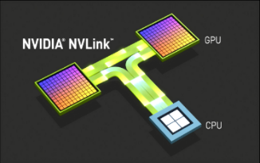
What Makes Deep Learning Succeed?
Improved models
14M images
RDMA
Massive labeled datasets
Massive computing power
Fast communication
Easy programming
Fast model evolution
Fast training and inferencing
Notes:
我们认为主要有几个方面的原因。首先现在互联网技术的发展使得人们有能力在一些领域里获得非常大量的有标注的数据。由于深度学习本质上是基于统计的科学，所以大的数据对于深度学习的效果是至关重要的。另一个重要的原因是模型和算法的快速发展。近些年来在人工智能相关的国际会议上每年都会有很多的新的神经网络架构和算法被提出来以改进深度学习的效果。那么第三个使得深度学习如此成功的原因是如今硬件计算和通信能力的飞速提升使得我们有能力处理这些海量数据。比如现在GPU的处理能力已经能够达到100TFLOPs，另外工业界还出现了许多定制化的处理器硬件专门优化深度学习的计算，比如google的TPU，还有一些创业公司例如寒武纪，graphcore等等。而现在基于infiniband的RDMA的网络可以达到100G的带宽和微秒级别的延迟。
那么模型和算法应该如何映射到强大的硬件资源上呢？这对于我们的软件系统有什么新的要求呢？那么首先，一个好的编程语言和编程抽象，对于模型和算法的开发者来说非常重要，这可以使他们能够快速的实现新的模型架构。另外，大量的这些新设计模型需要实际的训练和实验来证明其有效性。其中很多都会被淘汰。这是一个迭代的过程。这意味着快速的模型训练和推理对于深度学习模型的快速发展非常重要。

Slide 6
What Makes Deep Learning Succeed?
Improved models
Software frameworks
14M images
RDMA
Massive labeled datasets
Massive computing power
Fast communication
Easy programming
Fast model evolution
Fast training and inferencing
Notes:
而深度学习框架这样的系统软件就是跨越模型和硬件计算资源之间的鸿沟的桥梁。在当今的工业界，已经有许多深度学习框架被设计和实现出来。最著名的应该数google的tensorflow。概括来讲，这些系统软件最重要的两个目标，一个是提供好的编程抽象，另一个就是将深度学习算法中的计算映射成底层硬件资源上的高效执行。

Slide 7
Importance of Optimization for DL Computation
Data scale and model complexity → Prediction accuracy
A rule of thumb: larger data and model bring better accuracy
Training time → Period of model evolution
Training ResNet-50 on ImageNet dataset with single GPU takes more than one week.
Training GNMT on WMT’14 En→Fr takes a week on 96 GPUs
Inference performance → Serving latency
Many large scale models have to be deployed with hand-coded optimizations.
Image
Speech
8 layers
1.4 GFLOP
16% Error
152 layers
22.6 GFLOP
3.5% Error
80 GFLOP
7,000 hrs of Data
8% Error
465 GFLOP
12,000 hrs of Data
5% Error
2012
AlexNet
2015
ResNet
2014
Deep Speech 1
2015
Deep Speech 2
Notes:
那我想再用几个具体一点例子来让大家更直观的感受一下优化深度学习计算的重要性。第一，数据和模型的规模正在变得越来越大，更大的数据和模型通常会带更好的准确度。
第二，我们刚才说了模型训练的速度影响模型发展的迭代速度。那么目前是一种什么形式呢，最近的一些论文报告的数据是这样的。可以看到训练的周期非常长。这意味着我们想要快速的实验新的模型是非常困难的。
第三，模型推理的性能影响着服务的延迟。这意味着在工业界，许多大规模的模型在实际部署的时候都需要手工的重新实现和优化，从而增加了工程难度。

Slide 8
Representation of DL Computation
TensorFlow
x
y
z
$$∇x$$
$$∇y$$
*
*$g$
$$∇z$$
Data-Flow Graph (DFG)
as
Intermediate Representation
a
$$∇a$$
+
+$g$
b
$$∇b$$
Σ
Σ$g$
c
Notes:
既然优化深度学习计算非常重要，我们接下来就看看在深度学习系统中优化计算有什么样的挑战。不过在这之前，我们先简单了解一下深度学习计算在深度学习系统中是如何表示的。事实上，深度学习计算可以很自然的用数据流图来表示。我们用TF作为例子。首先我们定义三个tensor变量，x，y，z。然后我们进行一个前向计算得到c。这个前向计算就可以表示如图所示的数据流图。我们可以把c看成是x,y,z的函数，然后可以对它求导，这时系统会自动生成求导的反向计算的数据流图。有了这个数据流图，我们就可以给它输入数据来trigger相应的计算。

Slide 9
Deep Learning Framework Architecture
Front-end
Language Binding: Python, Lua, R, C++
Graph definition (IR)
x
*
+
y
w
b
Data-Flow Graph Optimizer
Execution Runtime
CPU, GPU, RDMA devices
Notes:
因此，一个典型的深度学习系统的架构就是这样的。
数据流图的优化器就是深度学习系统中优化计算的关键部分。

Slide 10
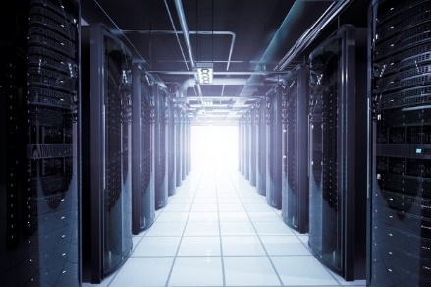
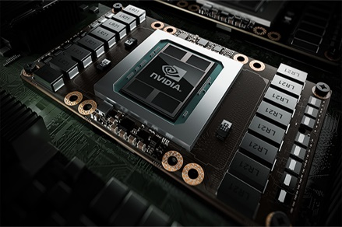
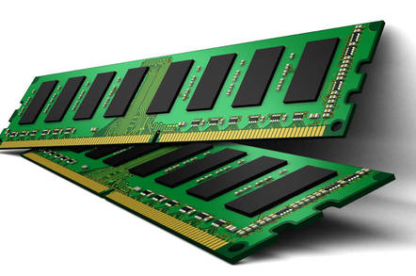
Challenges of DL Optimization in Framework
Communication efficiency over RDMA, NVLink
Zero-copy
Device placement of tasks
Shortening critical path and maximizing parallelism
Remove framework overhead, e.g., scheduling, kernel launch
Operator batching
Kernel fusion
Compiling tensor algebra
Model quantization and compression
Trading computation and memory consumption
Transparently apply over heterogeneous hardware environment
Local Efficiency
Memory Effectiveness
Scale-out
Notes:
那接下来我们来看看在深度学习系统中优化计算性能主要有哪些需要考虑的问题。当然我列出来的并不是全部， 只是目前我们比较关心的一些问题。大概可以分为三类问题。第一是我们应该如何scale-out深度学习的计算，也就是如何通过分布式来加速计算。在这个方向上我们主要考虑两个方面的问题。

Slide 11
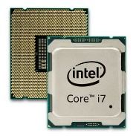
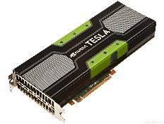
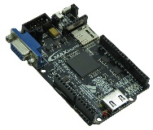
Project Wolong (卧龙)
Distributed Optimizer:
Fast distributed training over RDMA
Efficient communication through zero-copy
Automatic computation placement across devices and servers
Cost model with static and dynamic information
Intermediate Representation (IR)
x
*
+
y
w
b
Wolong Compiler & Optimizer Infrastructure
Local Optimizer:
Automatic operator batching and kernel fusion
Tensor algebra compiler
Highly efficient sparse operators
Seamless integration of model compression
Adaptive switch between dense and sparse operators
Execution backends

Slide 12
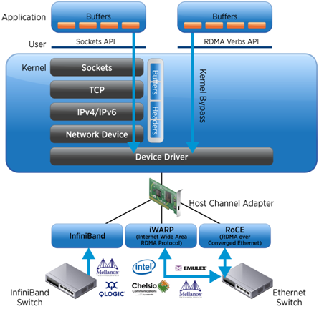
RDMA (Remote Direct Memory Access)
High throughput: 40-100 Gbps throughput
Low latency: 1-3 µs latency
Communication related computation overhead can be significant
Zero-copy communication for extreme efficiency
Notes:
Talked about RDMA, many people may be very familiar with. It is technique that allows direct memory access from the memory of one computer into that of another without involving either one's operating system. This permits high-throughput, low-latency networking.
Compared with traditional TPC/IP stack, it can save the overhead of data copy from multiple layers and the CPU overhead to processing the network packages.

Slide 13
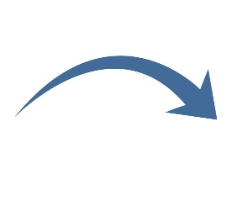
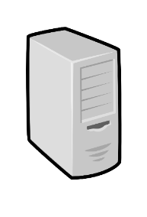
Distributed Optimizer of Wolong
Optimize distributed DAG to fully utilize the power of RDMA
Global graph optimizer
Dispatch
partitions
Partition graph
$$Y$$
*
Send
$$H$$
$$H$$
$$Y$$
$$σ$$
$$W_{2}$$
$$σ$$
*
*
*
Recv
$$W_{2}$$
Server₁
$$W_{1}$$
$$X$$
$$W_{1}$$
$$X$$
Server₀
Server₀
Server₁
13
Notes:
The goal of the global optimizer of Wolong is to optimize distributed graph execution to fully utilize the power of RDMA.
During the execution, when the front-end layers passes a user defined graph, the system first conduct a graph partitioning according to the participated workers, then dispatch each subgraph to corresponding servers.
During the partitioning, if there is an edge that is across two servers, we will insert a pair of send and recv nodes in this two partitions. This send/recv nodes are responsible for actual communication. In the execution, when the tensor data is ready in the sender side, the send node will send the tensor through underlying RDMA network to recv node, and when recv node got the tensor, it will passes it to downside nodes.

Slide 14
RDMA-based RPC in Existing Frameworks
Issues of general message passing library (e.g., RPC)
Designed for dynamic data structure
Unaware of data placement and size
Extra memory copy comes from data serialization and packet split/merge
$$H$$
Send
$$Y$$
$$σ$$
*
*
Recv
$$W_{2}$$
$$W_{1}$$
$$X$$
Application memory
Application memory
t
t
10x
RPC managed buffer
RPC managed buffer
t
t
t
Server₀
Server₁

Slide 15
Opportunities when deep-learning meets RDMA
One-side RDMA R/W; GPU-Direct RDMA
Efficient memory copy between host and device memory across servers
Enables to manage global memory similar to local one
Many data operated and transferred are dense tensors
Do NOT require variant data serialization/deserialization
Do NOT require extra batching since access pattern is already sequential
Many runtime information can be decided statically
Workload patterns are repeated across mini-batches in iterative way
Shape and placement of tensors can be known beforehand
Notes:
Thus we argue that there are some new opportunitys when appling RDMA in deep learning training. This is because:
The RDMA communication can be abstracted as a simple memory copy mechanism, which enable us to mange global memory cross servers similar to local one;
Many data in deep learning are dense tensors, which means we do not need
Many runtime ….

Slide 16
Distributed Optimizer of Wolong
Transfer statically placed tensor through one-side RDMA write
Phase I: graph analyzing
Phase II: graph execution
RDMA-based zero-copy communication
RDMA lib:
Conduct remote memory copy
Send
$$H$$
$$Y$$
$$σ$$
One-sided RDMA write
(Polling flag byte)
*
......
......
1
*
1
0
Recv
$$W_{2}$$
$$W_{1}$$
$$X$$
Source Tensor
Dest Tensor
Tensor Manager:
Detect the source tensor place
Re-allocate as RDMA memory
Tensor Manager:
Pre-allocate RDMA compatible receive tensor
Server₀
Server₁
16
Notes:
In our proposed protocol, we assume the shape of the transferred tensor is known before the graph execution.
The communication protocol include two phases, before the graph execution, the first phase is graph analyzing. In the sender side, we have a tensor manager which can detect the physical tensor place of the sending tensor. Then, it will reallocate this tensor as RDMA compatible memory. In the receiver side, since it knows the shape of receiving tensor, it will pre-allocate the receiving tensor as RDMA compatible memory as well, and it will share the tensor address to the send operator.
In the second Phase, when the graph is actually running. The Send operator just needs to issues a one-sided RDMA write, then the RDMA nic will directly copy the tensor from sender server’s memory to receiver side memory. In receiver side, the Recv operator will be continuously polling on a flag byte. When this byte value turning into 1, it means the whole tensor has been arrived, then Recv operator will simply pass the tensor data to downside operators.
As we can see, this protocol avoided any data copy in both sender and receiver side.
So far, we are assuming the transferred tensor shape is static and pre-known before running. However, in real DNN models, the shape of some tensors are dynamically changed during the runtime. For example, in a language model, the length of sentences are not the same. So we need to also support to transfer dynamically changed tensor.

Slide 17
Distributed Optimizer of Wolong
Transfer dynamically allocated tensor through RDMA write/read
Phase I: graph analyzing
Phase II: graph execution
Supports GPUDirect RDMA as well
Send
$$H$$
One-sided RDMA write
Tensor meta data
$$Y$$
$$σ$$
Tensor meta data
*
0
1
1
*
Recv
$$W_{2}$$
$$W_{1}$$
$$X$$
One-sided RDMA read
Allocate
......
......
Source Tensor
Dest Tensor
Server₀
Server₁
17
Notes:
For dynamically changed tensor shape, we also designed a protocol to efficiently transfer the tensor through using an one-sided RDMA write and an one-sided RDMA read.
This protocol also has two phases. In the graph analyzing phase, in the receiver side, since we don’t know the shape of receiving tensor, thus we only allocate a meta data buffer, which is used to record the shape information of the receiving tensor.
Then going into the graph execution phase, in the sender side, when a Send operator is ready to send the source tensor, it first fills the tensor shape information into a tensor meta data, then use one-sided RDMA write to transfer the shape information to receiver side. The Recv tensor will also continuously poll the flag byte until it received the meta data. Based on the shape information in the meta data, it will allocate a receiving tensor with RDMA compatible memory, Then the Recv operator issues a one-sided RDMA read operation, and the RDMA NIC will directly copy the source tensor in remote memory to the receiver server’s memory. Finally, the Recv operator passes the tensor to downside nodes.
As we know, this protocol for dynamic tensor transferring also involves zero memory copy in both sender and receiver side. Currently, this mechanism also support GPUDirect RDMA in Wolong.
With GPUDirect, the tensor data can be directly transferred between GPU devices without need to go to CPU memory.

Slide 18
Global Optimizer: Performance Evaluation
Improve training throughput, convergence speed and scalability
2-3x speed up
* Experiments are conducted on 8 servers 8 Nvidia GTX 1080 GPUs; The translation model uses WTM’15 datasets;
Notes:
Now let’s look at the performance of the global optimizer.
To do the evaluation, we integrates the Wolong optimizer into an existing framework,Tensorflow. We first compare Wolong with default TensorFlow on a set of deep learning benchmarks, which include both CNN, RNN, and fully connected models. We conduct the experiments on a 8 server cluster with RDMA equipped. Both TensorFlow and Wolong are running on the same network. The y-axis of the figure shows the training throughput, the larger the better. As the figure shows, Wolong can outperform TensorFlow from 1.8x to 8.1x for different workloads.
We also compared the Wolong and TensorFlow on a real sequence-to-sequence translation model using public datasets, the x-axis is the training time and the y-axis is the perplexity, which measure the convergence score, the lower the better. As we can see, Wolong can speed up the training speed by around 2 to 3 times faster than TensorFlow.

Slide 19
Project Wolong (卧龙)
Distributed Optimizer:
Fast distributed training over RDMA
Efficient communication through zero-copy
Automatic computation placement across devices and servers
Cost model with static and dynamic information
Intermediate Representation (IR)
x
*
+
y
w
b
Wolong Compiler & Optimizer Infrastructure
Local Optimizer:
Automatic operator batching and kernel fusion
Tensor algebra compiler
Highly efficient sparse operators
Seamless integration of model compression
Adaptive switch between dense and sparse operators
Execution backends

Slide 20
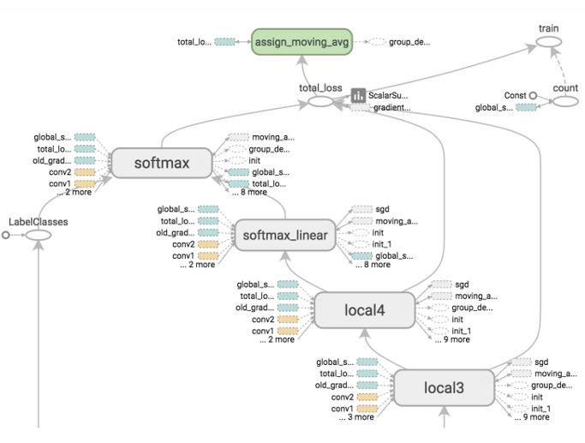
Why Operator Batching and Kernel Fusion?
Fine-grained operators introduce performance issues
DFG scheduling overhead
kernel-launch overhead
Data transmission overhead cross kernels through device memory
Notes:
Before introduce our compiler, we first look at what’s the problem of existing framework when executed on a single GPU.
The right figure is a example data-flow graph of a typical dnn model. As we can see, the graph is composed of many operators. In practice, a typically DNN model may have large than thousands of nodes. Most of these operators are very small operators.
If a graph is composed by such kind of fin-grained operatoers, it will introduce significant performance issues. This is mainly because the small operator will have constant scheduling overhead, kernel launch overhead, and data transmission overhead across kernels.
To demonstrate this case, we compared a LSTM network(which includes abount hundreds of nodes) execution time in TensorFlow, and our hand optimized implenetaion, which fuse all the operators into a single kernel. The results show that if we fusing the small operators into a large one can significantly improve the performance, for example, in the LSTM case, we can gain more than 40 time improvement.
Thus, we need a automated graph optimizer which can automatedly conduct such kind of optimizations.
Wolong compiler is designed for this purpose. currently Wolong can conduct automated operator batching and kernel fusion, as well as static memory placement optimization.

Slide 21
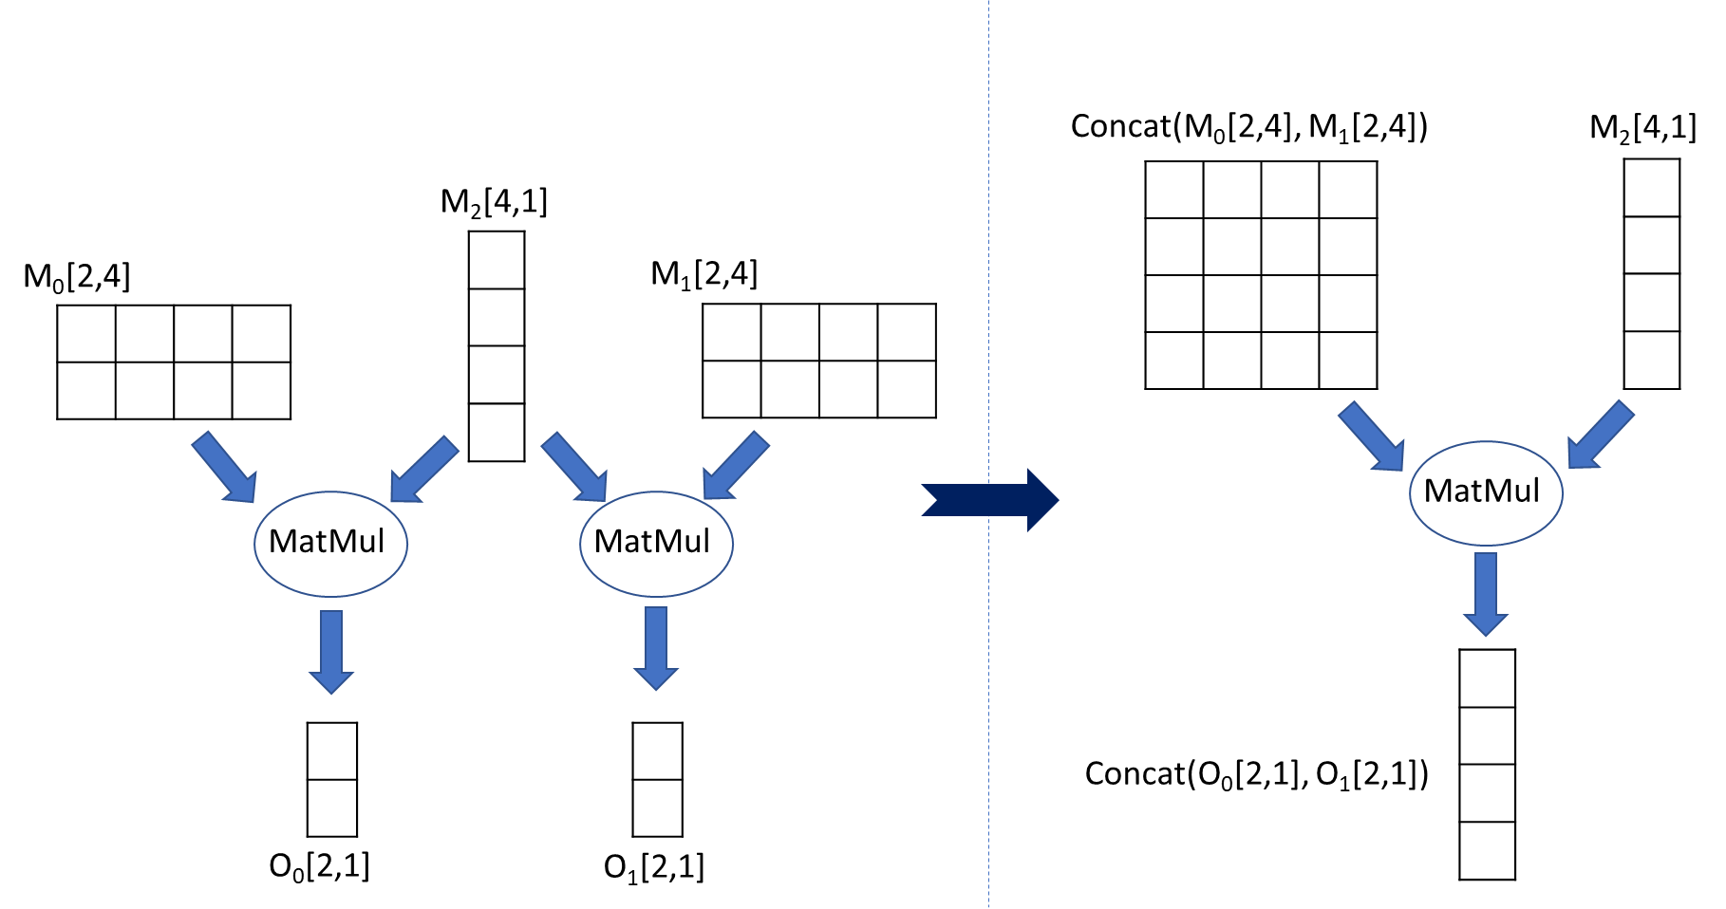
Operator Batching: Matrix Multiplication
Batch same-type operators to leverage GPU massive parallelism
h_{t}
+
×
×
$$σ$$
$$σ$$
$$tanh$$
+
+
+
M
M
M
M
M
M
R_{f}
R_{o}
R_{z}
h_{t-1}
x_{t}
W_{f}
W_{o}
W_{z}
Data-flow graph of a GRU cell
Notes:
First, let first look at the operator batching.
Generally, when executing a data-flow graph on GPU, if there are some operators with same type but different input data, we can batching them as a single operator, so as to more efficiently leverage GPU’s massive parallelism.
For example, in the right figure which is a GRU cell network, we can see there are two groups of matrix multiplication operators in the graph. In each group, the matMul operators are sharing one same input and with another different inputs.
According to the properties of matrix multiplication, if two matmul operator share one same input, we can cancat the other inputs to make it as a single larger matmul operation.
Based on this rule, we can batching the operators in each group, can transfer the graph into a new graph, which can be more effceitly exected on GPU.

Slide 22
Operator Batching: Matrix Multiplication
Batch same-type operators to leverage GPU massive parallelism
h_{t}
h_{t}
+
+
×
×
×
×
$$σ$$
$$σ$$
$$tanh$$
$$σ$$
$$σ$$
$$tanh$$
+
+
+
+
M
M
M
M
M
M
M
M
R_{f}
R_{o}
R_{z}
h_{t-1}
x_{t}
W_{f}
W_{o}
W_{z}
R
h_{t-1}
x_{t}
W
Data-flow graph of a GRU cell

Slide 23
Automatic Operator Batching
How to decide which operators to merge
Computation equivalence
Summarize a series of math rules, e.g., associativity
Operator concurrency
Dependent operators cannot be merged
Expected start time of operators
If one operator can start much earlier than the other, they should not be merged
Merge orders with maximal benefit is a global opt problem
If both OP_{A}, OP_{B} and OP_{A}, OP_{C} can be merged, merging OP_{A} with OP_{B} may lead to losing future merge opportunities

Slide 24
Kernel Fusion
Operator-merging for different operators
Further decrease the kernel-launch overhead
Need to fuse different kernel code into a single one
Can even fuse dependent operators
Pointwise kernels can be fused without synchronization
E.g., pointwise matrix Mul, Add, and Activations like Sigmoid
Fusing non-pointwise kernels requires special sync in GPU
Need compiler technologies to automatically generate fused kernel code
h_{t}
Kernel
+
×
×
$$σ$$
$$σ$$
$$tanh$$
+
M
M
R
h_{t-1}
x_{t}
W
Data-flow graph of a GRU cell
Notes:
The second optimization techniques is called kernel fusion. Different with operator batching, the kernel fusion can fuse different operators into a single kernel.
For example, after applying the operator batching on the GPU cell graph, we can further fuse the reset operators in to a single kernel function, so as to avoid the overhead introduced by the fine-grained operators.
Unlike the operator batching, kernel fusion can even fuse dependent operators. We currently supports two kind of operators: pointwise and non-pointwise.
The kernel fusion needs compiler ….

Slide 25
Example of Kernel Fusion
CodeGenBinary<Add>(“temp0”, B[idx]”)
CodeGenUnary<tanh>(“temp1”)
CodeGenUnary<sigmoid>(“A[idx]”)
A
B
//kernel code generated by Wolong compiler
__global__
void kernel_0(float *A, float *B, float *C) {
int idx = blockIdx.x * blockDim.x + threadIdx.x;
if (idx < num_elements) {
Code generation templates
$$σ$$
//template for unary op code generation
template <typename Op>
string CodeGenUnary(string v) {
return Op.str() + “(” + v + “);\n”;
}
$$+$$
$$tanh$$
float temp0 = sigmoidf(A[idx]);
float temp1 = temp0 + B[idx];
C
float temp2 = tanhf(temp1);
//template for binary op code generation
template <typename Op>
string CodeGenBinary(string v1, string v2) {
return v1 + Op.str() + v2 + “;\n”;
}
C[idx] = temp2;
}
}
…

Slide 26
Code Generation Challenges
Thread tiling optimization
Number of threads that each phase needs
Thread mapping based on global information
Intermediate results placement
Use faster memory to transmit data
Register/ shared memory/ device memory
Decide the fusion granularity
Too large kernel may lead to low occupancy
Iterative compiling and code re-generating
Synchronization
phase1
Device memory
phase2
register
phase3
shared mem
barrier
phase4
Notes:
In the kernel fusion, we still have to resolve many research challenges when doing the code generation:
For example,

Slide 27
Performance: batching matrix-multiplication and fusing pointwise kernels
Speed up DNN model inference on benchmarks and real model
81%
46%
Experiments are conducted on Nvidia GTX 1080 GPUs; Dictation model and the test dataset are from Microsoft internal production team
Notes:
This is the preliminary evaluation results for Wolong compiler.
We tested the compiler on two RNN benchmarks, LSTM and GRU. We compared the performance with default TensorFlow and XLA, which is Google’s compiler for deep learning. The y-axis in the figure is running time. As we can see our preliminary version has already outperformed XLA and the default TensorFlow. For the current TensorFlow, we can speedup by more than 2X.
We also evaluated the Wolong compiler on a inference model from Microsoft internal production team, which is a language model. This figure plots the different percentiles latency of TensorFlow, XLA and Wolong on real testing datasets. If we take the 99 percentile latency, Wolong can reduce the inference latency than TensorFlow by 81% and XLA by 46%.

Slide 28
Tensor Algebra Compiler
$$C_{ij}=\sum_{k}{A_{ik}B_{kj}}$$
Hand-optimized (compound) operators requires tremendous efforts
Large search space in computation scheduling
Combinatorial explosion of compound operations
Existing compiler frameworks
Halide, Taco, tvm
Still need improvement on optimization for GPU and sparse operators
Fusing hand-optimized operators vs. compiling compound operators

Slide 29
Optimization by Model Compression
Model has redundancy
Model Pruning
Dense to Sparse

Slide 30
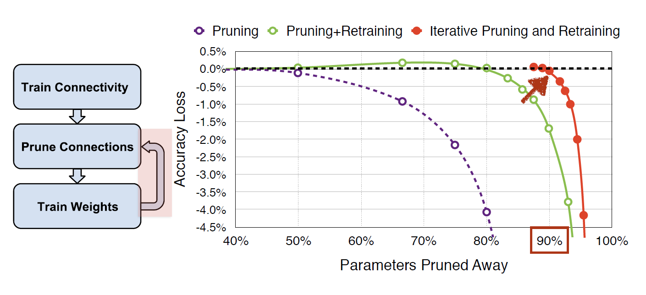
Iteratively Retrain to Recover Accuracy

Slide 31
Remaining Issues
How to make the entire process automated and convenient?
How to accelerate operators on sparse data?
Can we even accelerate training?

Slide 32
Efficient Sparse Operators
Unstructured Sparsity vs. Structured Sparsity
Sparsity: 69%
Sparsity: 69%
Sparsity: 69%
2.5
7.3
0.1
1.5
0.0
0.1
1.5
0.3
2.5
7.3
0.1
1.5
0.0
0.1
1.5
0.3
2.5
7.3
0.1
1.5
0.0
0.1
1.5
0.3
0.5
0.7
4.3
0.9
0.5
0.0
0.8
4.5
0.5
0.7
4.3
0.9
0.5
0.0
0.8
4.5
0.5
0.7
4.3
0.9
0.5
0.0
0.8
4.5
0.0
0.0
0.5
8.5
0.1
0.0
2.5
0.5
0.0
0.0
0.5
8.5
0.1
0.0
2.5
0.5
0.0
0.0
0.5
8.5
0.1
0.0
2.5
0.5
1.4
0.2
3.7
0.5
0.5
0.2
0.7
9.5
1.4
0.2
3.7
0.5
0.5
0.2
0.7
9.5
1.4
0.2
3.7
0.5
0.5
0.2
0.7
9.5
0.6
7.5
0.2
0.5
5.4
7.5
0.0
0.0
0.6
7.5
0.2
0.5
5.4
7.5
0.0
0.0
0.6
7.5
0.2
0.5
5.4
7.5
0.0
0.0
0.0
0.2
7.5
0.6
0.3
2.5
0.2
0.1
0.0
0.2
7.5
0.6
0.3
2.5
0.2
0.1
0.0
0.2
7.5
0.6
0.3
2.5
0.2
0.1
0.1
0.1
0.9
9.2
0.5
0.0
0.1
3.5
0.1
0.1
0.9
9.2
0.5
0.0
0.1
3.5
0.1
0.1
0.9
9.2
0.5
0.0
0.1
3.5
0.0
0.5
3.7
0.5
0.2
0.1
5.7
0.8
0.0
0.5
3.7
0.5
0.2
0.1
5.7
0.8
0.0
0.5
3.7
0.5
0.2
0.1
5.7
0.8
Point-wise pruning
Random access
Vector-wise grouping
Benefit SSE/AVX for CPU
Block-wise grouping
Benefit block tiling for GPU

Slide 33
Effectiveness of Structured Sparsity

Slide 34
Accelerating Training with Sparse Operations
DSD: Dense-Sparse-Dense Training for Deep Neural Networks [Han et al. ICLR 2017]
Adaptively switch between dense and sparse operators

Slide 35
Conclusion
Optimizing deep learning computation is important
Automatic optimization in DL framework is more important
There are still challenges and opportunities to achieve higher efficiency

Slide 36
Backup

Slide 37
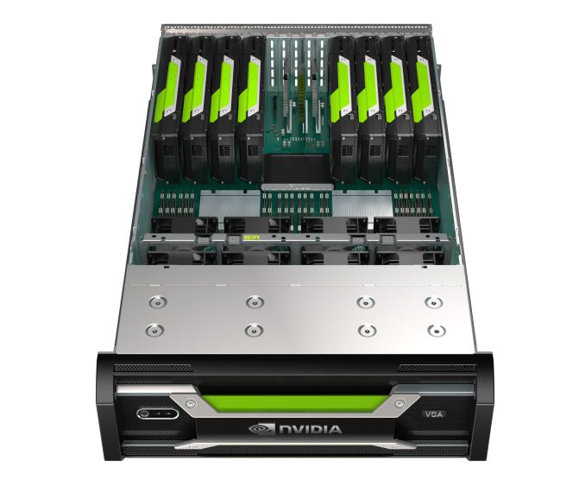
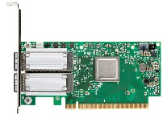
Modern GPU Cluster Architecture
How to execute a data-flow graph in a distributed GPU-cluster?
Server 0
QPI bus
Server 1
QPI bus
PCI-Express Switch
PCI-Express Switch
PCI-Express Switch
PCI-Express Switch
PCI-Express Switch
PCI-Express Switch
PCI-Express Switch
PCI-Express Switch
RDMA
Notes:
Let’s first look at the typical architecture of modern GPU cluster.
Commonly, ech server will equipped with 8 GPU cards, and they are connected by several PCI-E switches in a tree based topology. Each server will also equip with server RDMA nics, which is used to do crosss-server communication. Each communication path will have different throughput and latency.
The first question about distributed training is how to execute a data-flow graph in such a distributed GPU cluster?

Slide 38
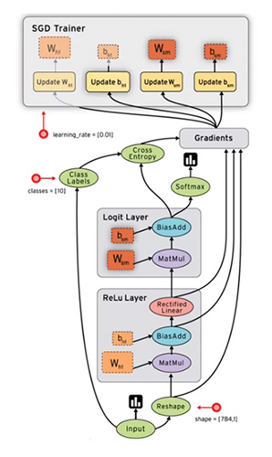
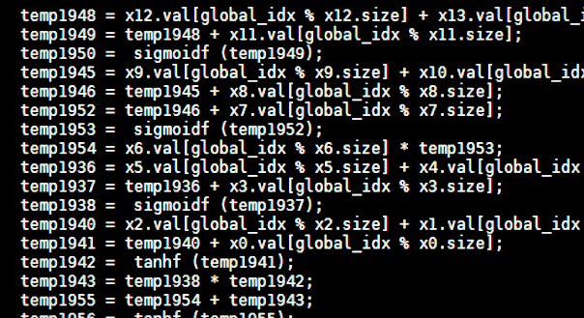
Local Optimizer of Wolong
Kernel fusion and operator batching execution workflow
Detect fusion group
Generate code
Rewrite graph
LSTM
Sigmoid
Mul
Output
Relu
BiasAdd
FusedKernel
MatMul
MatMul
Reshape
MatMul
Input
Operator batching
JIT compile
FusedKernel
Input graph
Multiple rounds optimizations
Notes:
In summary, let’s look at the overall workflow of the Wolong compiler.
The Wolong compiler takes input as a local graph. Once got a graph, it first detect the fusible operators to create a fusion group. In the fusion group, there are some special nodes, where these nodes are with the same types but taking different input tensors. For these node, we can batching them together to improve the execution efficiency. Thus the operator batching mechanism automatically detect and merge the operators into one for the same type.
Then, for the rest operators in the fusion group, we will generate device specific code for them and fuse them into a single kernel function. After that, Wolong call a just-in-time compiler to compile the code that can be running in the target device, like GPU. At last, we will rewrite the graph through replacing the original small operators by the compiled FusedKernel operator. Finally, we will have multiple rounds optimizations until there is no any further optimization opportunities or maximum rounds reached.
After the local compiling phase, the output graph will send to underlying execution runtime to do real execution.
Note that, the currently Wolong only supports element-wise kernel fusion, we are still working on fusing more different types of operators.

Slide 39
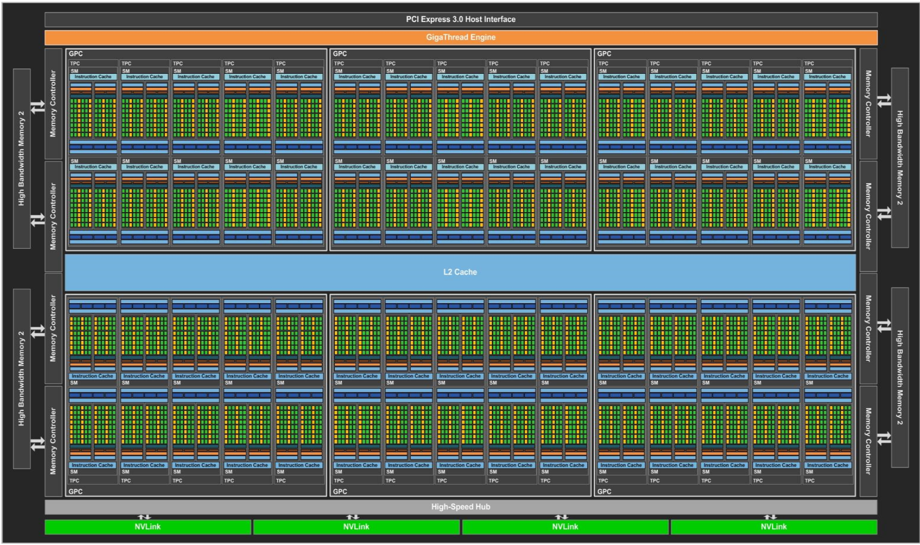
GPU Architecture
Notes:
Since this talk will mainly target to GPU, we first breily look at the GPU architechture.
As a comparison, we also show the CPU architecture.
In general, there are two major differs between CPU and GPU:
CPU have very few core, but each one is very complex. However, GPU often with handreds to thousands cores, however, each is very simple.
CPU is mainly targets to general workload, while GPU is good at high-throughput float-point computaions. This naturally fits the deep learning requirements.
This is the latest P100 architechtuer, it aleady has 3840 cores, and provide 9.3 teraFlops in total.

Slide 40
Combine Dataflow Graph with RDMA
Coupled with RDMA directly
Remove RPC overhead
No memory-copy/ (de)serialization
Challenges
Tensor place tracking
Handle dynamic changed tensor
$$H$$
Send
$$Y$$
$$σ$$
*
*
Recv
$$W_{2}$$
$$W_{1}$$
$$X$$
Application memory
Application memory
t
t
RPC managed buffer
RPC managed buffer
t
t
t
Server₀
Server₁
Notes:
Thus, we combine the dataflow graph in deep learning computation with RDMA, and proposed a new communication protocol. Which can completely remove the RPC layer. The tensor data can be directly copied to remote server in application memory space.
However, to achieve this, there are server chanllenges: likes, how to track the tensor’s physical placement, and how to handle dynamically changed tensor
I will introduce the detailes in the following slides.

Slide 41
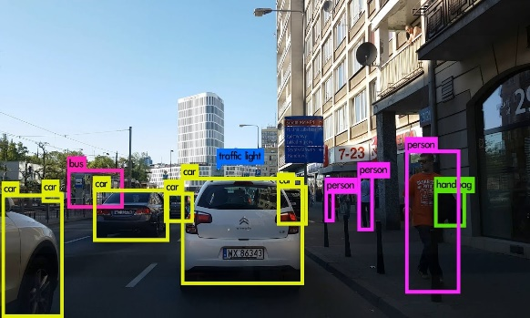
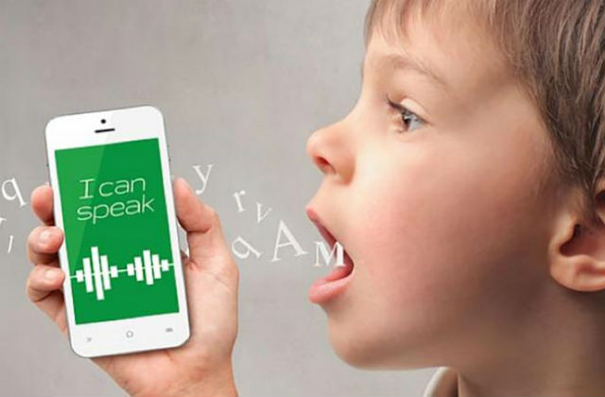
深度学习（深度神经网络）
Deep learning is changing our lives
Machine Translation
Object Detection
Speech Recognition
Feed Forward
$$W$$
$$X$$
$$Y$$
$$∆$$
$$η∆W$$
Back Propagation

