Slide 1
xLearn: High-Performance, and Scalable Machine Learning Package
xLearn: High-Performance and Scalable Machine Learning Package
Zhen Xiao
Zhen Xiao
zhenxiao.com/xlearn

Slide 2
http://www.domo.com/learn/data-never-sleeps-2

Slide 3
http://www.domo.com/learn/data-never-sleeps-2

Slide 4
http://www.domo.com/learn/data-never-sleeps-2

Slide 6
Deep Learning

Slide 7
Tree Model
LightGBM

Slide 8
What we are missing in open-source community？

Slide 9
CTR Prediction

Slide 10
The most visible and ubiquitous applications of
machine learning

Slide 11
Recommender Systems

Slide 12
Machine Learning Problems on
Large-Scale Sparse Data

Slide 13
Existing Machine Learning Packages
LibLinear LibFM LibFFM

Slide 14
All of the existing software …
X Jump into different package
X Cannot support Python and R
X Lack Flexibility
X Cannot maximize CPU utilization
X Cannot optimize cache access
X Cannot support out-of-core computing
X Cannot scale to distributed setting

Slide 15
Motivated by this, we introduce xLearn ..
Open source for one week and get 1000+ stars

Slide 16
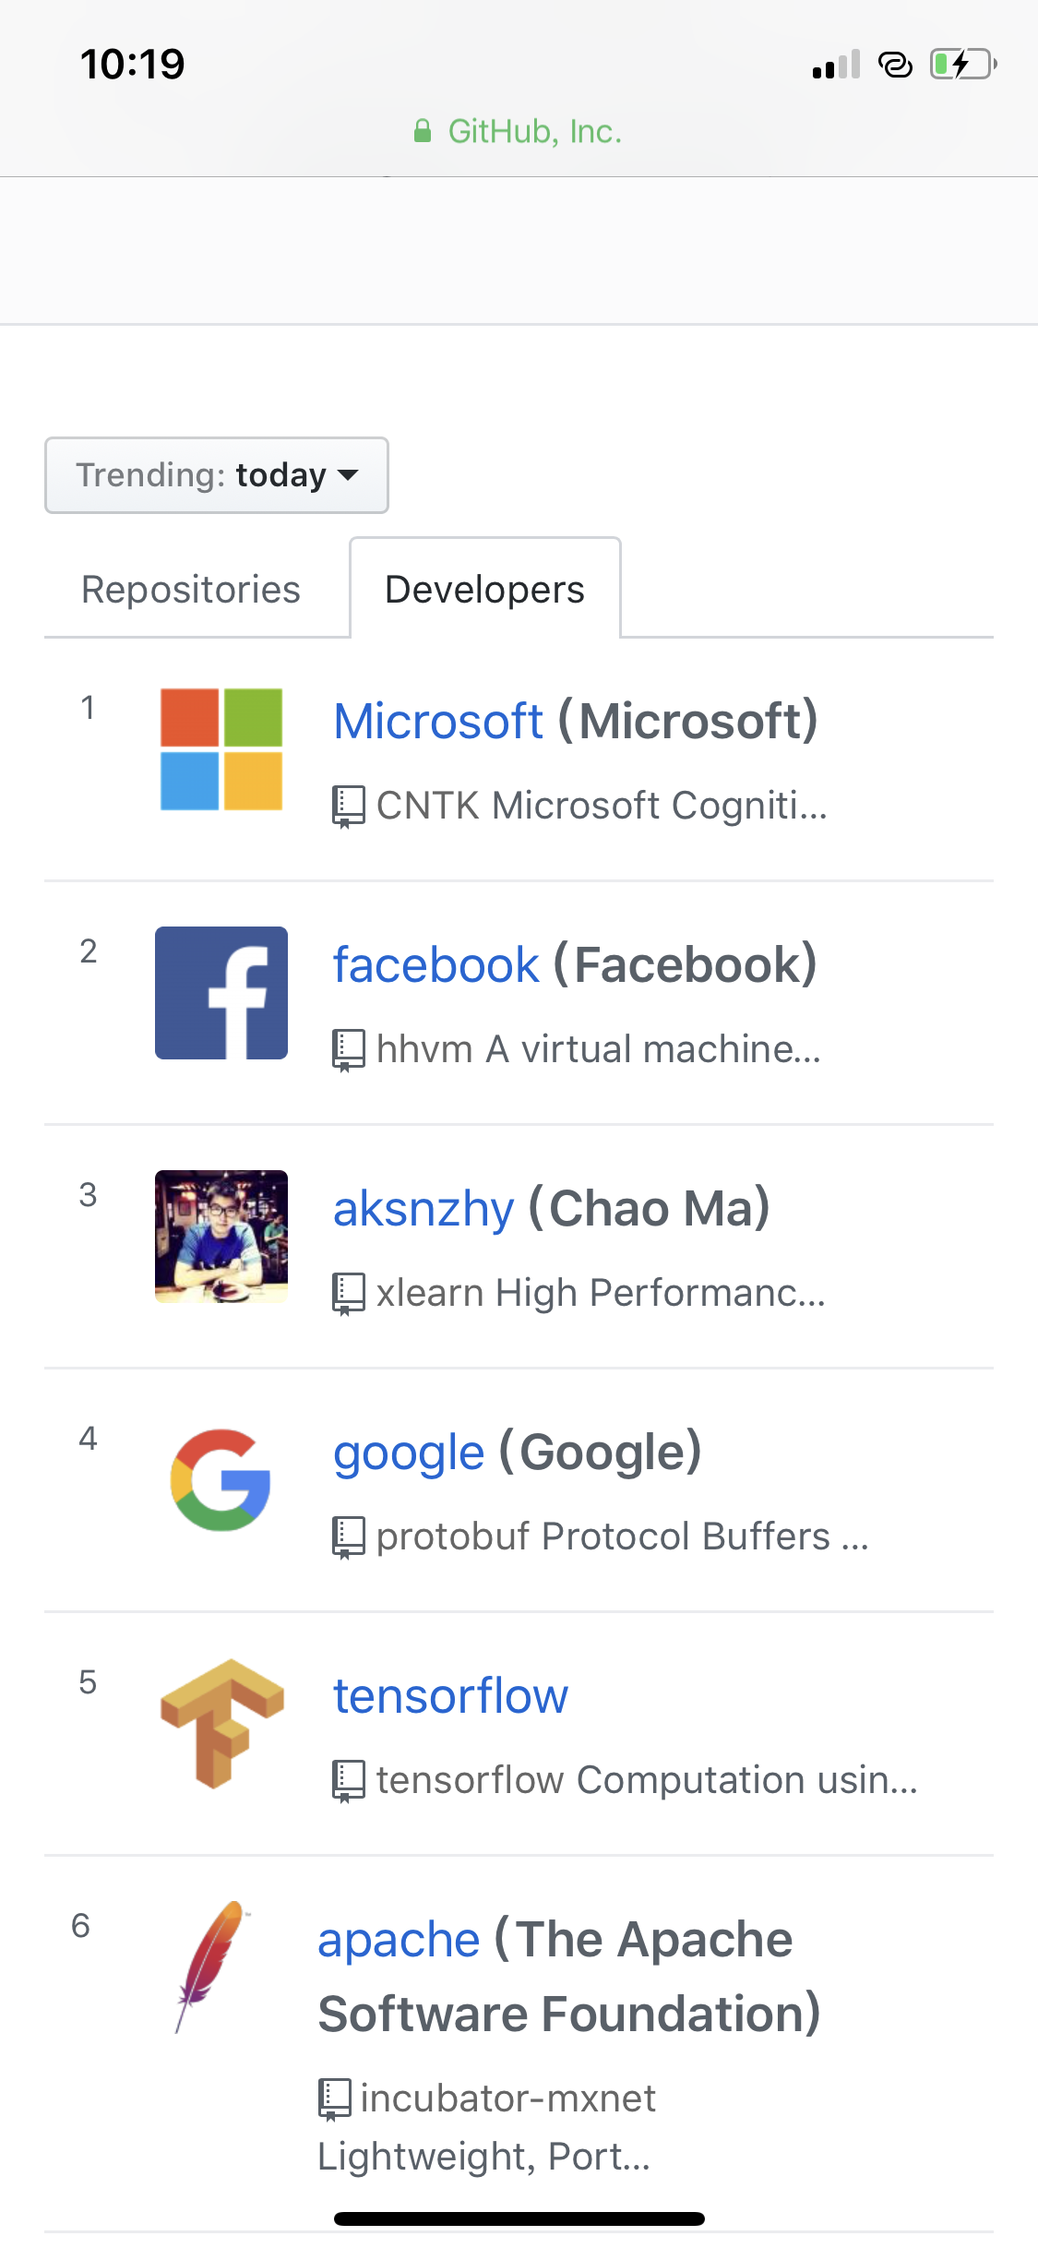

Slide 17
Ease-of-Use

Slide 18
API for Different Users

Slide 19
Installation
pip install xlearn

Slide 20
A Simple Python Demo

Slide 21
Flexibility: Building Machine Learning by Modules
Reader
Loss
Score
Updater
Distributed

Slide 22
Flexibility: Building Machine Learning by Modules
Different data source (local file or HDFS?)
Reader
In-memory Reader or On-disk Reader
Different File Format (csv or libsvm?)

Slide 23
Flexibility: Building Machine Learning by Modules
Classification: Log loss, Hinge Loss, Softmax …
Regression: Squared Loss, MAPE …
Loss
Ranking: NDCG…
Metric: Precision, Recall, AUC, F1 …

Slide 24
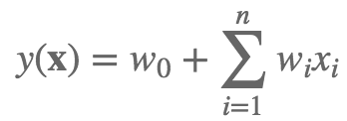
Flexibility: Building Machine Learning by Modules
Linear model:
Score
FM:
FFM:

Slide 25
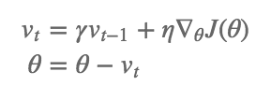
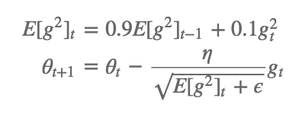
Flexibility: Building Machine Learning by Modules
SGD
Momentum
Updater
Adagrad
RMSprop

Slide 26
Performance

Slide 27
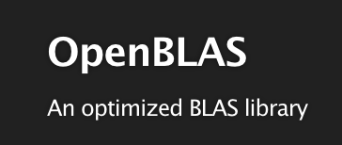
Vectorization
X
Existing vectorization library like OpenBLAS are
not optimized for sparse data.
Optimize our code by using SSE / AVX
instructions manually.

Slide 28
Cache Locality
Model vector
0
1
2
3
4
5
6
7
8
Gradient vector
0
1
2
3
4
5
6
7
8
Mixed vector
0
0
1
1
2
2
3
3
4
Avoid large gap in memory

Slide 29
Multi-thread: Hogwild！
Batch-0
Batch-1
Batch-2
Batch-3
Core-0
Core-1
Core-2
Core-3
Shared model
Lock-Free Training

Slide 30
Scalability

Slide 31
Out-of-Core Computing
On-disk
In-memory
Reader
Batch-0
Batch-0
Batch-1
Batch-2
Compute
Batch-3
Batch-4
Batch-5
Aync. pipeline can overlap I/O and computation

Slide 32
Distributed Training: Parameter Server

Slide 33
Asynchronous Execution
Parameter Server (Logical)
w₁
w₂
w₃
w₄
w₅
w₆
w₇
w₈
w₉
Machine 1
Iteration
Iteration
Iteration
Iteration
Machine 2
Iteration
Iteration
Iteration
Machine 3
Iteration
Iteration
Iteration
Iteration
Iteration

Slide 34
2-bit quantization
0.1 0.2 -0.4 -0.3 1.2 0.5
+0.25
-0.25
0 0 -0.25 -0.25 0.25 0.25
00 00 10 10 01 01
Reduce 4000x network overhead for sparse data !

Slide 35
Residual
0.1 0.2 -0.4 -0.3 1.2 0.5
0 0 -0.25 -0.25 0.25 0.25
0.1 0.2 -0.15 -0.05 0.95 0.25

Slide 36
Compared with other systems
Using Criteo CTR data

Slide 37
Scalability
Using Criteo CTR data

Slide 38
Thank You Questions?

