Slide 1
BestConfig: Tapping the Performance Potential of Systems via Automatic Configuration Tuning
ACM SoCC’17, 24-27 September
Yuqing Zhu¹, Jianxun Liu¹, Mengying Guo¹, Yungang Bao¹, Wenlong Ma¹,
Zhuoyue Liu², Kunpeng Song², Yingchun Yang²
¹Institute of Computing Technology, CAS
²Huawei

Slide 2
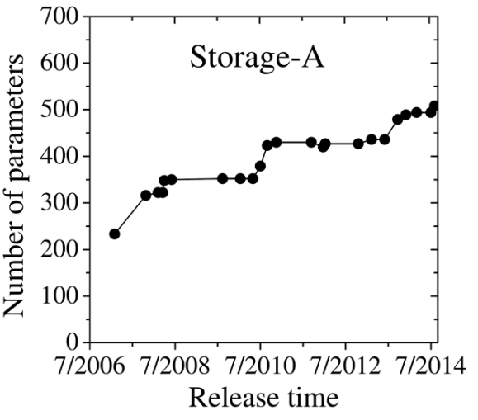
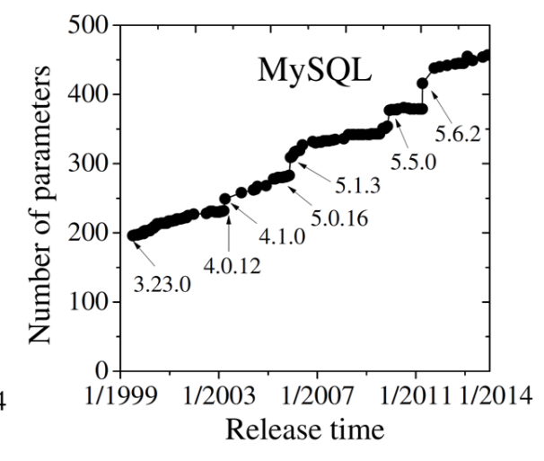
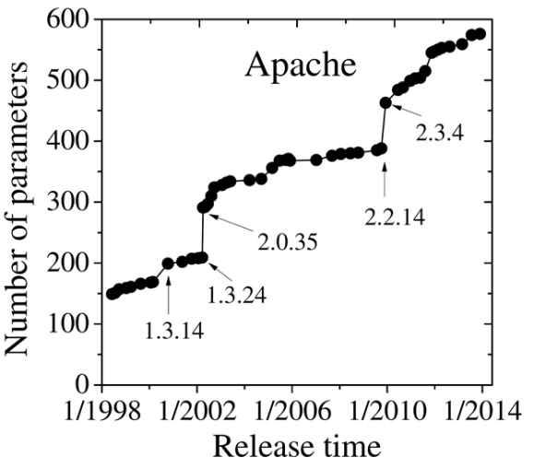
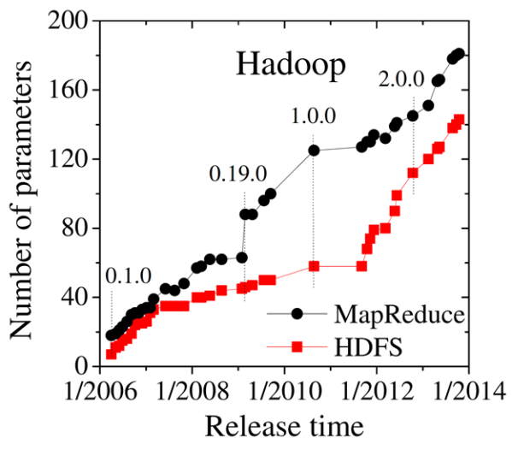
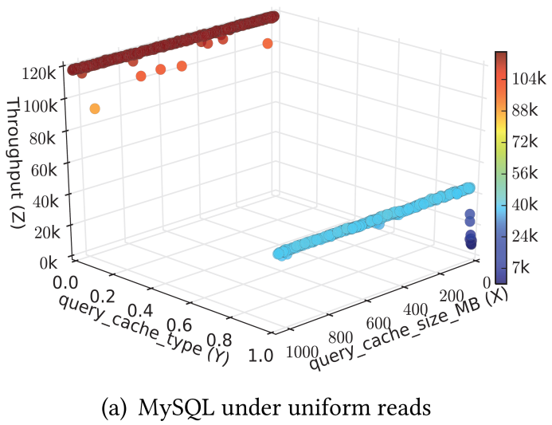
Automatic Configuration Tuning
More and more configuration parameters are provided, as systems aim to support a wide variety of use cases.
Hadoop: 180+; Spark: 230+; MySQL: 450+; PostgreSQL: 140+
A good configuration setting can greatly improve the system performance.
118184 ops/sec
9815 ops/sec
12 times!
T. Xu, L. Jin, X. Fan, Y. Zhou, S. Pasupathy, and R. Talwadker. Hey, you have given me too many knobs!: understanding and dealing with over-designed configuration in system software. In Proceedings of the 2015 FSE. ACM.
Notes:
HStore整理了174个参数，postgrel：138，mySQL：218个

Slide 3
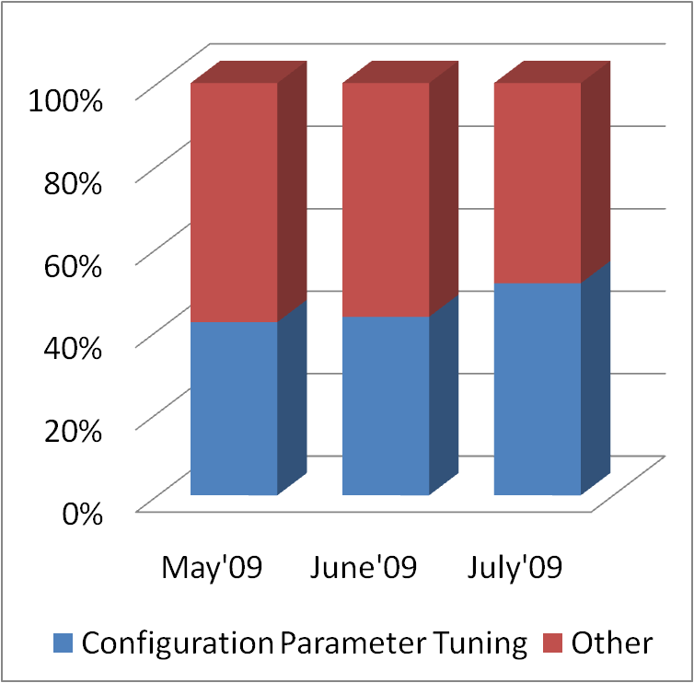
Motivation
Manual tuning: time-consuming and laborious
If heuristics are wrong, all efforts are in vain
Case study: 5 junior employees half a year, tuning MySQL
sample in the para space
Find heuristics
Adjust configuration settings
optimize
based on samples
collect (para-perf) samples
Monitor and observe
Run test(s)
Configuration tuning discussions:
Number of threads related to configuration tuning
vs.
other
under “PostgreSQL performance” mailing list
Thummala, Vamsidhar, and S. Babu. "iTuned: a tool for configuring and visualizing database parameters." ACM SIGMOD International Conference on Management of Data ACM, 2010:1231-1234.

Slide 4
Motivation
Tuning for web servers
RRS^{[Ye+, SIGMETRICS’2003]}, Smart Hill Climbing^{[Xi+, WWW’2004]}
Tuning for databases
iTuned^{[Duan+, VLDB’2009]}, OtterTune^{[Aken+, SIGMOD’2017]}
Tuning for Hadoop
Starfish^{[Herodotou+, SoCC’2011]}, Aloja^{[Berral+, SIGKDD’2015]}
Assuming the existence of large samples or a model
Not tuning solutions for general systems
Big data jobs can involve multiple processing tasks, requiring the support of multiple different systems, e.g., Hadoop+Hive
Co-tuning is needed, as any subsystems can be bottlenecks

Slide 5
Challenges
Dynamicity and complexity
Performance goals: latency, throughput, utilization, etc.
SUT (System Under Tune)
Workload
deployment environment: hardware, co-deployed software
And combinations
Yuqing ZHU, Jianxun Liu, Mengying Guo, Yungang Bao. ACTS in Need: Automatic Configuration Tuning with Scalability. Proceedings of the 8th ACM SIGOPS Asia-Pacific Workshop on Systems (APSys’17)

Slide 6
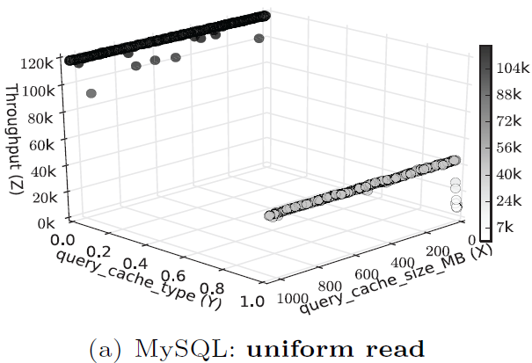
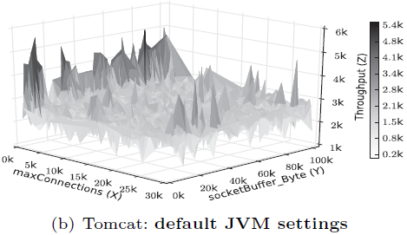
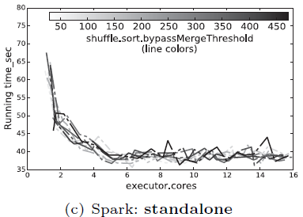
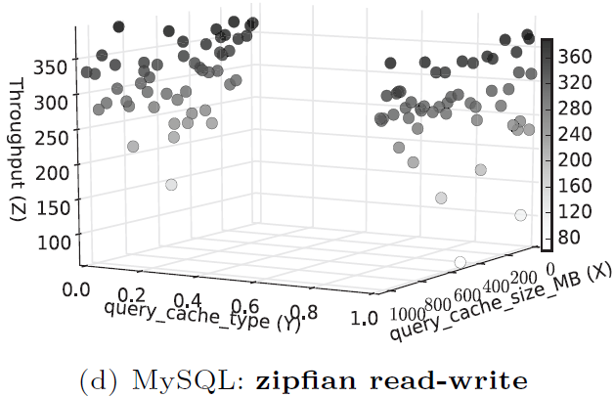
Challenges
Diverse performance models: SUT factor
Diverse performance models: workload factor

Slide 7
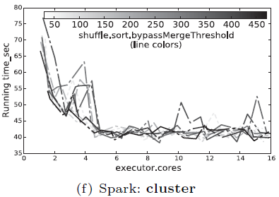
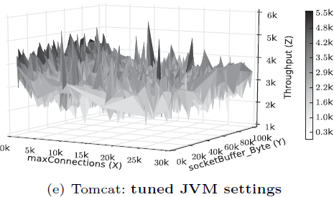
Challenges
Diverse performance models: deployment--hardware
Diverse performance models: deployment--software

Slide 8
Challenges
Dynamicity and complexity
Performance goals: latency, throughput, utilization, etc.
SUT (System Under Tune)
Workload
deployment environment: hardware, co-deployed software
And combinations
Costly Sample Collection
Sample collected from SUT in real deployment environment
Costly tests and collect; limited number of samples
➔Limited number of samples
A large number of configuration parameters
Hadoop: 180+; Spark: 230+; MySQL: 450+; PostgreSQL: 140+
Previous works: 10+
➔ High dimensional parameter space

Slide 9
BestConfig
The problem of Automatic Configuration Tuning with Scalability guarantees (ACTS)
To find, within a given resource limit, a configuration setting that can optimize the performance of a given SUT’s deployment under a specific workload
Scalability guarantees:
resource limit: performance improved on relaxed limit
configuration parameter set: evolved parameter set
SUT: various systems, possibly co-deployed
deployment environment: evolved hardware, software
workload: the diversity of workloads

Slide 10
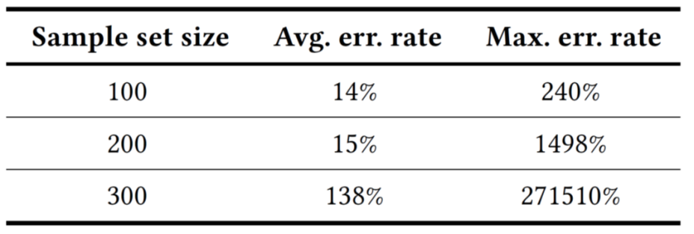
Infeasibility of Model-based Methods
COMT: Co-Training Model Tree^{[Guo+, IJCAI’2011]}
Semi-supervised, use unlabeled samples, for limited samples
GPR: Gaussian Process Regression, ituned^{[Duan+, VLDB’2009]}, OtterTune^{[Aken+, SIGMOD’2017]}
State-of-the-art

Slide 11
BestConfig: Design Overview
Performance goal/metric
Utility function
Various systems, workloads and deployment settings
Highly-extensible architecture
High-dimensional parameter space + limited samples
Scalable sampling method
Scalable performance optimization (PO) algorithm

Slide 12
Performance Goal
Possible performance metrics
throughput x_{t}
latency x_{l}
duration, …
Utility function
Example 1: f(x_{t}, x_{l})=x_{t}/x_{l}
Example 2:
the memory usage must not exceed the threshold x_{m}
Implementation
Implement the interface Performance

Slide 13
Highly-Extensible Architecture
Four key components
Loosely coupled through data flows
A closed-loop tuning process
Tune as long as the resource limit permits
Easy implementation
Scripts interacting with the SUT and the workload generator
Interfaces ConfigSampler and Optimization

Slide 14
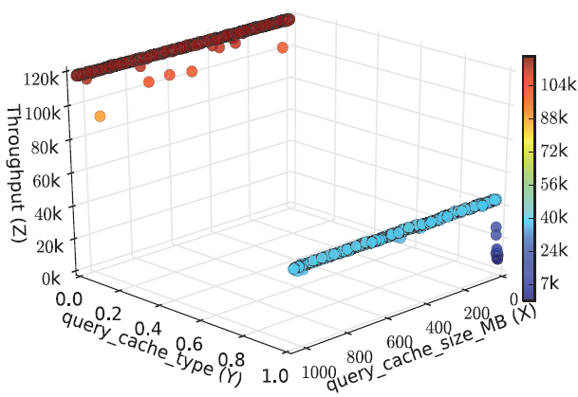
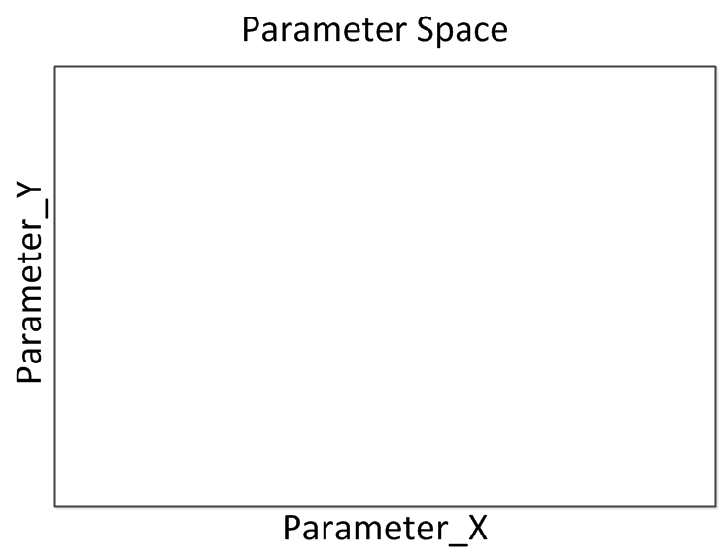
Divide & Diverge Sampling (DDS)
Sub-problem of sampling
Wide coverage over the high-dimensional space
Small enough to meet the resource limit
Scalable to a wider coverage on an expanded resource limit
Observation
the impact of an influential parameter’s values on the performance can be demonstrated through comparisons of performances, disregard of other parameters’ values
Sample for 6 tests

Slide 15
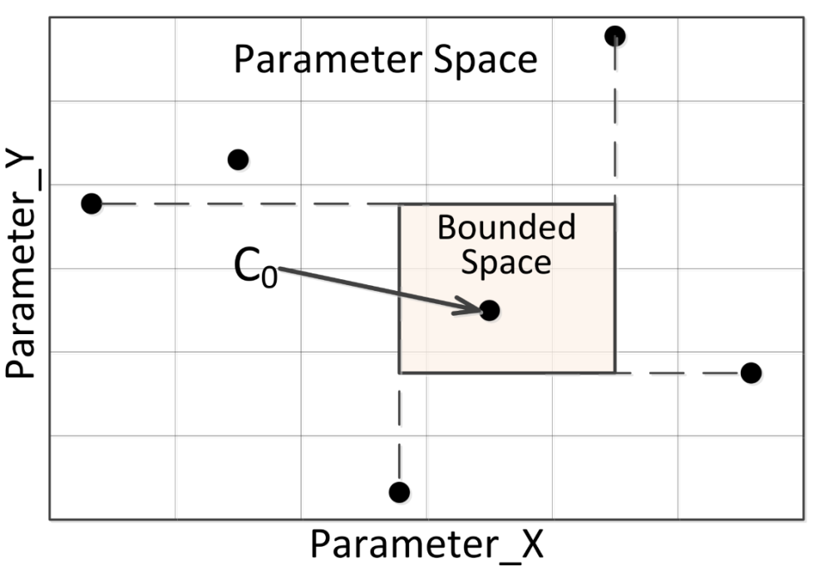
Recursive Bound & Search (RBS)
Sub-problem of performance optimization
Find an answer even with a limited sample
Find a better answer with a larger sample
Not stuck on local sub-optimum and possible to find the global optimum
Observation
It is highly probable that we find other points with similar or better performances around the point with the best performance in the sample.
RBS algorithm
Search the best setting in the sample set
If not exist, do step 3 for the whole space
Bound the unexplored subspace around the best setting
Invoke the sampling method to get a new sample set
Recursively go from the first step through the third step till the resource limit is reached

Slide 16
DDS & RBS
Combining DDS & RBS to form the solution
With randomness
With certainty to exploit the limited resource as far as possible
Wide coverage for DDS
Boundary made by RBS
DDS in the exploitation of RBS
Sub-spaces of a high-dimensional space remain HUGE
Guarantee coverage to exploit the limited resource
No fitted curves
Any guesses can be wrong given the limited samples and huge empty spaces
The above differentiate BestConfig from others
RRS, HillClimbing, genetic algorithm, curve fitting, …

Slide 17
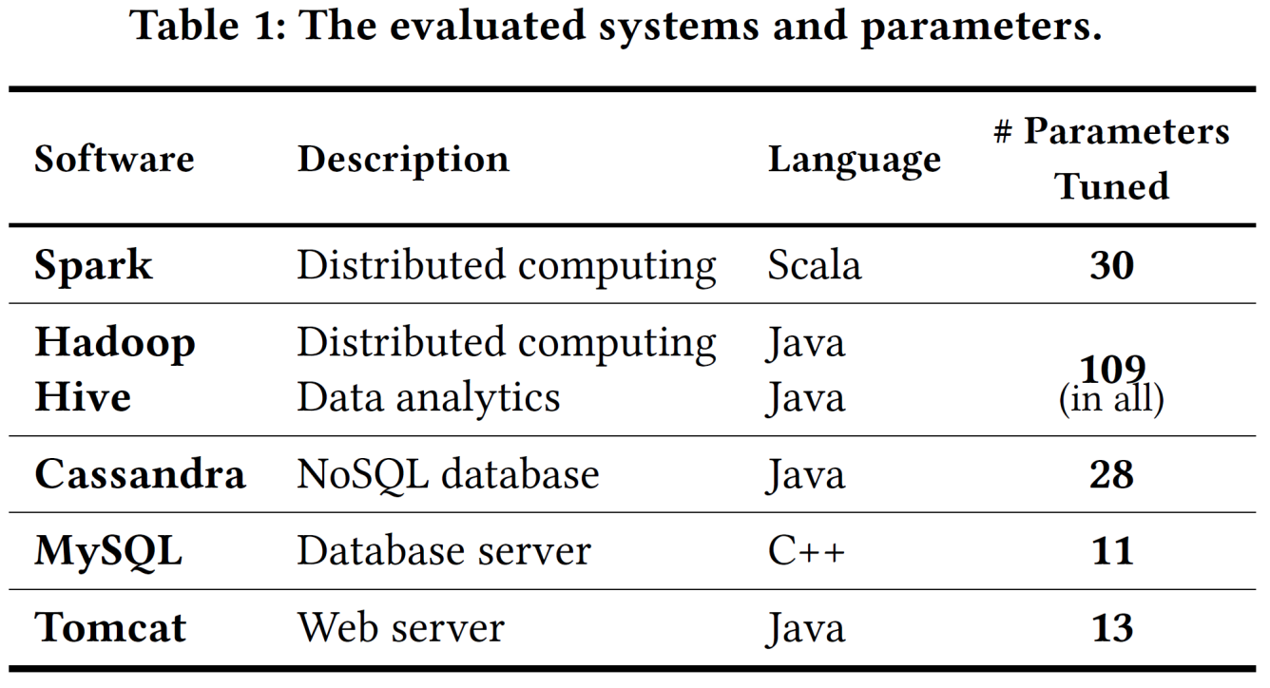
BestConfig: Experimental Settings
Six SUTs widely used in the cloud
Workload generators
HiBench, YCSB, SysBench, JMeter
Local clusters and Huawei Cloud+ clusters

Slide 18
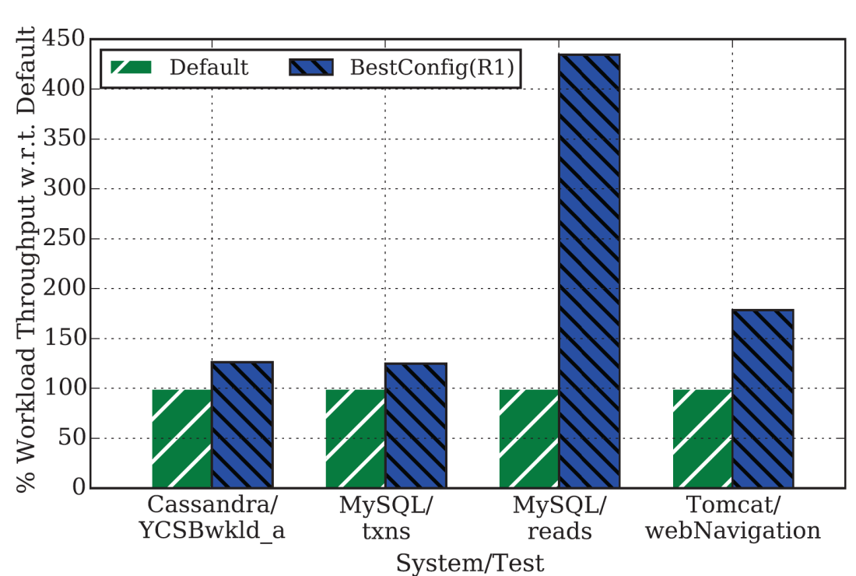
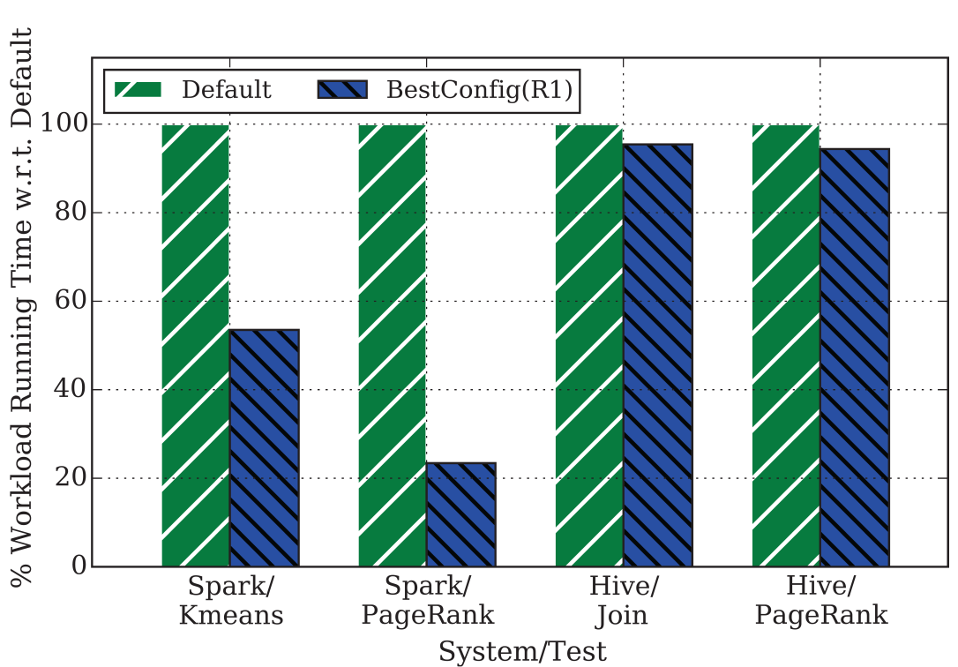
BestConfig: Tuning Results
Cassandra, MySQL, Tomcat, Spark, Hadoop+Hive
Maximum number of tuned parameters: 109
OtterTune^{[Aken+, SIGMOD’2017]} tuned ~20 parameters
Each tuned with 100 samples/tests only
OtterTune^{[Aken+, SIGMOD’2017]} requires an initial set of thousands
Other methods also require 2000+

Slide 19
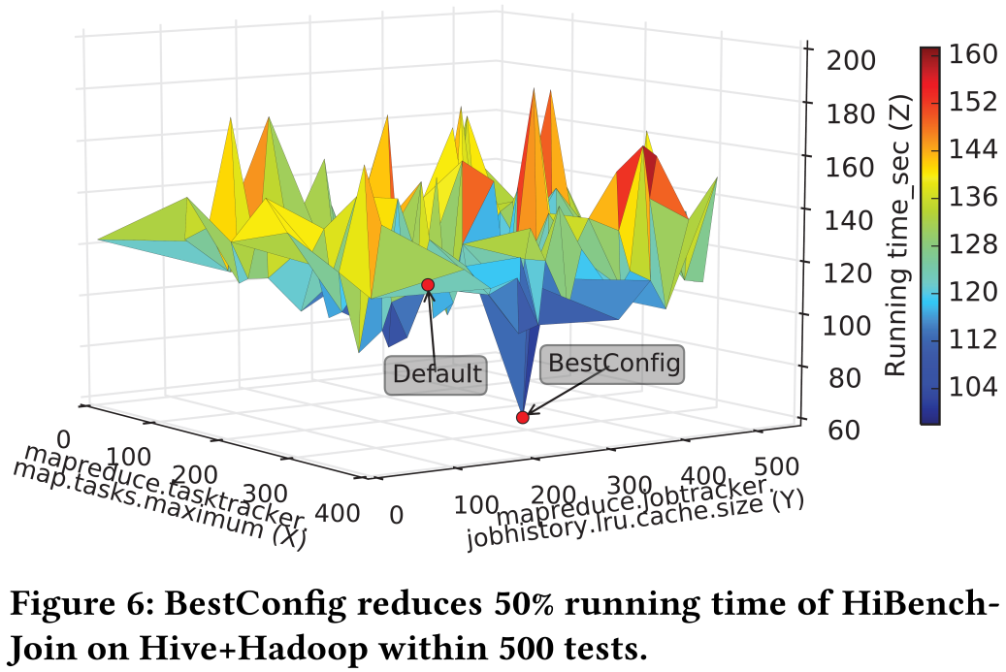
BestConfig: Tuning Results
Relaxing the resource limit
Increasing the number of tests: 100 ➔ 500
Performance speedup: 2X

Slide 20
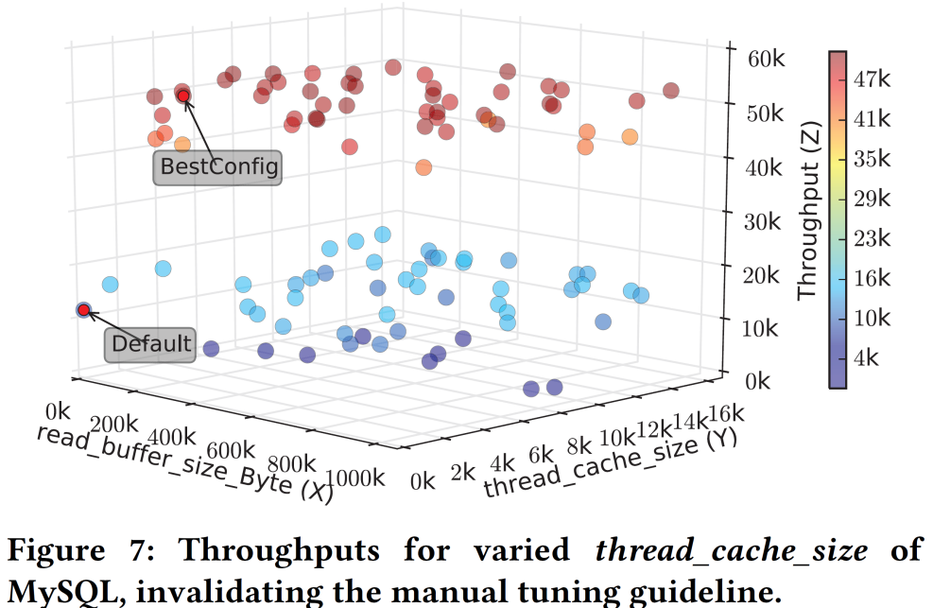
BestConfig: Tuning Results
Invalidating manual tuning guidelines
An example guideline:
Value of thread_cache_size should never be larger than 200.
Set the parameter to the large value of 11987, yet we get a much better performance than following the guideline!

Slide 21
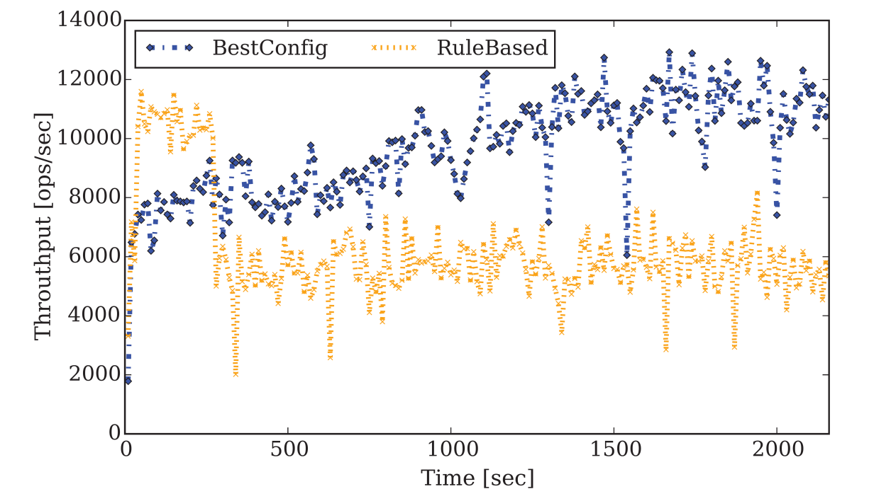
BestConfig: Tuning Results
Stable Advantage of BestConfig Setting
On tuning, BestConfig output a configuration setting with about 29% performance gain than an expert-tuned setting.
In long-tunning stability tests, BestConfig’s setting achieves 9679 ops/sec, while the expert-tuned setting achieves 5933 ops/sec
➔63% performance gain!

Slide 22
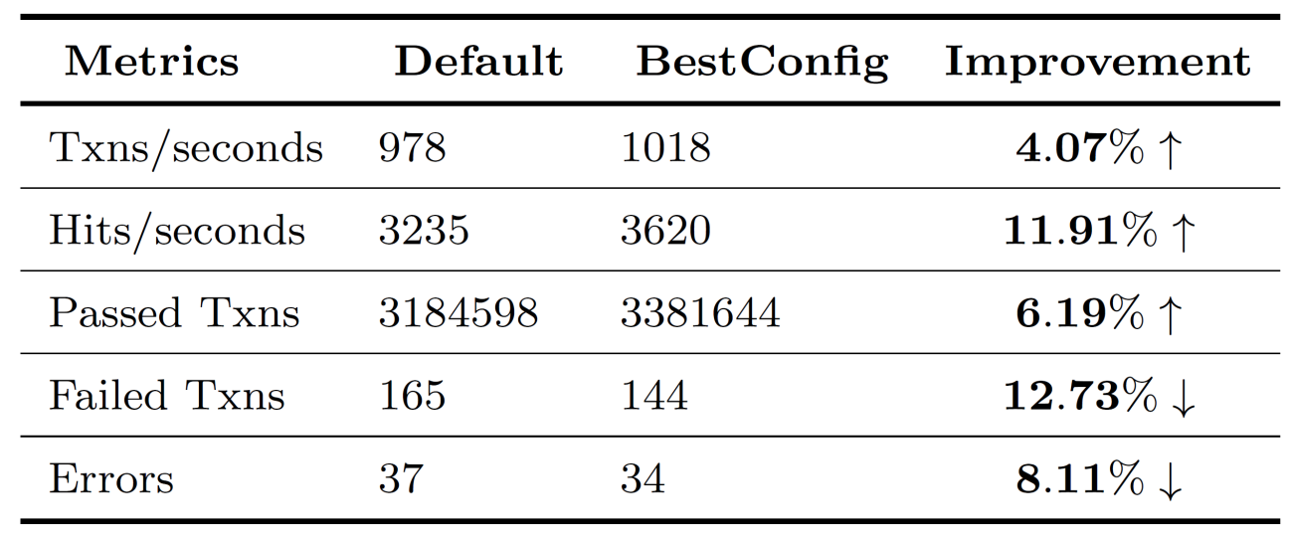
BestConfig: Use Case
Tuning systems on virtual machines
Tomcat on virtual machines in the cloud
Cloud equipped with ARM CPUs
Each virtual machine: fully utilized under a workload
After the tuning by BestConfig……
Eliminating the need for
1 virtual machine from every 26 virtual machines,
given the same workload

Slide 23
Summary
BestConfig automatically finds good configuration settings
For general systems
Within a given number of tests
A highly flexible and extensible architecture
Scalable sampling method: divide and diverge sampling (DDS)
Scalable PO algorithm: recursive bound search (RBS)
BestConfig can bring about the following benefits
Automatically tuning various systems in real deployment
Improving system performance: 11 times performance gain
Improving system utilization: Removing 1 virtual machine from every 26
Saving labor costs: 5 employees half a year ➔ machines in two days
Enabling fairer benchmarking and comparison of systems
Identifying system bottlenecks
https://github.com/zhuyuqing/bestconf

Slide 24
Thank you!
Yuqing Zhu, Jianxun Liu, Mengying Guo, Yungang Bao, Wenlong Ma, Zhuoyue Liu, Kunpeng Song, Yingchun Yang. BestConfig: Tapping the Performance Potential of Systems via Automatic Configuration Tuning.

