Slide 1
Embracing the Terabyte Memory Era with Intel DCPMM In Cloud
董耀祖 (eddie.dong@intel.com)
首席工程师，Intel开源软件技术中心
Notes:
128GB, 192GB, 256GB, 384GB, 512GB….

Slide 2
Computer Architecture Evolvement
Memory
（SRAM, DRAM)
DDR
DDR
Core
L2
CPU
CPU
Cache
(SRAM)
Core
L1
L1
Storage
Storage
Storage
DCPMM
（ Intel® Optane™ DC persistent memory）
HBM
HBM
Core
L2
Core
L2
Core
L1
DDR
Core
L1
DDR
L1
L1
Storage
Storage
Notes:
L1: 3---5 cycles
L2: 10---22 cycles.
DDR: 300 cycles
HBM: DRAM堆叠技术

Slide 3
Memory and Storage Sub-System in Cloud
Today’s Focus
MEMORY
DRAM
Improving memory capacity
Improving SSD performance
Delivering efficient and scalable storage
SSD
STORAGE
Intel® 3D Nand SSD
HDD/TAPE
Notes:
DRAM: 20GB/s
DCPMM: >2X Optane GB/s
Opatne: 2-3GB/s better latency.
DRAM: NAND SSD -- -latency 1000X, BW: 1/10, capacity per $ = 40.
SSD: 2GB/s…
QLC SSD ; better latency
HDD: 200 MB/s

Slide 4
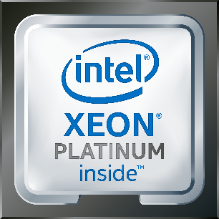
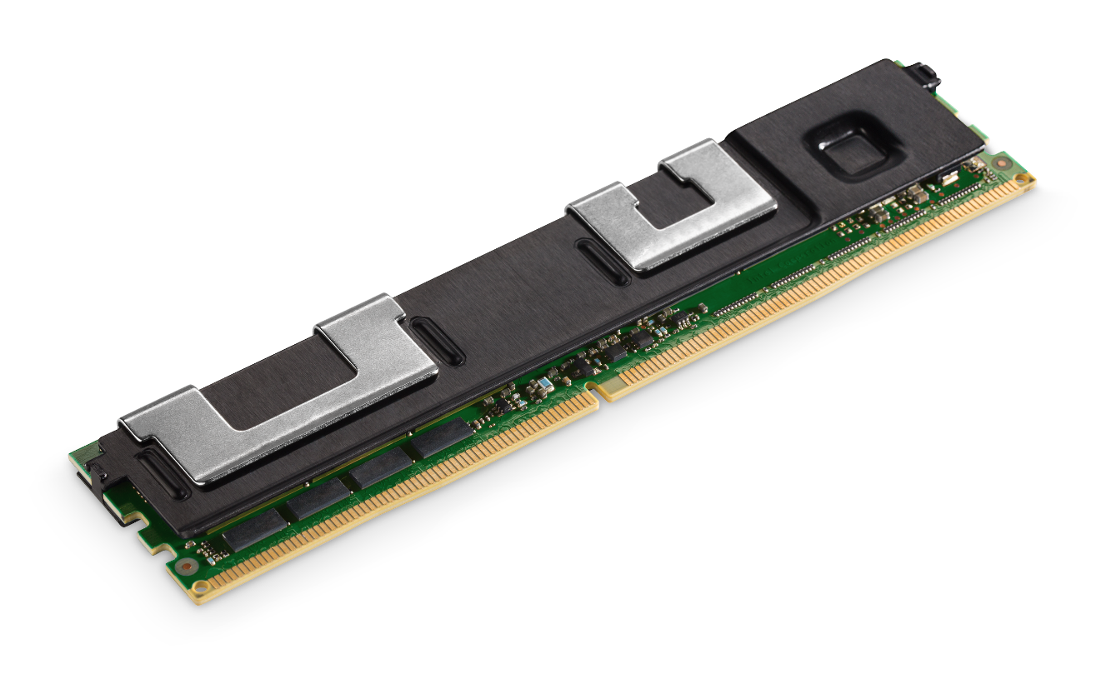
Big and Affordable Memory
128, 256, 512GB
High Performance Storage
DDR4 Pin Compatible
Direct Load/Store Access
Hardware Encryption
Native Persistence
High Reliability
Supported on future Intel® Xeon® Scalable Processors (Cascade Lake)

Slide 5
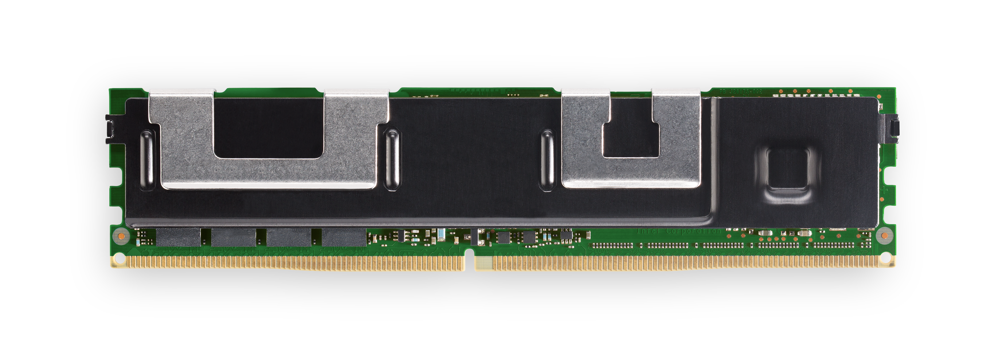
Intel® Optane™ DC Persistent Memory Hardware Interface
DDR4 electrical and physical interface with proprietary protocol extensions
Memory channel can be shared between DDR4 and Intel® Optane™ DC persistent memory modules
Enables systems to support greater than 3TB of system memory per CPU socket
Cache line size accesses
Idle latency close to DDR4 DIMMs
Intel® Xeon® Cascade Lake
IMC
IMC
Intel® Optane™ DC Persistent Memory Module
Performance measurements were obtained prior to implementation of recent software patches and firmware updates intended to address exploits referred to as "Spectre" and "Meltdown." Implementation of these updates may make these results inapplicable to your device or system.
Optimization Notice: Intel's compilers may or may not optimize to the same degree for non-Intel microprocessors for optimizations that are not unique to Intel microprocessors. These optimizations include SSE2, SSE3, and SSSE3 instruction sets and other optimizations. Intel does not guarantee the availability, functionality, or effectiveness of any optimization on microprocessors not manufactured by Intel. Microprocessor-dependent optimizations in this product are intended for use with Intel microprocessors. Certain optimizations not specific to Intel microarchitecture are reserved for Intel microprocessors. Please refer to the applicable product User and Reference Guides for more information regarding the specific instruction sets covered by this notice. Software and workloads used in performance tests may have been optimized for performance only on Intel microprocessors. Performance tests, such as SYSmark and MobileMark, are measured using specific computer systems, components, software, operations and functions. Any change to any of those factors may cause the results to vary. You should consult other information and performance tests to assist you in fully evaluating your contemplated purchases, including the performance of that product when combined with other products. For more complete information visit: http://www.intel.com/performance Source: Intel measured as of May 2018.
Notes:
DCPMM: 356ns
DDR:100ns
Optane: us

Slide 6
Problem With Intel DCPMM
AppDirect (AD) Mode | Storage over AppDirect | ?
Memory | Block Device | Memory
Yes | No | No
Yes | Yes | No
Usage
App Change
Persistency
Customer Looking for app-transparent, high-perf memory solution
IaaS/VM renting
Commercial SW
“Others” owned SW
TTM

Slide 7
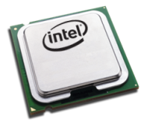
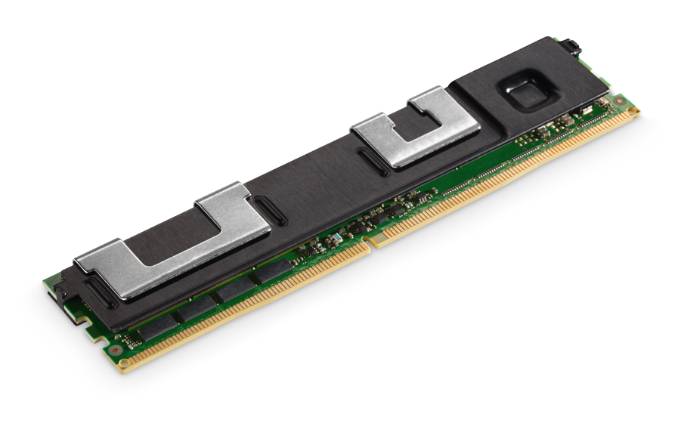
PMEM as DRAM
VM
Usage
Present homogeneous memory to VM
MemoryOptimizer: Map hot pages to DRAM thru EPT
Native Usage
MemoryOptimizer: Map hot pages to DRAM thru OS Page table
VM₁
VM_{n}
App
App
App
App
App
App
MemoryOptimizer
App
App
…
App
End User Software
vCPU
Memory
vCPU
Memory
App
vCPU
vCPU
vCPU
vCPU
End User Software
DRAM/PMEM
DRAM/PMEM
Service Provider Software
Page Table
MemoryOptimizer
Hypervisor
(Linux)
NFIT Driver
Page Table
Linux
NFIT Driver
Page Table
EPT
Xeon
Hardware
Xeon
Xeon
Xeon
CPU
DRAM
PMEM
CPU
DRAM
PMEM

Slide 8
Remap Hot Pages to DRAM
VM Usage
Present PMEM and DRAM as homogeneous memory to guest VM
MemoryOptimizer to migrate hot pages to DRAM
Migrate guest pages to map hot pages to DRAM (cold pages to PMEM) thru EPT
Native Usage
PMEM as normal memory, but in a separate NUMA node
MemoryOptimizer to migrate hot pages to DRAM
Migrate application pages to map hot pages to DRAM (cold pages to PMEM) thru OS page table

Slide 9
MemoryOptimizer Architecture
Host Linux User
VM
MemoryOptimizer
Vanilla
Applications
Policies (Per usage scenario)
Vanilla
Applications
Vanilla
Applications
Future Activity Predicators
User
Kernel
Collectors
Actions
PMU
Page
Migrator
EPT
KVM
Host Page Tables
Hotness Collector
Hotness Collector
Host Linux Kernel

Slide 10
MemoryOptimizer - Adaptive Policy Selection
Memory access pattern and predictors
Access pattern is likely per workload
Focus on typical cloud workload
Need different predictors to handle different scenario
Explore the possibility of AI in predictors
Usage scenario difference
Throughput focus vs. latency focus
Policies
Each predictor couldn’t precisely project the future page hotness
Page mis-migration costs (actually pretty much for 2MB pages)
Explore moderately conservative migration policy
Avoid the cost of page mis-migration
Workload and usage scenario specific

Slide 11
Performance Evaluation
Amazing thing, Coming Soon!!!

Slide 12
Summary
Terabyte memory era is rolling …
App-transparent memory solution, which features
Good SLA control
Cost effective
Intel is actively working on host side solution
Customer can innovate in migration algorithm and policy

Slide 13
Backup – Original version

