Slide 1
Innovating Collaboratively in an Open AI Platform
Fan Yang
Systems Research Group, Microsoft Research Asia

Slide 2
Background and Motivation
Artificial Intelligence (AI) becomes the focus across academia and industries
Major opportunities to democratize AI through platform innovations
  Lower the entry bar for new comers
  Facilitate AI education
  Speed up AI research
  Accelerate the penetration of AI across industries

Slide 3
The Importance of AI Platform
Infrastructure support for the advance of artificial intelligence
  Deep learning algorithms and frameworks run on
  Manage hardware, e.g., GPU cluster
A platform to boost AI innovation and productivity
  Allow researchers/practitioners to focus on AI innovation, instead of the hassles of infra. construction, deployment, management, and optimization
  Enable results sharing, build a community for mutual learning/leveraging, and rapid innovation

Slide 4
Challenges of AI Platform
Need a platform that works in different environments and application domains
  On-premise, cloud, and hybrid environment
  Image/video, speech, language, vertical domain
  High compatibility, extensibility, manageability, efficiency
A fast-moving target
  Substantial advances in 2018 on NLP, AutoML, GAN, and Reinforce Learning
  A platform to accommodate the changing techniques

Slide 5
Build the AI Platform with a Growth Mindset
Embrace changes with a highly modularized design
  Every component is customizable and replaceable
  Can adapt to different environment and for different purpose
Open source: build the stack together with the community
  Whitebox: everyone can try, learn, and contribute
  Reproducible AI: containerized resource with unified resource specification
A platform for Research, Education, and Productization
  Every party on the same page and evolves together
  Speed up the penetration from academia to industry
  Shorten the feedback cycle from industry to academia

Slide 6

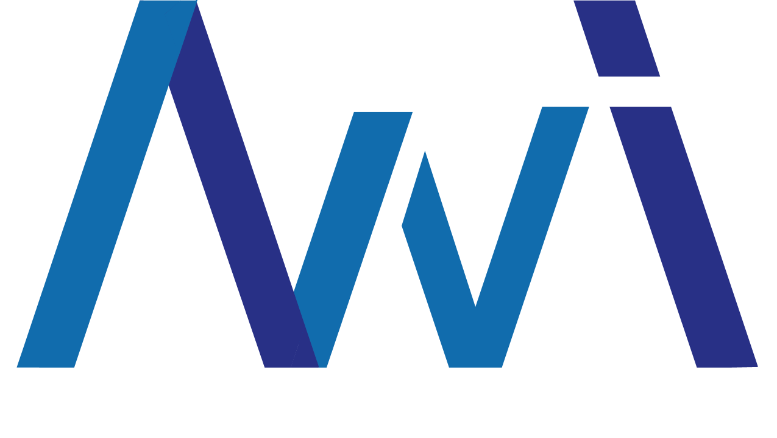


An Open Source Stack for AI Innovation
OpenPAI platform (2017-December)
  Cluster management for AI training and Marketplace for AI asset sharing
NNI – Neural Network Intelligence (2018-September)
  A toolkit for automated machine learning experiments
MMdnn (2017-November)
  A tool to convert, visualize and diagnose deep neural network models
Tools for AI (2017-September)
  A VS Code extension to build, test, and deploy deep learning/AI solutions
Notes:
Compiler infrastructure (TBD)
Compile time and runtime optimization

Slide 7
OpenPAI – Modularized AI Platform
OpenPAI marketplace
  Innovations reproducible and shared
PAI protocol – HW/SW specification
  Data, code, docker image
  # GPU, CPU, Memory, single-machine, distributed
Job Launcher
  Execute the job according to the OpenPAI protocol
  Onboard new AI workload w/o modifications to the platform
https://github.com/Microsoft/pai
Notes:
Can deployment in different environment
Single-box, cloud, on-prem, hybrid

Slide 8
OpenPAI Reference Implementation
Web Portal
PAI Runtime
PAI Runtime
PAI Runtime
Launcher
PAI Runtime
PAI Runtime
PAI Runtime
DL Jobs
Big Data Jobs
AutoML Jobs
DL Jobs
Big Data Jobs
AutoML Jobs
Tools for AI
REST Server
Launcher
YARN+AI
HDFS
PAI Monitor
Customer Managed Kubernetes Cluster
K8s Storage Service
K8s Scheduler
GPU Plug-In
Managed by Hadoop+AI
Kubernetes Cluster Management
Managed by Kubernetes
Docker / Ubuntu
Hadoop + K8s = Best of both worlds
All K8s implementation
https://github.com/Microsoft/pai
https://github.com/Microsoft/frameworkcontroller

Slide 9
Neural Network Intelligence
A toolkit for AutoML experiments and research
  Include popular AutoML algorithms
  Focus on AI research w/o worrying about system issues
Training service as the abstraction to run experiments on the platform (OpenPAI)
Extensible interface to support future innovation
https://github.com/Microsoft/nni
Notes:
AutoML algorithms: TPE, Random, Anneal, Evolution, ENAS, etc.
Gandiva → OpenPAI → NNI
e.g., Reinforce learning

Slide 10
An Open Ecosystem: Engage with China AI Community
Community & Ecosystem
Research | Education | Product
Cognitive Ability
Tools
Shared Resources
AI Platform

Slide 11

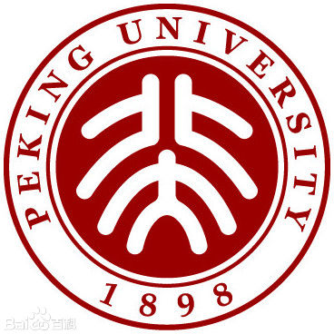
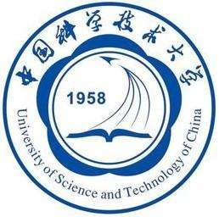

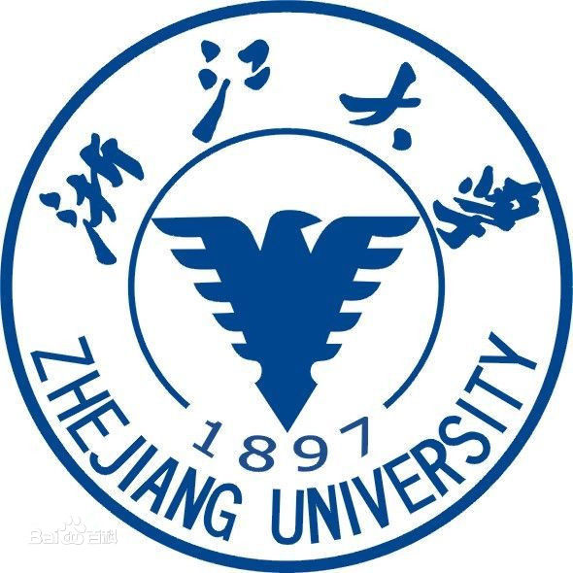
China Open AI Platform Alliance
Notes:
New universities joining: Fudan, U S T of South China, etc.

Slide 12
A Platform to Facilitate AI Research
Enable AI research
  AutoML, etc.
  Efficient training platform
    School of Information Science and Technology of USTC
    MSR, Bing
The platform itself exposes lots of research opportunities
  System primitives for deep learning scheduling (Gandiva, OSDI2018)
  GPU memory management abstraction
  Cross job optimization
  Large scale training
Notes:
OSDI 2018 – first paper of the kind in top system conference
Cross job optimization -- Common subexpression elimination, etc.

Slide 13
An Open Platform for AI Education
Design AI course projects, perform training to grow the AI talent pool
Work with MSRA outreach team to define the agenda
Engage with multiple Universities

Slide 14


An AI Platform to Help Digital Transformation
Microsoft Research Asia Innovation Partnership Forum (MSRA-IPF)
  IPF members
USTC
Community engagement
  Github
Notes:
Leinao: 700+GPU deployment, 2k+ in the future

Slide 15
Conclusion
We advocate an open model to innovate collaboratively
An open source stack to facilitate the R&D and Education on AI and Systems
Early practice inside and outside Microsoft
  Research, education, and production usage
Notes:
Eat our own dog food

Slide 16
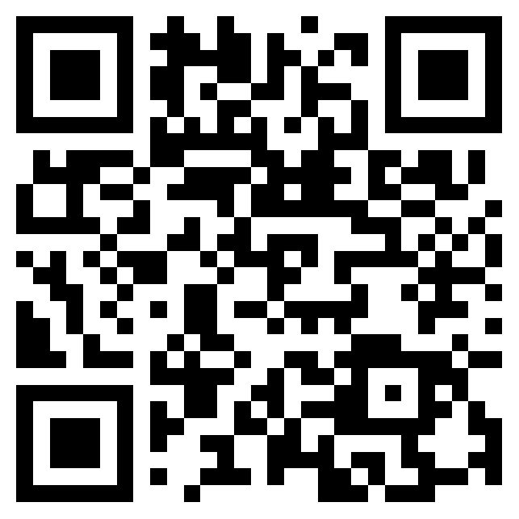
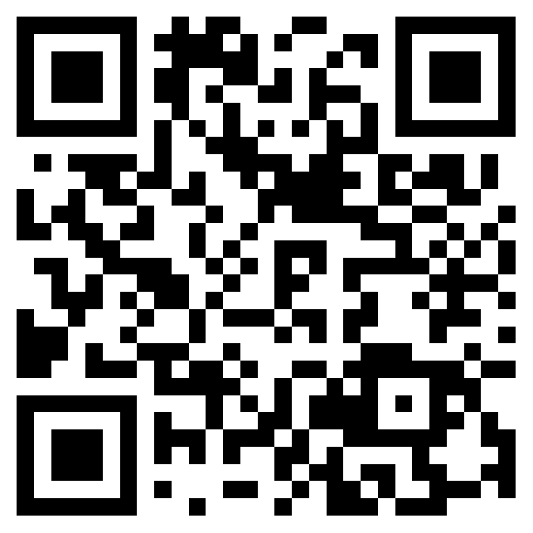
NNI
OpenPAI

Slide 17
Thank you!

