Slide 1
Three-hot Technologies
and Their Usages at Huawei Public Cloud
Liu Jinsong, Huang Zhichao
Huawei

Slide 2
Agenda
Online update scenario @ cloud
Huawei’s 3-hot technologies
  Hot patch
  Hot replacement
  Hot migration (live migration ☺)
3-hot usages @ Huawei Public Cloud

Slide 3
Online update requirements @ cloud
SRE is the core competitiveness for public cloud
  Bugs & security holes
    Hundreds of CVE reports per year
    High risk security holes
      XSA-108
      Intel security hole: spectre, meltdown, and … (it’s just 1 hole but …)
  Components upgrade
    Fast upgrade support newly-add features, say, once per month
    Openstack components: nova, neutron, cider, etc.
    VM related components: libvirt, qemu, ovs, vims, etc.
  Hostos upgrade
    New CPU/Chipset support, i.e, Skylake adds ~40 hardware features
    New kernel support, w/ better performance and newly-add features
  CPU microcode upgrade, hardware broken
    Microcode for Intel security hole
    Memory error: UCNA, SRAO, SRAR
    Other unbelievable hardware broken: i.e., CPU crazy fans ☹

Slide 4
Online update requirements @ cloud
We have to fix/upgrade the SPEED car !!!

Slide 5
Huawei’s 3-hot technologies
 | Advantages | Disadvantages
hot patch | Bugfix and security holes Light-weight operation | Usually for small but critical fix Do not support newly-add functions/features Some bugs/security holes are hard to fix via hot patch Troublesome for SRE to manage and verify patch branches
hot replacement | Component replaced entirely Support newly-add features Medium-weight operation | Not good at kernel fix/update
hot migration (= live migration in Chinese ☺) | Kernel upgrade Not only for upgrade Solve problems what hot patch or hot replacement cannot handle | Cannot migrate vm w/ sr-iov Heavy-weight operation

Slide 6
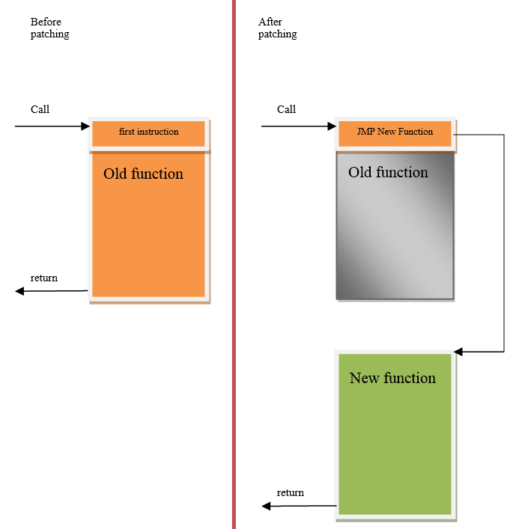
Hot patch
Hot-patch for Xen
  xSplice-like solution (thanks Konrad @ Oracle)
  Trampoline jump at the head of old func
    Wait for all pCPUs to stop and apply together
    clean stack ensure not running at any CPU
      Idle
      Before vmentry
    cpuid serializing
  Enhancement
    Auto build from a patch and auto test
    A framework to hot-patch a POD
      Retry, revert, and reboot handler
    Support hot-patching assembly code
Hot-patch for KVM & Linux
  livepatch combine consistency model of kGraft + kPatch
  https://www.slideshare.net/GlobalLogicUkraine/linux-kernel-live-patching
Hot-patch for usrspace processes
  Huawei’s Dopra, a framework
  Patching qemu, ovs, vims, …

Slide 7
Hot patch use case @ Huawei cloud
Fix CVE-2017-5715 (Intel Spectre) at Xen hypervisor
  xSplice fix C function but cannot fix assembly code
  xpatch/tools/create-diff-object.c
    Define and handle special symbol (w/ prefix ‘_fix_’)
    Find correct assembly address to replace
  Fix vmx_asm_vmexit_handler
--- arch/x86/hvm/vmx/entry.S
+++ arch/x86/hvm/vmx/entry.S
@@ -116,6 +116,81 @@ vmx_asm_vmexit_handler:
+ ALIGN
+ .globl _fix_vmx_asm_vmexit_handler
+ _fix_vmx_asm_vmexit_handler: // special symbol w/ prefix ‘_fix_’
push %rdi
push %rsi
……
push %r15
+ xor %edi,%edi // fix assembly
+ xor %esi,%esi
+ ……
+ xor %r15,%r15
get_current(bx)
……

Slide 8
Advantages and disadvantages of hot patch
Hot patch
  Some fix are hard to be hot-patched
    data structure (shadow variable after kernel 4.15)
    .rodata
    cannot change function api and semantic
    unsafe to fix ftrace handler w/ infinite loop risk
    unsafe to fix NMI handler
    booting stage bugfix
    inline function
    should be very careful about deadlock
    do not support newly-add functions
    ……
  Light-weight operation for cloud SRE
  But troublesome for SRE to manage baseline branches

Slide 9
Hot replacement
Components entirely upgrade
  Fast upgrade support newly-add features, say, once per month
  Reboot-able components: VM runtime-unrelated
    nova, neutron, libvirt, etc.
  Non reboot-able components: VM runtime-related
    compute (qemu), storage (vims), network (ovs), etc.

Slide 10
Hot replacement framework
Host components at backend
VM at frontend
Old component
New component
Qemu
VM
Virtio FE
1
Virtio BE
VM pause
Running
Preload
2
disconnect
Pause
re-connect
VM
States copy if need
3
Virtio FE
Unpause
Lazy_offload
VM unpause
4
Unified replacement framework for OVS (network) and VIMS (storage)
  Preload and lazy-offload, fast switching (less than 100ms)
  State vs. stateless design
  Add component agent connecting qemu (if possible) so that no disconnect and no re-connect
Qemu is another story

Slide 11
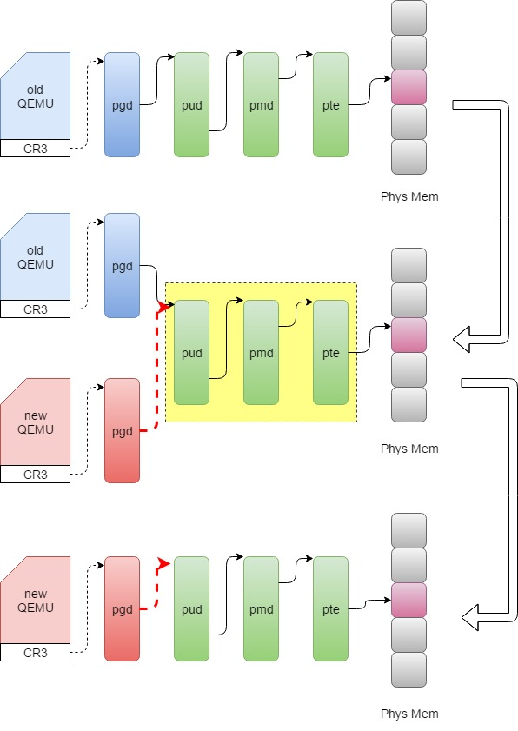
Hot replacement - qemu
Qemu hot replacement
  Way 1: migrate vm locally
    may fail since insufficient memory
    may fail for VM under high dirty page speed
  Way 2: share page
    Zero copy
    Performance issue w/ giant vm, transparent huge pages
  Way 3: share page table, cover qemu VMAs except that of VM
    Zero copy
    keep pid unchange
    Much bigger switch downtime, kill old qemu then covered by new qemu VMAs
    Cannot revert if new qemu fail
  Way 4: share page table, but exec new qemu process
    Zero copy
    Preload new qemu sharing VM PUD with old qemu
    Pause old qemu and unpause new qemu
    Lazy-offload old qemu if new qemu success, or, revert old qemu if new qemu fail
    Different pid but acceptable

Slide 12
Hot migration -- challenges
Live migration @ virtualization
  Xen live migration
    PV is unfriendly to live migration
      Buggy PV disconnect and re-connect
      Ecosystem issue, work around by guest whitelist but >15% guest cannot migrate
    Support migration among different CPUs via emulated tsc but w/ performance issue
  KVM live migration
    Not support migration among different CPUs because of native tsc (until Skylake tsc scaling)
    Log dirty issue w/ giant VMs
  SR-IOV migration
  Giant VM migration under huge memory dirty ratio

Slide 13
Hot migration -- challenges
Live migration @ cloud
  Cloud environment challenges
    Cloud environment is very complicated and unfriendly to live migration
      Different software version and configuration
      Different hardware types: CPU, MSRs
      Even buggy network switch may result in migration error !!
    different storage/network types
  Performance challenges
    Network breaktime, growing w/ VPC scale (10S->10 minutes)
    Communication among cloud components
      Nova, neutron, libvirt, etc.
  Reliability challenges
    Migrating VM may dead or brain-split
    Ensure vm 100% survive when migrate fail
  Large scale parallel migration challenges
    Server congestion, network congestion, etc.
    Gratuitous ARP may not accepted by parallel migrating vms
    Malfunction server isolation
  Blablabla ……

Slide 14
Hot migration design @ Huawei cloud
De-couple
  Event mechanism and publisher-subscriber model
  Support different storage/network types
Reliability
  Shakehands and roll-back when anything wrong (vm will survive)
  How about shakehands broken (say, network issue)?
    image lock: who get the image lock will survive (vm will not brain-split)
Performance
  Fast event channel for performance-critical ops
  Network trampoline when VPC path not ready
Giant vm migration
  Support any giant vm migration under any dirty page ratio
    If only transfer ratio > dirty page ratio

Slide 15
Hot migration result @ Huawei cloud
Very strict testing & verifying before live migration online
  More than 3,000,000 live migration tested
Live migration for OS upgrade at all Huawei cloud sites
  QUIESCENTLY update, 1:1 customer notifications are NOT needed
  Reliability
    99.99% migration success
    100% vm survive when migration fail for whatever reason
  Performance
    CPU downtime: ~25ms
    VPC network breaktime:
      82% breaktime < 50ms
      99% breaktime < 200ms
      100% breaktime < 500ms
  Degree of parallelism
    > 2000 servers
    Technically support much higher parallelism but no enough free servers
  Support all giant vm live migration

Slide 16
Hot migration use case @ Huawei cloud
MCE/Disk error/Filesystem readonly ……
  ~1%% server crash per day, while ~48% hardware issue
Dynamic resource scheduling (DRS)
Fix CVE-2017-5715 (Intel Spectre) at KVM
  Better performance than upstream: 30% -> 10%-
  Retpoline optimization: remove uneccessary retpoline(no vcpus)
  IBPB/IBRS optimization: remove uneccessary IBPB/IBRS (novcpus, A->Idle->A)
  Microcode update, so that guest upgrade by itself

Slide 17
“Quote
Placeholder”

