Slide 1
Rethinking Live Migration
Xiao Guangrong
<xiaoguangrong@tencent.com>

Slide 2
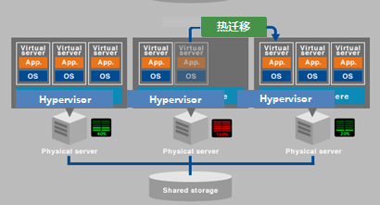
What is Live Migration
The picture comes from http://www.primeton.com/products/iaas/compositions_0.php

Slide 3
Why Live Migration?
Load Balancer
Upgrade
Recovery
etc

Slide 4
Challenges
Network Speed
Status (Mem.) Changes in VM
Performance in VM

Slide 5
Challenges (Contd.)
Dirty logging
Status (Mem.) Changes in VM
Performance in VM
Memory, IO, CPU, etc?
Bitmaps of Dirty pages
vCPU throttling

Slide 6
Challenges (Contd.)
Compression / XBZRLE
Status (Mem.) Changes in VM
Network Speed
Data Reduction is always good?
Skip Unused Pages

Slide 7
Make It Better
Fast Write Protection
Dirty logging
Status (Mem.) Changes in VM
Performance in VM
Bitmaps of Dirty pages
Shared Dirty bitmap sync
vCPU throttling
Smart vCPU throttling

Slide 8
Make It Better (Cont.)
Smart Compression
Compression / XBZRLE
Status (Mem.) Changes in VM
Network Speed
Skip Unused Pages
Skip Frequently changed pages
Adaptive Live Migration

Slide 9
More Detail
Some works have been presented
Fast Write Protection and Shared dirty bitmap
http://events17.linuxfoundation.org/sites/events/files/slides/Guangrong-fast-write-protection.pdf
Compression, XBZRLE, vCPU throttling improvements
https://www.lfasiallc.com/wp-content/uploads/2017/11/Better-Live-Migration-on-KVM_QEMU_Guangrong-Xiao.pdf
Adaptive Live Migration
https://kvmforum2018.sched.com/event/FzuU/adaptive-live-migration-xiao-guangrong-yulei-zhang-tencent-cloud

Slide 10
Q/A?

